Slide 1
Making Others a Priority
June 14

Slide 2


Video Introduction
View Video

Slide 3



We were lost …
When has a situation caused you to be separated from others?
Today we look at someone who people classified as “separate”, a sinner.
  Jesus paid attention to her, did not reject her.
  We are called not to separate people or reject them.
  Instead make it a priority to show God’s love to each person.

Slide 4
Listen for who gave attention to Jesus.
Luke 7:36-39 (NIV) Now one of the Pharisees invited Jesus to have dinner with him, so he went to the Pharisee's house and reclined at the table. 37 When a woman who had lived a sinful life in that town learned that Jesus was eating at the Pharisee's house, she brought an alabaster jar of perfume, 38 and as she stood behind

Slide 5
Listen for who gave attention to Jesus.
him at his feet weeping, she began to wet his feet with her tears. Then she wiped them with her hair, kissed them and poured perfume on them. 39 When the Pharisee who had invited him saw this, he said to himself, "If this man were a prophet, he would know who is touching him and what kind of woman she is--that she is a sinner."

Slide 6
Who Came to Dinner?
Why is it a bit ironic that Jesus was invited to dinner by a Pharisee?
What was the sequence of events as the woman came to the dinner?

Slide 7
Who Came to Dinner?
Although the woman’s actions seem strange to our culture, which of these actions do you find most compelling?
  The tears?
  The kissing of the feet? Why?
  The perfume?

Slide 8
Who Came to Dinner?
She risked misunderstanding, and maybe even being thrown out of the dinner. Why do you think she took these risks?
What thoughts did the Pharisee host have about the woman and about Jesus?
When have you ever felt like Simon or the other guests when confronted with a person of questionable morals?

Slide 9
Who Came to Dinner?
How can believers guard against judgmental attitudes toward others?
How can we maintain a heart that is open to all people?

Slide 10
Listen for a contrast between two men.
Luke 7:40-43 (NIV) Jesus answered him, "Simon, I have something to tell you." "Tell me, teacher," he said. 41 "Two men owed money to a certain moneylender. One owed him five hundred denarii, and the other fifty. 42 Neither

Slide 11
Listen for a contrast between two men.
of them had the money to pay him back, so he canceled the debts of both. Now which of them will love him more?" 43 Simon replied, "I suppose the one who had the bigger debt canceled." "You have judged correctly," Jesus said.

Slide 12
When You Cannot Pay
Compare/contrast the two people in Jesus story.
First Man | Second Man

Slide 13
When You Cannot Pay
Jesus asked, “which one would be the most grateful, love the most?” What makes you wonder about Simon’s answer?
Now which of them will love him more?"
Simon replied, "I suppose the one who had the bigger debt canceled." "You have judged correctly," Jesus said.

Slide 14
When You Cannot Pay
Why do you think Simon struggled to appreciate Jesus the way the woman did?
So Simon was contrasting himself to the woman. What danger is there in contrasting ourselves to others spiritually?
In what ways do people minimize their own sin and highlight the sins of others?

Slide 15
Listen for another contrast.
Luke 7:44-48 (NIV)Then he turned toward the woman and said to Simon, "Do you see this woman? I came into your house. You did not give me any water for my feet, but she wet my feet with her tears and wiped them with her hair. 45 You did not give me a kiss, but this woman, from the time

Slide 16
Listen for another contrast.
I entered, has not stopped kissing my feet. 46 You did not put oil on my head, but she has poured perfume on my feet. 47 Therefore, I tell you, her many sins have been forgiven--for she loved much. But he who has been forgiven little loves little." 48 Then Jesus said to her, "Your sins are forgiven."

Slide 17
Who Loved the Most?
Now list how Jesus contrasted the woman and Simon, the host.
Simon the Pharisee | Woman

Slide 18
Who Loved the Most?
Now … what was the purpose of Jesus story?
Consider how we are like Simon in this story?
  We think of ourselves as “proper”
  We are religious (he was a Pharisee)
  Might be put off by excessive expressions of love for Jesus
  We “invite” Jesus to our gatherings, maybe only as a formality

Slide 19
Who Loved the Most?
How might understanding how much God has forgiven us shape the way we view others?
How could we express more love to Jesus or express it more intensely?

Slide 20
Application
Assess.
  Identify those you tend to avoid because of their spiritual lostness.
  Pray for God to show you how you can relate to them with grace and patience.

Slide 21
Application
Confess.
  Under the Holy Spirit’s guidance, pinpoint any attitudes toward others that might lead you to avoid them.
  Look for attitudes like disapproval or legalism. Confess them to God in prayer.
  Ask Him to replace these attitudes with patience, grace, and forgiveness.

Slide 22
Application
Express.
  Invite an unbeliever to join you for a meal.
  Build the relationship by showing genuine interest, and share your faith when appropriate.

Slide 23
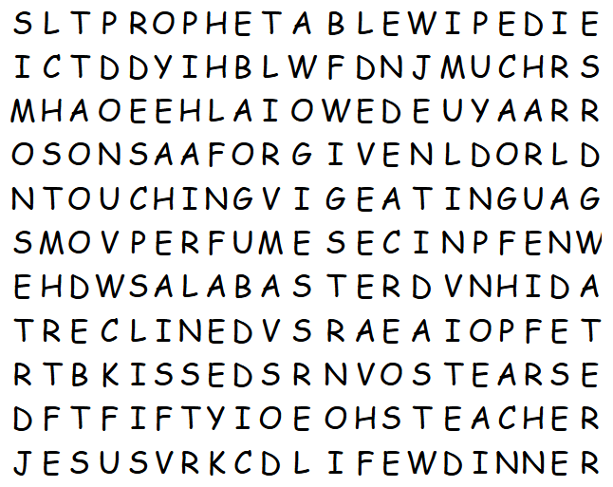
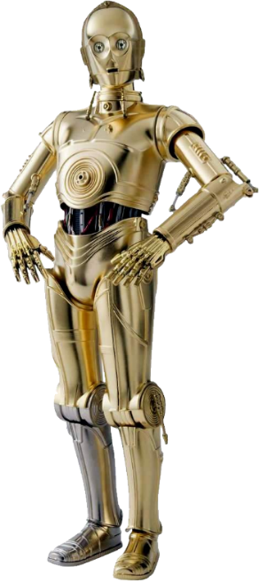
Family Activities
“It appears Her Highness, Lady Wordsearch, has temporarily abandoned her post in pursuit of higher literary matters at a grand Librarian Conference. Before departing, she insisted that you not neglect your book report assignments.

Slide 24
Making Others a Priority
June 14

