Slide 1
Maintaining Focus on God
February 14

Slide 2
Introduction Video
View Video

Slide 3
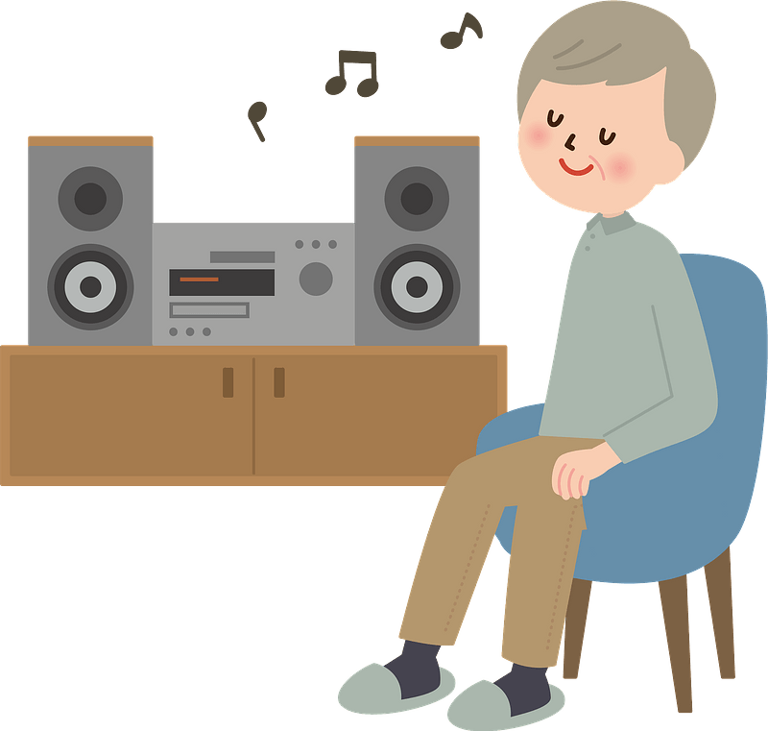
We need your ideas …
How do you tune out distractions when you really need to focus?
In today’s world, we have many distractions.
We need times when we focus on spiritual things.
We can stay rightly focused on Christ by the practices of fasting and confession.

Slide 4
Listen for how Daniel approaches God.
Daniel 9:1-4 (NIV) In the first year of Darius son of Xerxes (a Mede by descent), who was made ruler over the Babylonian kingdom-- 2 in the first year of his reign, I, Daniel, understood from the Scriptures, according to the word of the LORD given to Jeremiah the prophet, that the desolation of Jerusalem

Slide 5
Listen for how Daniel approaches God.
would last seventy years. 3 So I turned to the Lord God and pleaded with him in prayer and petition, in fasting, and in sackcloth and ashes. 4 I prayed to the LORD my God and confessed: "O Lord, the great and awesome God, who keeps his covenant of love with all who love him and obey his commands.

Slide 6
Focus on More than Physical Needs
What events motivated this prayer of Daniel?
How did he approach his time of communicating with God?
Identify the various words and phrases that speak of the character of God.
What is the significance of fasting, sackcloth, and ashes?

Slide 7
Focus on More than Physical Needs
What are some reasons for fasting?
What are some other activities besides eating that we could set aside or fast from in order to spend time with God?

Slide 8
Focus on More than Physical Needs
In addition to prayer, what other spiritual disciplines can you engage in during a time set aside for a fast?
What life events might cause us to seek the Lord through prayer and fasting?

Slide 9
Listen for the need of confession.
Daniel 9:5-7 (NIV) we have sinned and done wrong. We have been wicked and have rebelled; we have turned away from your commands and laws. 6 We have not listened to your servants the prophets, who spoke in your name to our kings, our princes and our fathers, and to all the people of the land.

Slide 10
Listen for the need of confession.
"Lord, you are righteous, but this day we are covered with shame--the men of Judah and people of Jerusalem and all Israel, both near and far, in all the countries where you have scattered us because of our unfaithfulness to you.

Slide 11
Focus on God’s Forgiveness
What words did Daniel use to describe the state of the people before God?
How did Daniel contrast the Lord and the people?
How does our sin become magnified in the presence of a righteous, holy (unique, distinctly different) God?

Slide 12
Focus on God’s Forgiveness
What can we learn about genuine confession from Daniel’s prayer?
Why should confession be an important part of our spiritual lives?

Slide 13
Listen for Daniel’s appeal for God to hear his prayer.
Daniel 9:17-19 (NIV) "Now, our God, hear the prayers and petitions of your servant. For your sake, O Lord, look with favor on your desolate sanctuary. 18 Give ear, O God, and hear; open your eyes and see the desolation of the city that bears your Name.

Slide 14
Listen for Daniel’s appeal for God to hear his prayer.
We do not make requests of you because we are righteous, but because of your great mercy. 19 O Lord, listen! O Lord, forgive! O Lord, hear and act! For your sake, O my God, do not delay, because your city and your people bear your Name."

Slide 15
Focus on the God Who Answers
As Daniel closed his prayer, what various appeals did he make to the Lord?
What is NOT seen in the reasons why God should hear Daniel’s prayer
What ARE the reasons why God should hear and answer Daniel’s prayer? For whose sake was he raising this prayer?

Slide 16
Focus on the God Who Answers
On what basis do we often make requests of the Lord?
“Mercy” means that someone does not receive what they do deserve.
It is God's mercy that we are not punished for our sins
We deserve destruction for our sinfulness, but God withholds it

Slide 17
Focus on the God Who Answers
How does this definition of “mercy” help us to pray for ourselves, our families, our nation?
⇨Thus, we have every reason to believe that God wants to hear and answer our prayers.

Slide 18
Application
Confess.
Spend time confessing any sin you have not previously brought to God.
Confession is “agreeing with God” that your actions were sinful.
Don’t make excuses.
Confess—and thank Him for His forgiveness.

Slide 19
Application
Fast from technology.
Choose something that you do daily, such as watching television or connecting on social media.
Commit to a fast from that activity for the next week.
Use that time for uninterrupted prayer and focus on Christ.

Slide 20
Application
Fast from food.
If your health allows, spend next weekend in an extended fast.
Join others who are doing this Bible study in praying for a spiritual awakening in our nation.

Slide 21
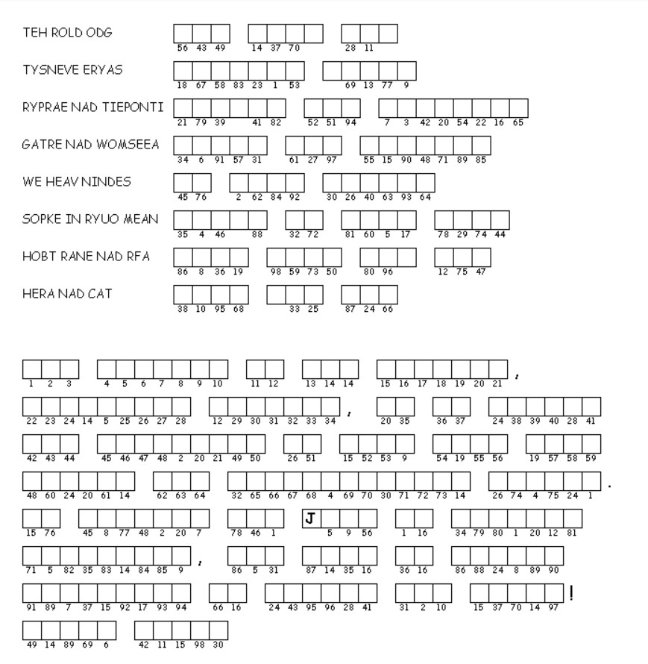
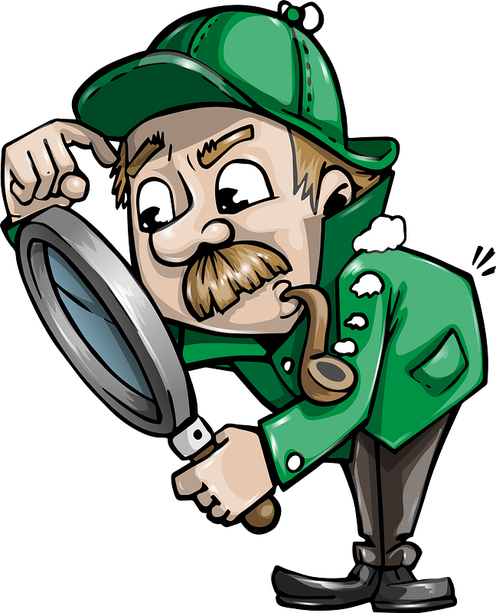
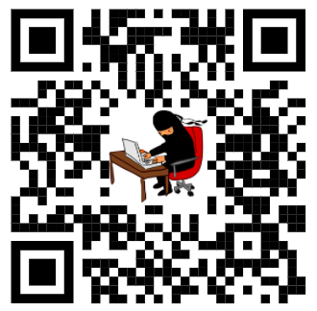
Family Activities
Well, I can see some patterns there, but we need your help. It’s a message that needs decoding. The Word Search Lady thinks it has something to do with “fasting”. We’ll see. If you need help use the QR code (your phone’s camera can do it). There are other intriguing activities there pertaining to our Bible Study.

Slide 22
Maintaining Focus on God
February 14

