Slide 1
Love in Place of Fear
December 18

Slide 2
Video Introduction
View Video

Slide 3
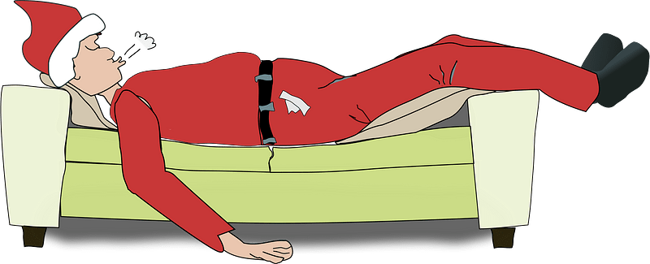
Consider …
What gives you a strong sense of contentment?
When you are contented, you probably don’t want any more.
Knowing God’s love can bring great contentment.
Today we consider how there is no room for fear when we are filled with God’s love.

Slide 4
Listen for a definition or description of love.
1 John 3:13-18 (NIV) Do not be surprised, my brothers, if the world hates you. 14 We know that we have passed from death to life, because we love our brothers. Anyone who does not love remains in death. 15 Anyone who hates his brother is a murderer, and you know that no murderer has eternal life in him. 6 This is how we

Slide 5
Listen for a definition or description of love.
know what love is: Jesus Christ laid down his life for us. And we ought to lay down our lives for our brothers. 17 If anyone has material possessions and sees his brother in need but has no pity on him, how can the love of God be in him? 18 Dear children, let us not love with words or tongue but with actions and in truth.

Slide 6
Experience the Love of Jesus
According to this passage, we know what love is.
Example of Jesus Christ
Laid down His life for us
Died in our place
Took the punishment (death) we deserved for our sinful lives
Gave of himself totally

Slide 7
Experience the Love of Jesus
How then should Christians love? If God’s loves dwells with us, what ought we to be willing to do with the resources we have at our disposal?
Why is it easier to love with words rather than actions?
What are some not-so-apparent needs of different age groups in our church, in our community?

Slide 8
Experience the Love of Jesus
Why do we sometimes fail to help these groups meet their needs, even if we are aware?
Consider steps we can take to overcome the feeling of being overwhelmed by the number of needs to be met.
Pray regularly for families around you (in church, in neighborhood, at work)
Ask God to minister to them
Ask God what role He would have you play in ministering to them

Slide 9
Listen for why Jesus came to earth.
1 John 4:14-16 (NIV) And we have seen and testify that the Father has sent his Son to be the Savior of the world. 15 If anyone acknowledges that Jesus is the Son of God, God lives in him and he in God. 16 And so we know and rely on the love God has for us. God is love. Whoever lives in love lives in God, and God in him.

Slide 10
God’s Love in Us
What qualified John and others to be witnesses?
Note the substance of their testimony.
Jesus was/is the Messiah
He is God’s Son
He is 100% God … and He is 100% man
He came to be the Savior of the world

Slide 11
God’s Love in Us
What is implied by the phrase “acknowledges that Jesus is the Son of God”? How is it more than mental acceptance of that fact?

Slide 12
Listen for loss of fear.
1 John 4:17-18 (NIV) In this way, love is made complete among us so that we will have confidence on the day of judgment, because in this world we are like him. 18 There is no fear in love. But perfect love drives out fear, because fear has to do with punishment. The one who fears is not made perfect in love.

Slide 13
God’s Love Dispels Our Fear
Note the word, “herein” from the KJV at the beginning of verse 17. The NIV says “in this way”
It is a transitional word or phrase.
Similar to “therefore” (see what it is there for)
Refers to the previous verses,
Here it answers the question of how “love is made complete”

Slide 14
God’s Love Dispels Our Fear
What is the result of our being in God’s love, abiding in God, and knowing He dwells with us have on the character of our love?
What kind of fear or fears does this passage talk about?
Negatively speaking, what does a person who fears lack in his/her life?

Slide 15
God’s Love Dispels Our Fear
How does hate stimulate fear? What are some examples?
How does knowledge and being fully convinced of God’s love for you drive out these fears?

Slide 16
God’s Love Dispels Our Fear
We can choose actions that will convince ourselves (and others) how much God does love us, and have fears be driven away.
Fill our minds with what God says – read and apply God’s Truth
Avoid filling our minds with worldly messages (entertainment, news, etc.)
Heed what God says, not news of current events
Memorize scripture – God will bring it to our consciousness when confronted with things we fear

Slide 17
Application
Write.
Make a list of all the ways you know you are loved by Christ.
Turn that list into a prayer, thanking God for His incredible love.

Slide 18
Application
Serve.
Look for a tangible way to show love to somebody in your life.
Identify a need or way you can help that individual.
This could be anything from providing a meal to leaving a note of encouragement.

Slide 19
Application
Love.
Identify someone you find hard to love.
Do something intentionally that reflects how Christ has loved you.
It is genuinely Christlike to love an enemy or someone who is annoying or gets on your nerves.
Afterwards, write down what you learned and what it revealed to you about Christ

Slide 20
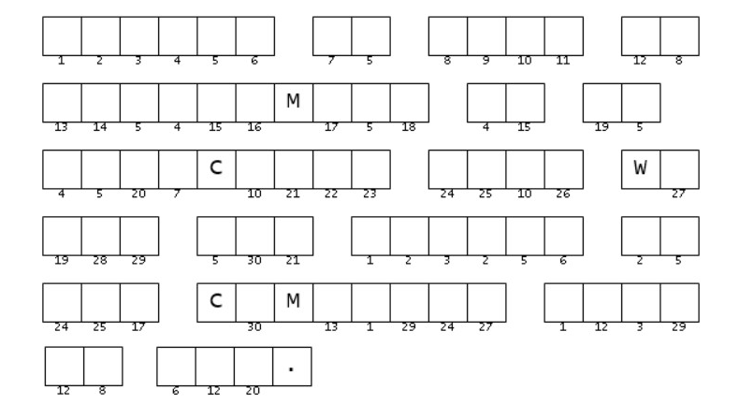
Family Activities
The Word Ninja needs your help. The clue words need to be unscrambled. Make sure they are found in your scripture passages for today. Once you get those words right, you can fill in these squares with the right letter. Help and other Family Activities can be found at https://tinyurl.com/bdzy65jd

Slide 21
Love in Place of Fear
December 18

