Slide 1
Love Your Enemies
May 5

Slide 2
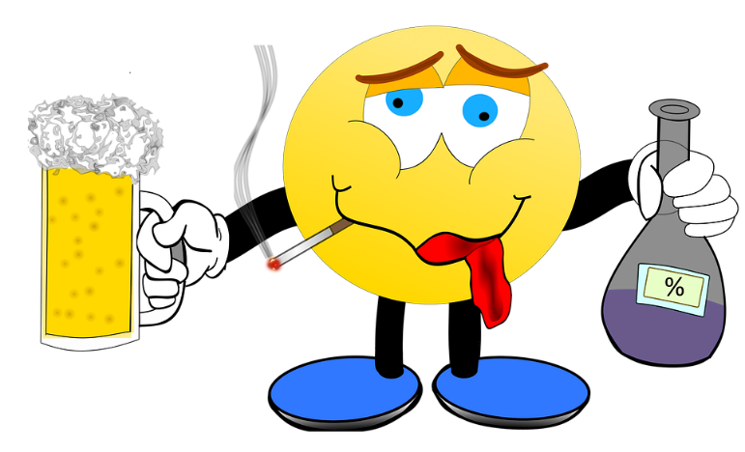
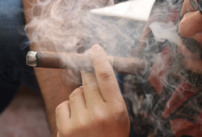
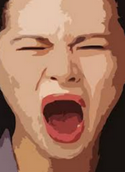
Remember that time …
What’s an experience you’ve had at a sports event with an obnoxious fan?
The natural human response to being treated wrongly could be an angry verbal response or even a physical confrontation.
  This might be what the world expects.
  But Jesus calls us to love our enemies, even as Christ has loved us.

Slide 3
Listen for radical teaching.
Luke 6:27-28 (NIV) "But I tell you who hear me: Love your enemies, do good to those who hate you, 28 bless those who curse you, pray for those who mistreat you.

Slide 4
Loving Attitudes and Actions
What different kinds of mistreatment did Jesus refer to in His commands? What actions does He say we are to take in each case?
How do you know when someone has crossed the line and become your enemy?
Mistreatment | Response

Slide 5
Loving Attitudes and Actions
What’s your natural reaction to Jesus’ commands in these verses? How do you think most people in our culture would react to Jesus’ teaching in these verses?
What does it mean to "bless those who curse you"?
What practical steps can we take to put these into action? How is it possible to do what Jesus expects?

Slide 6
Listen for specific examples of how to treat enemies.
Luke 6:29-31 (NIV) If someone strikes you on one cheek, turn to him the other also. If someone takes your cloak, do not stop him from taking your tunic. 30 Give to everyone who asks you, and if anyone takes what belongs to you, do not demand it back. 31 Do to others as you would have them do to you.

Slide 7
Loving Others Requires Our Action
Identify the four situations Jesus described to show how His call to love one’s enemies could be applied?
How does what He called for differ from the response of our society toward those who act against them? What would be a typical response?

Slide 8
Loving Others Requires Our Action
What is the great behavioral principle Jesus gave to His followers?
What keeps you from treating others the way you prefer to be treated?
Why/how are believers equipped to carry out this principle?

Slide 9
Listen for why we should love our enemies.
Luke 6:32-36 (NIV) "If you love those who love you, what credit is that to you? Even 'sinners' love those who love them. 33 And if you do good to those who are good to you, what credit is that to you? Even 'sinners' do that. 34 And if you lend to those from whom you expect repayment, what credit is that to you? Even 'sinners' lend to 'sinners,'

Slide 10
Listen for why we should love our enemies.
expecting to be repaid in full. 35 But love your enemies, do good to them, and lend to them without expecting to get anything back. Then your reward will be great, and you will be sons of the Most High, because he is kind to the ungrateful and wicked. 36 Be merciful, just as your Father is merciful.

Slide 11
Christ’s Love Flows through Us.
What are some tangible ways we can do good to those who treat us poorly?
What is realistic or unrealistic about the kind of love Jesus wants us to show?
Realistic | Unrealistic

Slide 12
Christ’s Love Flows through Us.
When is forgiveness most difficult to give?
What was Jesus’ basic argument in motivating His command to love others unconditionally?
What do believers prove when they love like God loves?
What does it take for a person to live the way described in these verses?

Slide 13
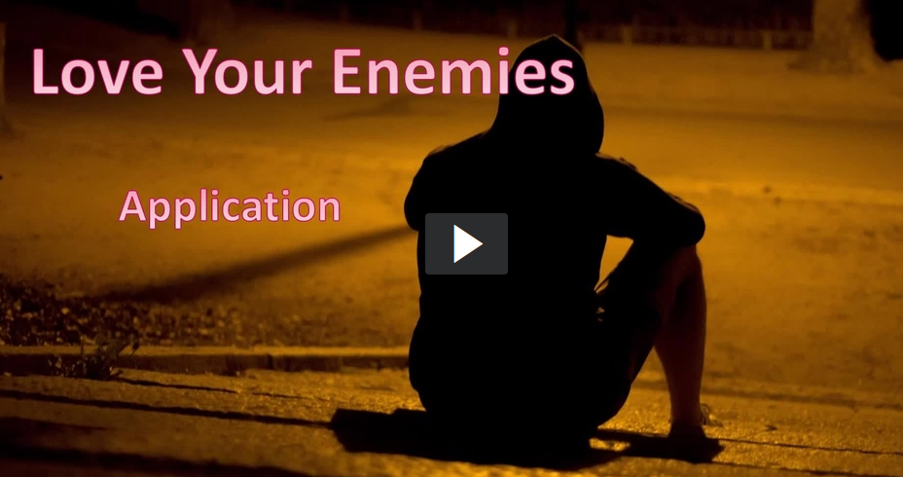
View Video

Slide 14
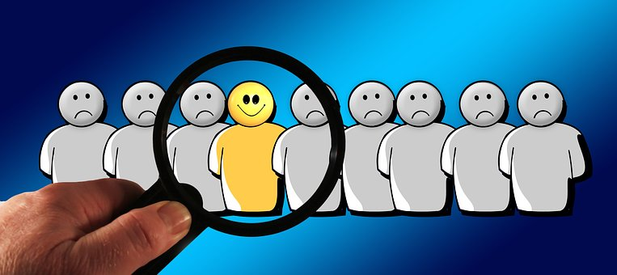
Application
Bless.
  If you’re continually around a person who is hard to love, be intentional in blessing them with a smile, a greeting, or some simple gesture of kindness.

Slide 15
Application
Identify.
  Write down the names of those who have wronged you or could be considered your enemy. Convert that list of names into a prayer list.
  Pray for their needs and pray for God to move your heart to love and serve them.
  Ask God to help you see them as people He loves, people who were created in the image of God.

Slide 16
Application
Serve.
  Invest your time and energy in assisting an “enemy” with something practical where they could use your help.
  Use the opportunity to point to Christ.

Slide 17
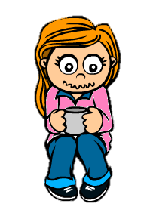


Family Activities
OK … you’ve had your coffee. Get off your chair … there’s a Crossword to do. And there’s even more Family Activities at https://tinyurl.com/yyy8sb7p

Slide 18
Love Your Enemies
May 5

