Slide 1
Lost
March 8

Slide 2

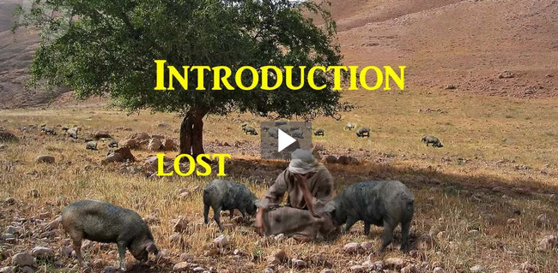
Introduction Video
View the Video

Slide 3



Go on … admit it …
What was your most memorable experience being lost?
We can lose our way, lose our keys, lose a billfold, lose a job …
  The ultimate loss is to be lost spiritually
  Without Christ, we are hopelessly lost.

Slide 4
Listen for poor choices.
Luke 15:11-14 (NIV) Jesus continued: "There was a man who had two sons. 12 The younger one said to his father, 'Father, give me my share of the estate.' So he divided his property between them. 13 "Not long after that, the younger

Slide 5
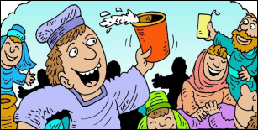
Listen for poor choices.
son got together all he had, set off for a distant country and there squandered his wealth in wild living. After he had spent everything, there was a severe famine in that whole country, and he began to be in need.

Slide 6
Lost – Living Apart from God
What are some of the implications behind the younger son’s request for his inheritance?
Was the father wise or foolish to give in to the son’s request/demand?
Wise | Foolish

Slide 7
Lost – Living Apart from God
In what ways did the younger son’s freedom soon become his bondage?
How are we tempted to squander what we’ve been given?
When/why have we been like the younger son, enticed by the things of the world?

Slide 8
Listen for the son’s response to his crisis.
Luke 15:17-19 (NIV) "When he came to his senses, he said, 'How many of my father's hired men have food to spare, and here I am starving to death! 18 I will set out and go back to my father and say to him: Father, I have sinned against heaven and against you. 19 I am no longer worthy to be called your son; make me like one of your hired men.'

Slide 9
Acknowledge Being Lost – Turn to God
What did the son eventually admit about his situation?
What did he decide to do about it?
What kinds of things leads people to come to their senses spiritually?

Slide 10
Acknowledge Being Lost – Turn to God
How is being spiritually lost (without Christ) a desperate, hopeless condition?
When did you first recognize your need for God’s forgiveness for your sin?

Slide 11
Listen for the father’s response to the son’s return.
Luke 15:20-24 (NIV) So he got up and went to his father. "But while he was still a long way off, his father saw him and was filled with compassion for him; he ran to his son, threw his arms around him and kissed him. 21 "The son said to him, 'Father, I have sinned against heaven and against you. I am no longer worthy to be called your son.'

Slide 12
Listen for the father’s response to the son’s return.
"But the father said to his servants, 'Quick! Bring the best robe and put it on him. Put a ring on his finger and sandals on his feet. 23 Bring the fattened calf and kill it. Let's have a feast and celebrate. 24 For this son of mine was dead and is alive again; he was lost and is found.' So they began to celebrate.

Slide 13
Restoration – Return to the Father
What suggests the sincerity of the son’s decision that he made in the pig pen?
How well do you think the son knew his father?
How did the father show his love for his wayward son?
How do the words “dead and alive again”, and “lost and found” describe the young man’s situation?

Slide 14
Restoration – Return to the Father
How can these words be applied spiritually? What does it look like for us to return to God?
How does this story help us understand the heart of God? What does this parable reveal to you about the Lord’s love?
In what ways does God restore people’s lives through His love and forgiveness today?

Slide 15
Application
Seek God.
  Perhaps you need to “come home” to God.
  Confess to God any destructive behaviors or thoughts and come to Christ.

Slide 16
Application
Forgive.
  When was the last time you ran to forgive someone with reckless abandon?
  Maybe it’s time to forgive even if it seems strange and shocking to everyone else around.
  Remember to forgive others as God forgives.

Slide 17
Application
Reach out.
  Reach out to someone who is lost and at rock bottom.
  Point them to the loving, restoring arms of God.
  Let them see the love of the Father in you

Slide 18


Family Activities
Don’t let your family fall apart like ours did. Do things together, like the Double Puzzle or the Color Page.
Find it all at
https://tinyurl.com/yxx22mor

Slide 19
Lost
March 8

