Slide 1
Looking Forward with Hope
December 1

Slide 2

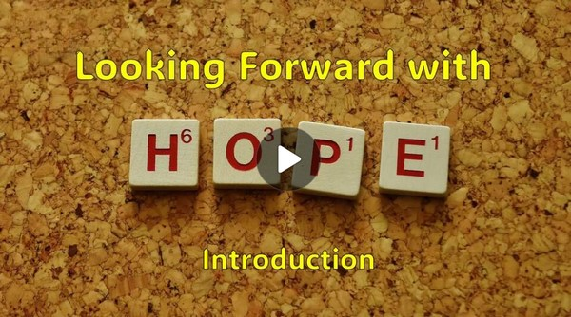
Video Introduction
View Video

Slide 3



Remember?
What was one gift you hoped for the most as a child?
Sometimes our hopes were childish, even futile.
  But Christmas celebrates the fulfillment of a significant spiritual hope.
  We have a sure hope because Jesus came to us.

Slide 4
Listen for assurance given.
Isaiah 40:1-2 (NIV) Comfort, comfort my people, says your God. 2 Speak tenderly to Jerusalem, and proclaim to her that her hard service has been completed, that her sin has been paid for, that she has received from the LORD's hand double for all her sins.

Slide 5
Comfort from Forgiveness
Note what the prophet is called to do in relationship to the people who were in despair and distress?
  Comfort the people (repeated)
  Speak tenderly to them

Slide 6
Comfort from Forgiveness
Let’s list the three elements of the message.
Comfort is emphasized here (the command is repeated). What kind of comfort does God offer?

Slide 7
Comfort from Forgiveness
Consider how Jesus made the comfort of forgiveness and hope possible.
  Came as both fully human and fully God
  Lived a perfect life with no sin
  Did not deserve to die for any sin in His life
  Died in our place, took the punishment for our sin
  We receive the comfort and assurance of forgiveness

Slide 8
Comfort from Forgiveness
What brings comfort to you when you’re going through a tough time?
How has your relationship with Jesus brought comfort to you?
You have just received tragic news. What do you need to do to know and experience God’s comfort for your family in this situation?

Slide 9
Listen for a phrase quoted in the New Testament.
Isaiah 40:3-5 (NIV) A voice of one calling: "In the desert prepare the way for the LORD; make straight in the wilderness a highway for our God. 4 Every valley shall be raised up, every mountain and hill made low; the rough

Slide 10
Listen for a phrase quoted in the New Testament.
ground shall become level, the rugged places a plain. 5 And the glory of the LORD will be revealed, and all mankind together will see it. For the mouth of the LORD has spoken."

Slide 11
Hope of God’s Glory
The “voice” could be …
  A prophet (Isaiah?)
  John the Baptist (Matt. 3:3)
  A modern-day evangelist
  One of us sharing the Gospel.
A voice of one calling …

Slide 12



Hope of God’s Glory
How does the roadbuilding imagery of verse 4 speak to us in spiritual terms?
What are some mountains or hills God has leveled in your life?

Slide 13
Hope of God’s Glory
What are some specific obstacles or "rough places" that need to be smoothed out in our lives?
Where do you see God's glory reflected in our world today?

Slide 14
Listen for good news.
Isaiah 40:9-11 (NIV) You who bring good tidings to Zion, go up on a high mountain. You who bring good tidings to Jerusalem, lift up your voice with a shout, lift it up, do not be afraid; say to the towns of Judah, "Here is your God!" 10 See, the Sovereign LORD comes

Slide 15
Listen for good news.
with power, and his arm rules for him. See, his reward is with him, and his recompense accompanies him. 11 He tends his flock like a shepherd: He gathers the lambs in his arms and carries them close to his heart; he gently leads those that have young.

Slide 16

Good News and Divine Care
Who are commissioned to declare the good news of the Lord’s coming to set people free?
Note the phrases that describe how the message is to be communicated.
  Lift up your voice with a shout
  Don’t be afraid
  Look and see God at work

Slide 17
Good News and Divine Care
What words and phrases describe the strong power and authority of the Lord to act?
Verse 10 describes God as coming with power and might. How does knowing that God is mighty affect your trust in Him?
When have you experienced the characteristics of God described in these verses?

Slide 18
Application
Pray.
  Our hope in Christ must be cultivated.
  Ask God to reawaken the hopes that have been dormant recently.
  Enter a life of holy expectation as you journey through this sacred season.

Slide 19
Application
Write.
  Is there someone in your life who is struggling to remain hopeful because of circumstance, disappointment, or fear?
  Send them an encouraging note to let them know you are praying for them.
  Underscore that hope is never lost in Christ.

Slide 20
Application
Serve.
  Our hope is activated through service.
  This week, express your hope by serving someone in need.
  It may be as simple as helping someone decorate for the Christmas season.
  Or reaching out to a stranger to offer radical generosity and help.

Slide 21
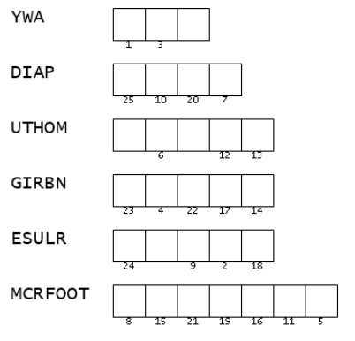

Family Activities
What is a “DIAP”??
I think you’re going to have to look at the Bible passage to find a word with those letters. Then you can use the numbers to find out the secret message. Technical help is available at https://tinyurl.com/277t4ckv And for you folks back in the corner, you can find your favorite, the crossword.

Slide 22
Looking Forward with Hope
December 1

