Slide 1
Looking Forward with Expectation
January 5

Slide 2
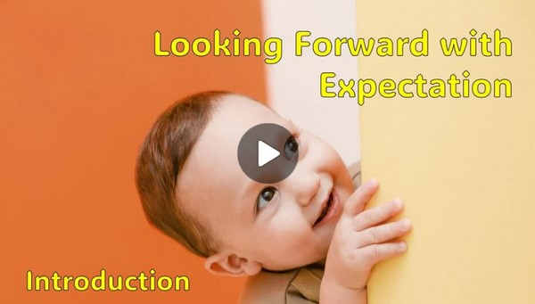
Video Introduction
View Video

Slide 3
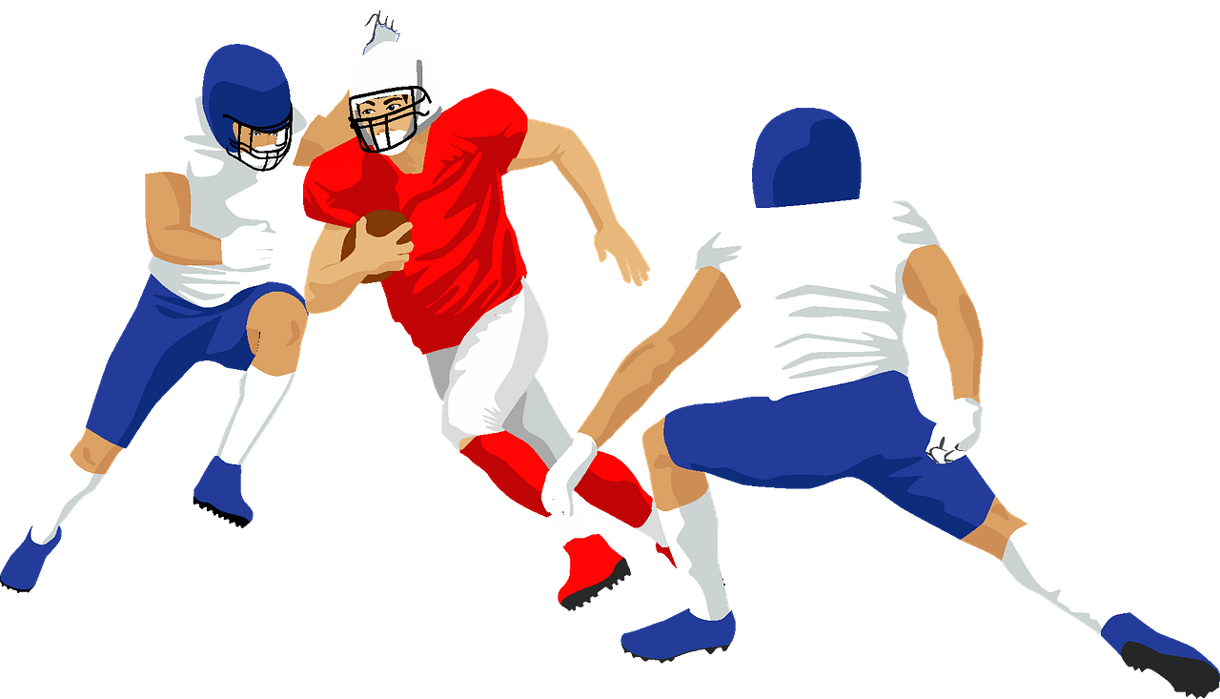
Admit it, now …
What activity or event are you looking forward to in the next few weeks?
We all have events in life that we anticipate with both expectation and maybe trepidation.
One milestone event that faces every person in the world is the Second Coming of Jesus.
Today we study the reality that Jesus will return to establish His eternal kingdom.

Slide 4
Listen for what stays and what disappears.
Matthew 24:32-35 (NIV) "Now learn this lesson from the fig tree: As soon as its twigs get tender and its leaves come out, you know that summer is near. 33 Even so, when you see all these things, you know

Slide 5
Listen for what stays and what disappears.
that it is near, right at the door. 34 I tell you the truth, this generation will certainly not pass away until all these things have happened. 35 Heaven and earth will pass away, but my words will never pass away.

Slide 6
His Return is Near
Consider changes in nature of which we take note:
Fall colors
Blooming flowers in spring
Snow which hinders travel
Viewing migration of birds

Slide 7
His Return is Near
What lesson did Jesus teach through the parable of a fig tree budding?
The word “near” can mean physical distance or soon in time … which do you think Jesus is meaning here? Why?
So, what is the “it” that is near, right at the door in verse 33?

Slide 8
His Return is Near
To what do “these things” refer?
Even so, when you see all these things, you know that it is near, right at the door.

Slide 9
His Return is Near
The Lord accentuated this point using a common image— “at the door”.
“I stand at the door and knock…”
When you hear a knock on the door, you understand someone is right outside.
This phrase emphasizes closeness of coming event: the return of Christ

Slide 10
His Return is Near
Jesus said, “this generation will not pass away until all these things have happened”. The generation represented by the disciples is long gone. So, what was Jesus talking about?

Slide 11
His Return is Near
Jesus contrasts demise of the temple with permanence of His words.
Jesus’ words are eternally true, trustworthy, authoritative
Disciples of Jesus are to …
Submit to authority of His word
Live in conformity to His message
Faithfully teach it to others

Slide 12
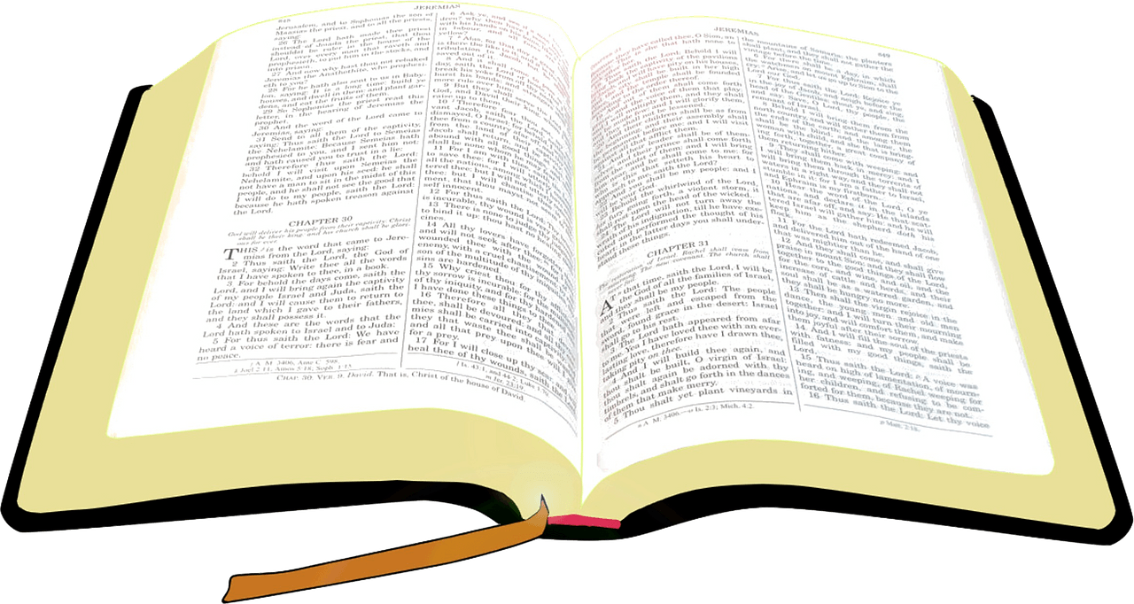
His Return is Near
When has God’s Word proven true in your life?

Slide 13
Listen for a comparison to Noah.
Matthew 24:36-39 (NIV) "No one knows about that day or hour, not even the angels in heaven, nor the Son, but only the Father. 37 As it was in the days of Noah, so it will be at the coming of the Son of Man. 38 For in the days before the flood, people

Slide 14
Listen for a comparison to Noah.
were eating and drinking, marrying and giving in marriage, up to the day Noah entered the ark; 39 and they knew nothing about what would happen until the flood came and took them all away. That is how it will be at the coming of the Son of Man.

Slide 15
His Return Will Be a Surprise
Jesus points out who knows and who does not know God’s timing.
People do not know
Angels do not know
Jesus (as a human) did not know
God the Father does know

Slide 16
His Return Will Be a Surprise
What does this imply about Jesus’ limitations here on earth?
What does the reference to the days of Noah mean?
in the days before the flood, people were eating and drinking, marrying and giving in marriage, up to the day Noah entered the ark; and they knew nothing about what would happen

Slide 17
His Return Will Be a Surprise
Why is that historical event an apt illustration of the coming of the Son of man?
How should the warning in these verses change the way we live?

Slide 18
Listen for why to be ready.
Matthew 24:40-44 (NIV) Two men will be in the field; one will be taken and the other left. 41 Two women will be grinding with a hand mill; one will be taken and the other left. 42 "Therefore keep watch, because you do not know on what day your Lord will come. 43 But understand this: If the

Slide 19
Listen for why to be ready.
owner of the house had known at what time of night the thief was coming, he would have kept watch and would not have let his house be broken into. 44 So you also must be ready, because the Son of Man will come at an hour when you do not expect him.

Slide 20
So, Get Ready
Note the life principles Jesus gives concerning His return.
Keep watch
Be continuously prepared
You don’t know when Jesus will return

Slide 21
So, Get Ready
How does He illustrate that principle?
If the owner of the house had known at what time of night the thief was coming, he would have kept watch and would not have let his house be broken into

Slide 22
So, Get Ready
We use the term “imminent” to describe Jesus return. Some synonyms would be:
Looming,
Pending,
On the horizon,
Just around the corner …

Slide 23
So, Get Ready
Contrast believing in the imminent return of Christ with an attitude of “whenever … who knows?”
“Whenever … Who Knows?” | Imminent

Slide 24
So, Get Ready
How would an alert believer live his or her life differently in anticipation of Christ's imminent return? What is involved in getting ready?

Slide 25
Application
Read.
Set aside time this week to read all of Matthew 24
Make notes about Jesus’s return.

Slide 26
Application
Meditate.
This week, read John 14:1-3 and meditate on these comforting words.
We don’t need to be troubled by Jesus’s absence but be encouraged.
He’s been preparing for our reunion for thousands of years.
He is coming again. It must be an awesome new place for us all.

Slide 27
Application
Share.
Get together with some friends and talk about what you discovered from your readings from Matthew 24 and John 14:1-3.
Spend some time praying together for friends who need salvation

Slide 28
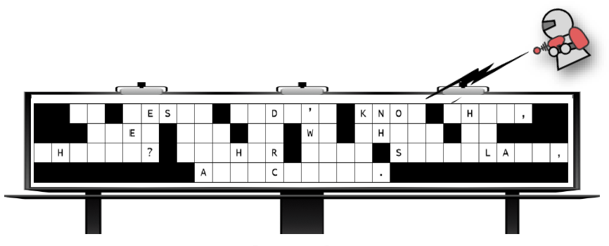
Family Activities
This looks bad ! The UFO team has been called. We need your help cleaning up the mess. Find the letters on the ground and place them in the right places directly above. Tech help are standing by at https://tinyurl.com/kvcxhvsw You can find other Fun Family Activities there also.

Slide 29
Looking Forward with Expectation
January 5

