Slide 1

Faith And/Or Works

Slide 2
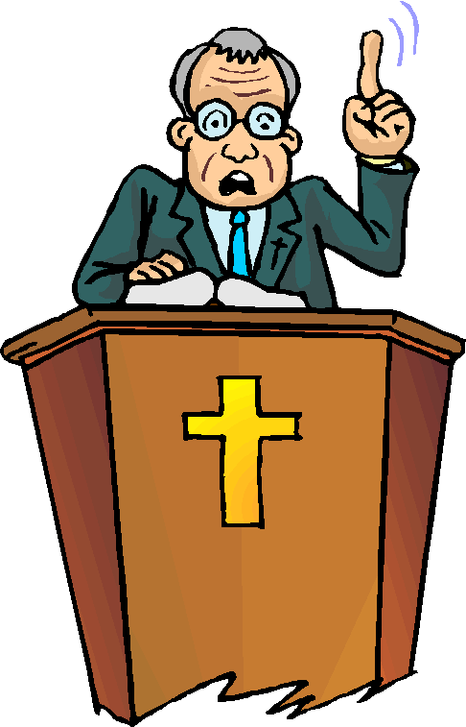
What do you think?
What does it mean to “practice what you preach”?
Today one of our passages is from the Epistle of James
  It looks at what James says about faith and how you live.
  What you believe is seen in what you do.

Slide 3
1. THE SUPREMACY OF THE
NEW COVENANT.

Slide 4
Listen for means of communication.
Hebrews 1:1-3 (NIV) In the past God spoke to our forefathers through the prophets at many times and in various ways, 2 but in these last days he has spoken to us by his Son, whom he appointed heir of all things, and through whom he made

Slide 5

Listen for means of communication.
the universe. 3 The Son is the radiance of God's glory and the exact representation of his being, sustaining all things by his powerful word. After he had provided purification for sins, he sat down at the right hand of the Majesty in heaven.

Slide 6
Supremacy of the New Covenant
Note the words and phrases from this passage which describe how God the Father has communicated to people.
  Through prophets
  At many times
  In various ways
  Through His Son, Jesus Christ

Slide 7
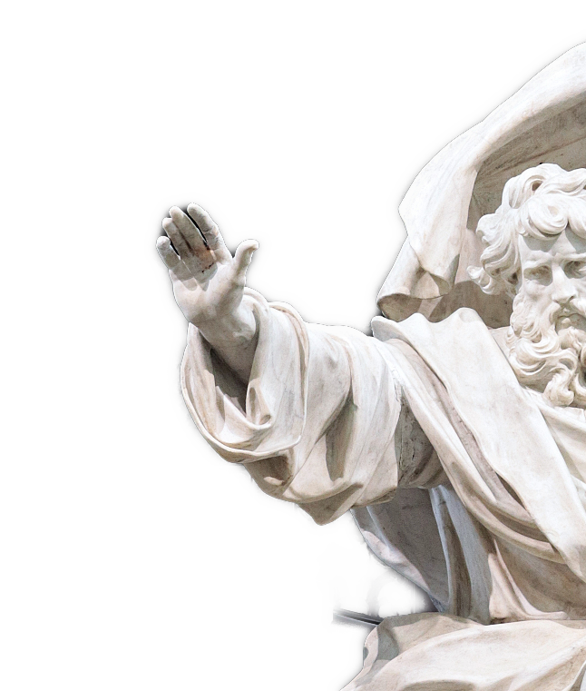
Supremacy of the New Covenant
In what ways is the picture we have of God in the Old Testament incomplete?
So, how does it benefit Christians today that God has spoken in many diverse ways?

Slide 8
Supremacy of the New Covenant
Why do you think the author of Hebrews made such a point of Christ’s deity to these Hebrew Christians?
his Son, whom he appointed heir of all things, and through whom he made the universe. The Son is the radiance of God's glory and the exact representation of his being, sustaining all things by his powerful word. After he had provided purification for sins, he sat down at the right hand of the Majesty in heaven. So he became as much superior to the angels as the name he has inherited is superior to theirs.

Slide 9

Supremacy of the New Covenant
What does Jesus’ life tell us about God that we wouldn’t know otherwise?
Based on what we have learned about Jesus in this passage, what are some words or phrases which describe how should we relate to Jesus?

Slide 10
2. THE NECESSITY OF FAITH.

Slide 11
Listen for how to be justified.
Galatians 2:15-16 (NIV) "We who are Jews by birth and not 'Gentile sinners' 16 know that a man is not justified by observing the law, but by faith in Jesus Christ. So we, too, have put our faith in Christ Jesus that we may be justified by faith in Christ and not by observing the law, because by observing the law no one will be justified.

Slide 12
The Necessity of Faith
What does Paul mean by “observing the law” or “works of the law”? It would have resonated with both Jews and Gentiles of his day.
a man is not justified by observing the law, but by faith in Jesus Christ

Slide 13
The Necessity of Faith
Contrast works of the law with faith in Christ.
Works of the Law | Faith in Christ
Requires effort, actions by us Earn forgiveness by deeds Actions/ceremonies must be repeated regularly

Slide 14
The Necessity of Faith
How do we sometimes still rely on “works” or on our own efforts to earn right relationship with God?
What will faith in Jesus Christ look like in your daily life?
How can we live out our faith in a way that reflects reliance on Jesus, rather than legalism or performance?

Slide 15
3. THE USEFULNESS OF WORKS.

Slide 16
Listen for a relationship.
James 2:20-26 (NIV) You foolish man, do you want evidence that faith without deeds is useless? 21 Was not our ancestor Abraham considered righteous for what he did when he offered his son Isaac on the altar? 22 You see that his faith and his actions were

Slide 17
Listen for a relationship.
working together, and his faith was made complete by what he did. 23 And the scripture was fulfilled that says, "Abraham believed God, and it was credited to him as righteousness," and he was called God's friend. 24 You see that a person is justified by what he does and not by

Slide 18
Listen for a relationship.
faith alone. 25 In the same way, was not even Rahab the prostitute considered righteous for what she did when she gave lodging to the spies and sent them off in a different direction? 26 As the body without the spirit is dead, so faith without deeds is dead.

Slide 19
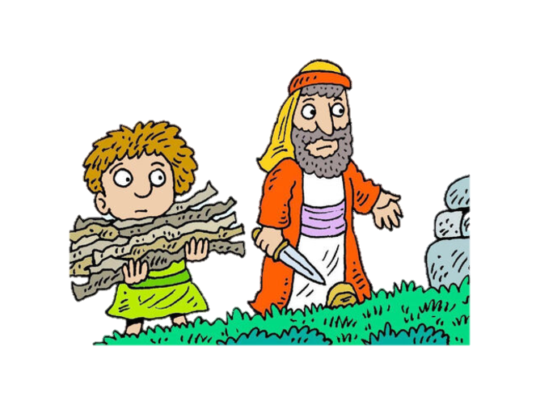
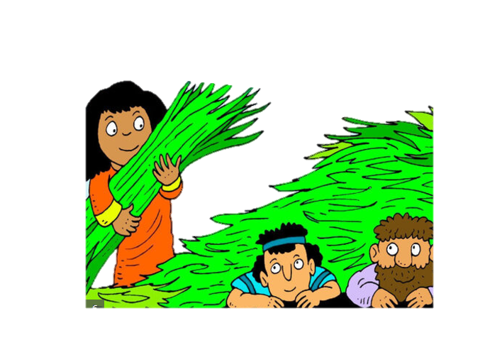
Usefulness of Works
Why was Abraham an apt example for showing the relationship between faith and works?
Why would Rahab be an
unusual person to be declared
as example of a person of faith?
How did she show that she
had faith?

Slide 20
Usefulness of Works
Why do you suppose Abraham was called “God’s friend”?
How do you become the friend of someone … anyone?
What changes can we make in our lives to be seen as “God’s friend”?

Slide 21
Application
Read and pray.
  Read Psalm 139:23-24: “Search me, God, and know my heart; test me and know my concerns. See if there is any offensive way in me; lead me in the everlasting way.”
  Pray, asking God to expose areas in your life where you are not living what you claim to believe. After praying, develop a plan for life change to help align your actions with your faith.

Slide 22
Application
Write and reflect.
  Create a “faith-in-action journal” in which you list at least five of your core beliefs.
  Over the next week, write ways your actions show (or do not show) that you are applying those beliefs in your life.

Slide 23
Application
Ask and listen.
  Ask a trusted friend to speak into your life and tell you how consistent you are at living your faith.
  Listen to what they tell you.
  Avoid getting defensive.
  Prepare to make some life changes based on what you hear.

Slide 24

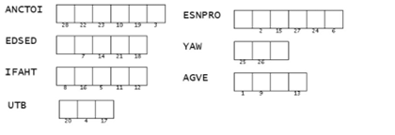
Double Puzzle
If you can unscramble these words (from James 2) you can decode the message!

Slide 25
Faith And/Or Works

