Slide 1
Early Church Struggles

Slide 2
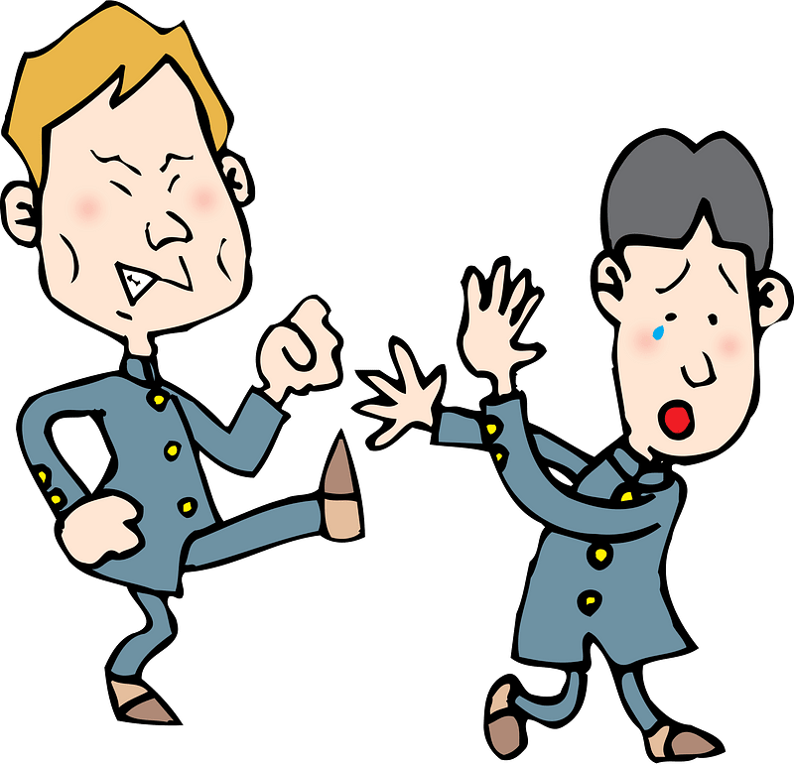
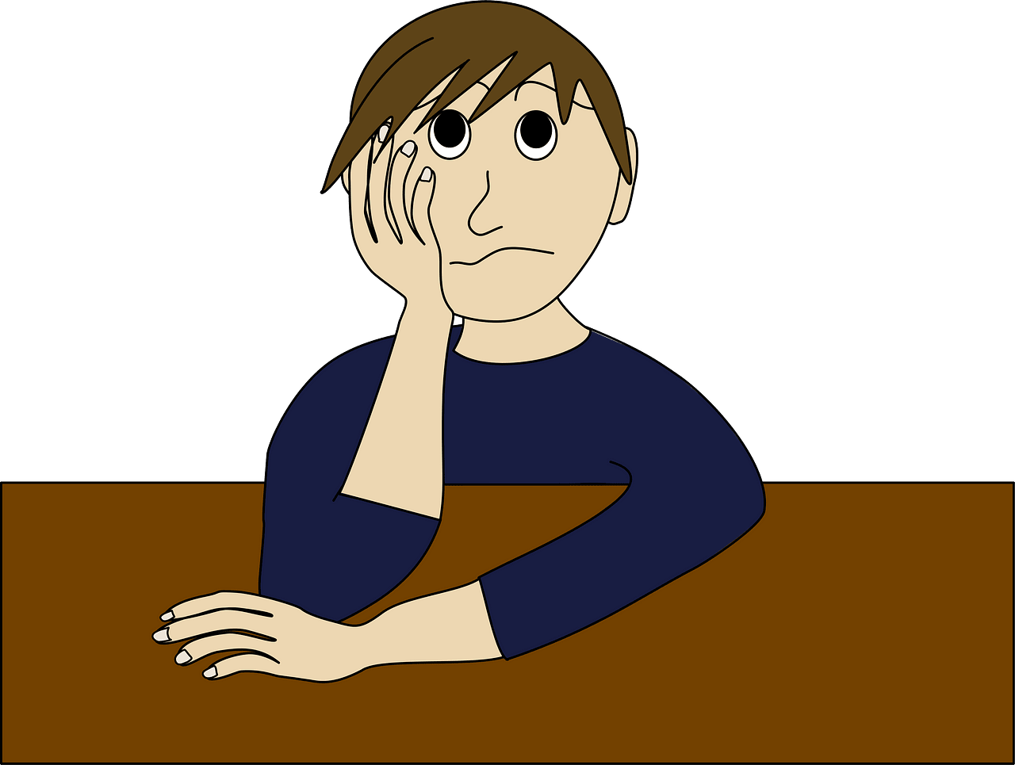
Remember those days?
What are some things children struggle with in grade school?
The early church also had some struggles.
Today we look at Paul’s exhortations to the church at Corinth.

Slide 3
1. DIVISIONS IN THE BODY OF CHRIST.

Slide 4
Listen for divided loyalties.
1 Corinthians 1:10-13 (NIV) I appeal to you, brothers, in the name of our Lord Jesus Christ, that all of you agree with one another so that there may be no divisions among you and that you may be perfectly united in mind and thought. 11 My brothers, some from Chloe's household

Slide 5
Listen for divided loyalties.
have informed me that there are quarrels among you. 12 What I mean is this: One of you says, "I follow Paul"; another, "I follow Apollos"; another, "I follow Cephas"; still another, "I follow Christ." 13 Is Christ divided? Was Paul crucified for you? Were you baptized into the name of Paul?

Slide 6
Divisions in the Body of Christ
Paul appeals to the Corinthians to "agree with one another" and "be perfectly united in mind and thought." What do you think it means (or does not mean) to be united in mind and thought?
Should Agree On | Doesn’t Matter if You Agree On

Slide 7
Divisions in the Body of Christ
Why do you think people in the church often become divided over leaders or specific teachings (end-times sequence, same-sex unions, baptism)?
How does this impact the church’s witness and unity?
Paul asks in verse 13, “Is Christ divided? Was Paul crucified for you?” How can making Christ the focus help prevent division within a church?

Slide 8
Divisions in the Body of Christ
What are some practical ways we can keep our focus on Christ as a unified church body?
How can practicing humility and selflessness contribute to unity within a church community?

Slide 9
2. THE STRUGGLE OF IMMORALITY.

Slide 10
Listen for when to run away.
1 Corinthians 6:15-18 (NIV) Do you not know that your bodies are members of Christ himself? Shall I then take the members of Christ and unite them with a prostitute? Never! 16 Do you not know that he who unites himself with a prostitute is one with her in

Slide 11
Listen for when to run away.
body? For it is said, "The two will become one flesh." 17 But he who unites himself with the Lord is one with him in spirit. 18 Flee from sexual immorality. All other sins a man commits are outside his body, but he who sins sexually sins against his own body.

Slide 12
The Struggle of Immorality
In what way did Paul argue that sexually immoral behavior dishonors the body of Christ?
your bodies are members of Christ himself. Shall I then take the members of Christ and unite them with a prostitute? Never! Do you not know that he who unites himself with a prostitute is one with her in body? … But he who unites himself with the Lord is one with him in spirit.

Slide 13
The Struggle of Immorality
Paul declared that sexually immoral behavior dishonors the Body of Christ (the Church).
Our physical bodies are meant to be “Members of Christ”
We must not unite our bodies to experiences that dishonor Christ.
We must not sin against our own bodies.

Slide 14
The Struggle of Immorality
How did Paul advise his readers to deal with the potential of sexual sin?
According to this passage, how will sexual misbehavior affect a believer?
that he who unites himself with a prostitute is one with her in body? For it is said, "The two will become one flesh." But he who unites himself with the Lord is one with him in spirit. … All other sins a man commits are outside his body, but he who sins sexually sins against his own body.

Slide 15
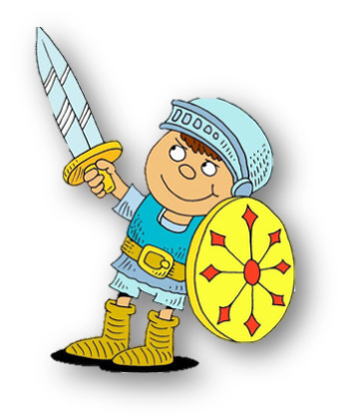
The Struggle of Immorality
Consider these specific ways Christians can live set apart for God (sanctified) in today’s culture.
Submit to the Holy Spirit who will produce the Fruit of the Spirit through you
Appropriate the whole armor and weapons of God for spiritual defense and spiritual ministry.

Slide 16
3. FALSE DOCTRINAL BELIEFS.

Slide 17
Listen for “if – then” statements.
1 Corinthians 15:12-17 (NIV) But if it is preached that Christ has been raised from the dead, how can some of you say that there is no resurrection of the dead? 13 If there is no resurrection of the dead, then not even Christ has been raised. 14 And if Christ has not been raised, our preaching is useless and so is your faith. 15 More than

Slide 18
Listen for “if – then” statements.
that, we are then found to be false witnesses about God, for we have testified about God that he raised Christ from the dead. But he did not raise him if in fact the dead are not raised. 16 For if the dead are not raised, then Christ has not been raised either. 17 And if Christ has not been raised, your faith is futile; you are still in your sins.

Slide 19
False Doctrinal Beliefs
In verse 12, Paul addresses the issue of some Corinthians denying the resurrection of the dead. Why do you think some people in the church struggled with the idea of resurrection?
List words and phrases in these verses that speak to what would be different if Jesus had not risen from the dead? Why is the resurrection so crucial for Christianity?

Slide 20
False Doctrinal Beliefs
So, based on this list, how does the reality of the resurrection of Jesus give meaning to our faith?
If we believe in the resurrection, how should this hope influence our daily lives, values, and decisions?

Slide 21
Application
Offer thanks.
Reflect on how your life has changed because of Christ.
Thank Him for setting you free from the former way of life.
Pray for the Lord to continue His good work.

Slide 22
Application
Memorize.
Memorize 1 Corinthians 6:19-20 and repeat it to yourself when you need to flee from temptation.
“Don’t you know that your body is a temple of the Holy Spirit who is in you, whom you have from God? You are not your own, for you were bought at a price. So glorify God with your body.”

Slide 23
Application
Walk alongside others.
Making the daily choice to live a holy life is much easier when you walk alongside other believers.
Surround yourself with others who also choose to live their lives for Christ. Your Bible study group is a good place to start.

Slide 24
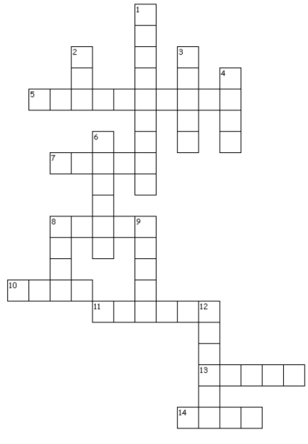
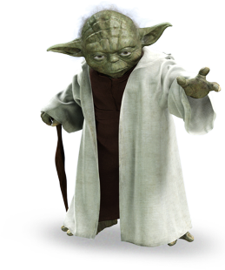
Crossword Puzzle
If the Bible you read, the words you will find. 1 Cor. 6:9 – 20 (NI V)

Slide 25
Early Church Struggles

