Slide 1
Looking Forward to Joy
December 15

Slide 2

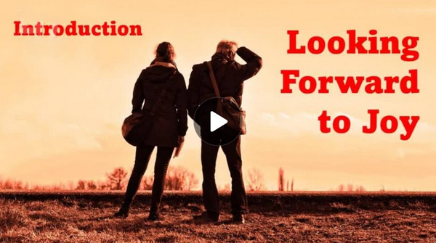
Video Introduction
View Video

Slide 3
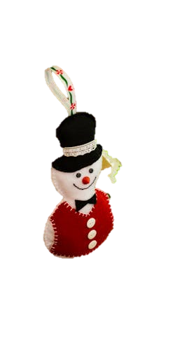
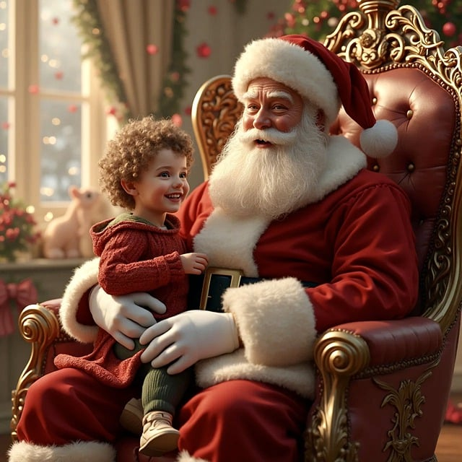

Remember it?
What’s a Christmas decoration, tradition, or memory that brings you joy?
We think of Christmas as a time of joy.
  If we’re missing loved ones or dealing with some other hardship, joy is difficult to realize.
  But … Jesus has come, giving us much cause for true joy.

Slide 4
Listen for hardships experienced.
Luke 2:4-7 (NIV) So Joseph also went up from the town of Nazareth in Galilee to Judea, to Bethlehem the town of David, because he belonged to the house and line of David. 5 He went there to register with Mary, who was pledged to be married to

Slide 5
Listen for hardships experienced.
him and was expecting a child. 6 While they were there, the time came for the baby to be born, 7 and she gave birth to her firstborn, a son. She wrapped him in cloths and placed him in a manger, because there was no room for them in the inn.

Slide 6
A Humble Birth
What were the conditions in Bethlehem the night Jesus was born?
What were the difficulties involved in this trip?
Actually, only the husband was required to go for the census registration – what are some possible reasons why Mary accompanied Joseph?

Slide 7
A Humble Birth
What are some things that are incongruous about the birth of the King of Kings?
Everything about Jesus would be miraculous.
  His virgin birth, his conception
  His divinity/humanity combination (incarnation)
  His ministry
  His resurrection
If the birth of Jesus was so momentous, why was He born in such humble circumstances?

Slide 8
A Humble Birth
What impresses you the most about the circumstances of Jesus birth?
He loved us enough to come and live in the
squalor of a middle eastern village, knowing
that one day He would endure a tortured death

Slide 9
Listen for an announcement.
Luke 2:8-12 (NIV) And there were shepherds living out in the fields nearby, keeping watch over their flocks at night. 9 An angel of the Lord appeared to them, and the glory of the Lord shone around them, and they were terrified. 10 But the angel said to them, "Do

Slide 10
Listen for an announcement.
not be afraid. I bring you good news of great joy that will be for all the people. 11 Today in the town of David a Savior has been born to you; he is Christ the Lord. 12 This will be a sign to you: You will find a baby wrapped in cloths and lying in a manger."

Slide 11


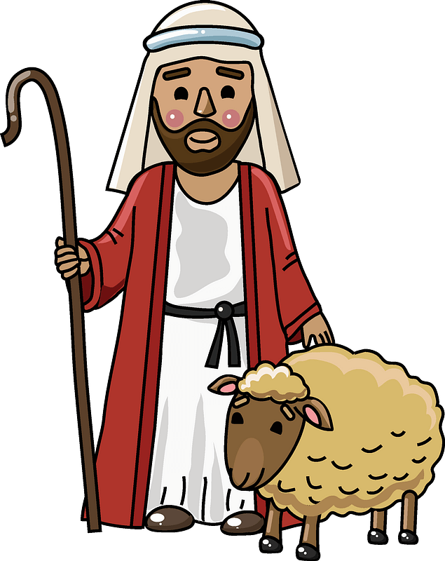
Of Great Joy
Suppose you were a shepherd outside of Bethlehem some 2000 years ago … you’ve got the sheep settled down, you’re taking turns being on watch against predatory animals and thieves … a brilliant light appears in the sky. What are some possible responses?

Slide 12
Of Great Joy
List words of encouragement and celebration that appear in the angel’s announcement
Shepherds were at the bottom of the socio-economic structure in those days. We might say “country bumkins” or “rednecks”. Why then would God bring the news of the Messiah’s birth first to them? (There are hints in the passage)
Jesus came for the rich and the poor,
for the Jews and the Gentiles

Slide 13

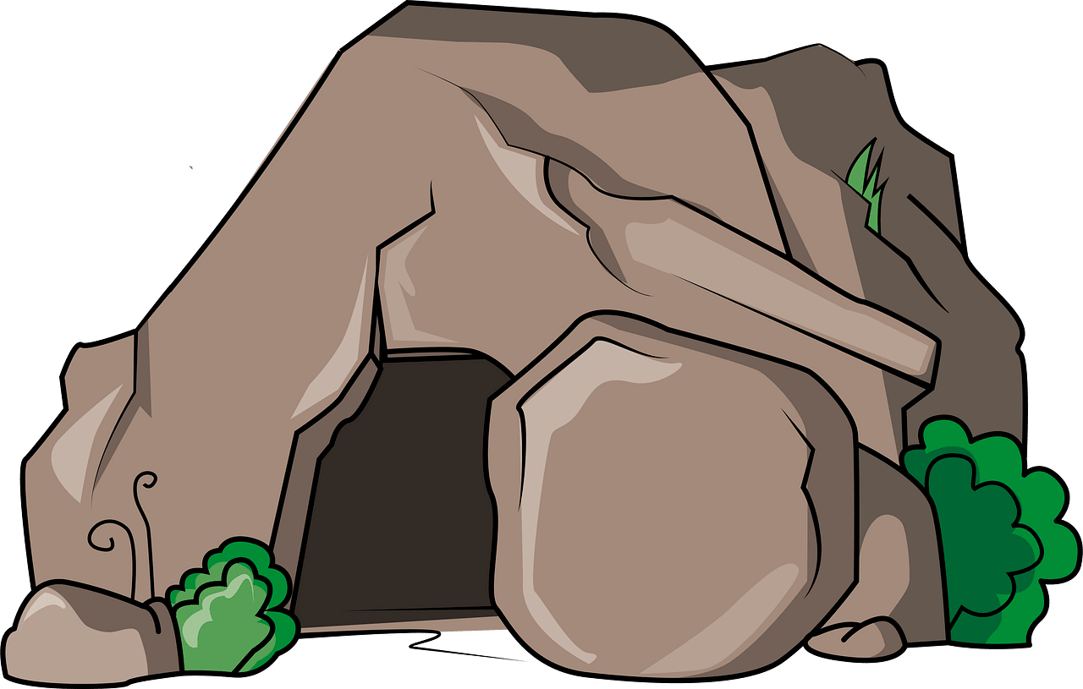

Of Great Joy
What specific signs were
the shepherds given?
What signs do we have to lead us to our Savior?

Slide 14
Listen for the concept of “peace”.
Luke 2:13-14 (NIV) Suddenly a great company of the heavenly host appeared with the angel, praising God and saying, 14 "Glory to God in the highest, and on earth peace to men on whom his favor rests."

Slide 15
Worthy of Praise
How many angels do you think were singing?
The message of the singing angles was …
  Praise to God
  Glory to God in the highest
  On earth, peace
  Peace to men on whom God’s favor rests

Slide 16
Worthy of Praise
Why do you think the angels praised God for His peace following the announcement of the Savior’s birth?
What other kinds of peace would Jesus, the Messiah bring to the earth?
The shepherds received a joyful personal announcement about Jesus. How can we make the joy of Christmas personal to those around us?

Slide 17
Application
Spend a moment reflecting on the time you received God’s gift of salvation.
  How old were you? How did that decision bring you joy?
  What was the catalyst of your decision to follow Jesus?
  If you haven’t received salvation, you’ll never have a better time than now. Go to the inside cover page for more information about how to become a Christian.

Slide 18
Application
Celebrate.
  If you want to experience a simple taste of joy, celebrate someone.
  Write a note, give a gift, and share a story with someone you know.
  In so doing you could bring joy through an encouraging act of kindness.

Slide 19
Application
Give.
  Second Corinthians 9:7 reminds us that God loves a cheerful giver.
  So many research studies claim that the most joyful people on Earth are the givers.
  Test it on yourself. Give sacrificially to the needy.
  Make plans to give more than you’ve ever given to mission work.
  A great place to start is the Lottie Moon Christmas Offering for world missions.

Slide 20
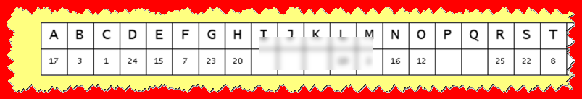


Family Activities
Spiros is on assignment to the North Pole. Something about contraband Barbi Dolls. He wishes you Merry Christmas, but still needs your help t use this key and decode the message you have been given. You can see the water stains and the truncated alphabet. Do your best … elves are standing by at https://tinyurl.com/5n7vxkpt for your help.

Slide 21
Looking Forward to Joy
December 15

