Slide 1
Living in Gratitude
November 24

Slide 2
Video Introduction

Slide 3
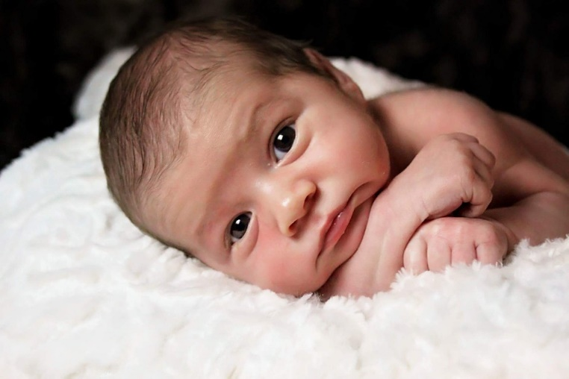
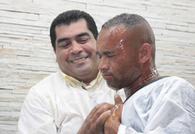
Think about it …
As you get ready for Thanksgiving, what has made you feel especially thankful this year?
While we have many blessings and occasional trials …
God calls us to give thanks … in everything.
Mortgage

Slide 4
Listen for Paul’s request.
1 Thessalonians 5:12-13 (NIV) 12 Now we ask [beseech] you, brothers, to respect those who work hard among you, who are over you in the Lord and who admonish you. 13 Hold them in the highest regard in love because of their work. Live in peace with each other.

Slide 5
Gratitude towards Those in Ministry
KJV says “beseech” – what are some synonyms?
Why do you think Paul might have implied urgency in his request?
Who are the them about whom he spoke? How did he functionally describe them?
How were the brethren to treat them? What words or phrases does Paul use to communicate this?

Slide 6
Gratitude towards Those in Ministry
How might the closing admonition in verse 13 apply to leaders and followers alike?
Who has been instrumental in your walk with God?
How can we practically recognize and appreciate spiritual leaders?
What can we do to live in peace with everyone in the church?

Slide 7
Listen for words of instruction.
1 Thessalonians 5:14-15 (NIV) And we urge you, brothers, warn those who are idle, encourage the timid, help the weak, be patient with everyone. 15 Make sure that nobody pays back wrong for wrong, but always try to be kind to each other and to everyone else.

Slide 8
Encourage Others in Their Christian Walk
What three categories of troubled members were to be ministered to and in what ways?
What prohibition did Paul give in verse 15?
Instead of retaliation, what were believers to pursue?
Paul says to be patient with everyone. What situations with other people tend to test your patience?
Troubled Members | Ministry to Them

Slide 9
Encourage Others in Their Christian Walk
So, what does it look like to obey these verses in the church today when your patience is tested?
When has someone followed one of these commands in a way that helped you in your walk with Christ?

Slide 10
Listen for practical commands.
1 Thessalonians 5:16-22 (NIV) Be joyful always; 17 pray continually; 18 give thanks in all circumstances, for this is God's will for you in Christ Jesus. 19 Do not put out the Spirit's fire; 20 do not treat prophecies with contempt. 21 Test everything. Hold on to the good. 22 Avoid every kind of evil.

Slide 11
Express Your Thanks to God
Paul mentions rejoicing, prayer, and giving thanks. How might these three be connected to each other?
In practical terms, how can we always be in a spirit of prayer? What does it mean to pray continually?

Slide 12
Express Your Thanks to God
How might refusing to quench the Spirit and refusing to reject the proclamation of God’s message be connected to each other?
Make a list of things in your life for which you may never have considered expressing gratitude to God because they seemed negative or bad. For what reason might they be worthy of gratitude to God?

Slide 13
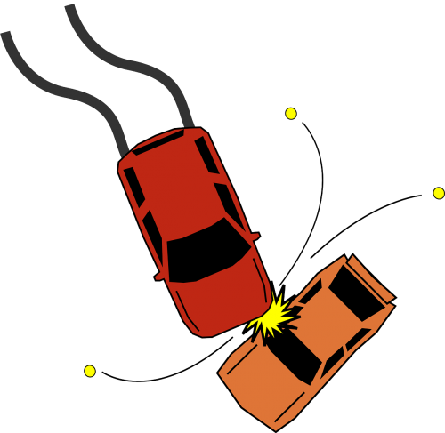
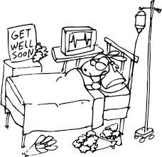
Express Your Thanks to God
What value is there in giving thanks in all circumstances?

Slide 14
Application
Thank God.
Take time daily to express gratitude to God.
Consider what He has given for you: a recent provision, a character trait, or life of His Son.
Reflect on this and express thanks throughout the day.
Watch how your heart will move from worry to trust and joy.

Slide 15
Application
Thank others.
Pray for your pastor or another believer who has helped you in your walk with Christ.
Ask the Lord how He wants you to encourage that person.
Send a card, a text, or an email expressing gratitude.

Slide 16
Application
Help others express thanks.
Encourage others who need physical and spiritual help.
Pray for them first and remind yourself of the gospel’s work in you.
Meet with these individuals, listen, and learn about their need.
Then, commit to walk with them, pray with them, and seek the solution that will help them.
Be a reason they can be thankful to God.

Slide 17
Family Activities
Alright you recruits … you need to police the area for these fallen letters. You know where to put them. Check the link at https://tinyurl.com/y2qef2k6 for help and for other appropriate activities. Double time, now! Go! Oorah!

Slide 18
Living in Gratitude
November 24

