Slide 1
Live the Message
May 16

Slide 2
Video Introduction
View Video

Slide 3
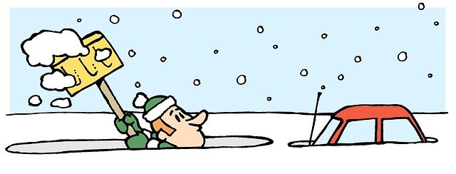
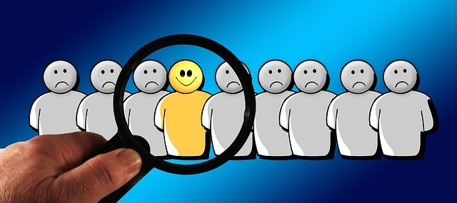
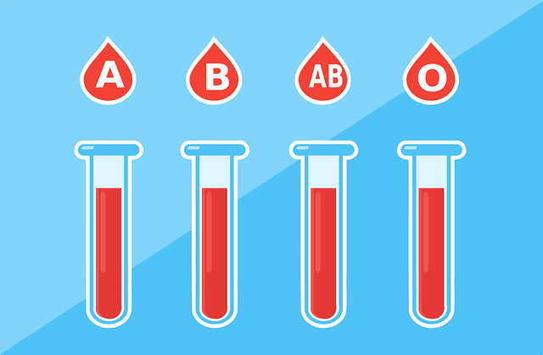
Think About It …
What’s a positive example of actions speaking louder than words?
As Christians, we claim to have the love of Jesus in our hearts.
How we live communicates whether or not that is a reality.
This will affect how believable is our witness to them.

Slide 4
Listen for where to set your thoughts.
Colossians 3:1-3 (NIV) Since, then, you have been raised with Christ, set your hearts on things above, where Christ is seated at the right hand of God. 2 Set your minds on things above, not on earthly things. 3 For you died, and your life is now hidden with Christ in God.

Slide 5
Seek the Things of Christ
What are Christians to desire (seek)?
What is the significance of Christ being at the right hand of God?
Paul says, “you died.” What are the implications of that statement in the context of these verses?
How exactly do we set our heart and mind on things above? What are these “things above” that we should set our minds on?

Slide 6
Seek the Things of Christ
What are some challenges we may face in trying to live an authentic Christian life? What are earthly things which try to crowd out these “things above”?
What evidence would cause people to say someone is more focused on things above and not on what’s here on earth?

Slide 7
Listen for what to wear.
Colossians 3:12-15 (NIV) Therefore, as God's chosen people, holy and dearly loved, clothe yourselves with compassion, kindness, humility, gentleness, and patience. 13 Bear with each other and forgive whatever grievances you may have against one another.

Slide 8
Listen for what to wear.
Forgive as the Lord forgave you. 14 And over all these virtues put on love, which binds them all together in perfect unity. 15 Let the peace of Christ rule in your hearts, since as members of one body you were called to peace. And be thankful.

Slide 9
Put On the Character of Christ
With what qualities of life should we clothe ourselves, according to this passage?
If these are, indeed, fruit of the Spirit, how do we “put them on” when they are qualities that are produced by God’s Holy Spirit? What is the Holy Spirit’s role? What is my role?
The Spirit’s Role | The Believer’s Role

Slide 10
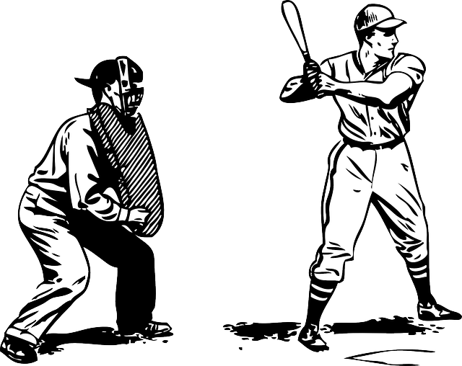
Put On the Character of Christ
When Paul says “let the peace of Christ rule in your hearts” he uses a term similar to the rule of an umpire or referee in a sports competition. What kinds of rulings does an umpire or referee make?
How would this apply to the “peace of Christ” making the calls, making the rulings in our relationship with others?

Slide 11
Put On the Character of Christ
Paul says, “and be thankful”… what does this have to do with living out the message of the Gospel?

Slide 12
Listen for music.
Colossians 3:16-17 (NIV) Let the word of Christ dwell in you richly as you teach and admonish one another with all wisdom, and as you sing psalms, hymns and spiritual songs with gratitude in your hearts to God. 17 And whatever you do, whether in word or deed, do it all in the name of the Lord Jesus, giving thanks to God the Father through him.

Slide 13
Your Life Should Point to Christ
What does it mean to have the “word of Christ dwell in you richly”?
What actions demonstrate that believers treasure the word of Christ?
How has music helped shape your knowledge and understanding of God?

Slide 14
Your Life Should Point to Christ
What are some signs that show when our lives don’t match the message we share?
How would acting “in the Name of Jesus” help us avoid some of these un-Christlike attitudes and actions?

Slide 15
Application
Confess.
Are there any areas of your life that don’t align with the message of Christ?
Pray and ask God to reveal any sins or habits.
Confess those and repent.

Slide 16
Application
Accept correction.
Give a trusted friend permission to point out …
Times when you are thinking more like the world.
Times you are thinking not like Christ.

Slide 17
Application
Share.
As God gives you opportunities to share your faith, be willing to admit your own sin and failure.
It’s important to be transparent but keep the focus on Christ who has forgiven and transformed you.

Slide 18
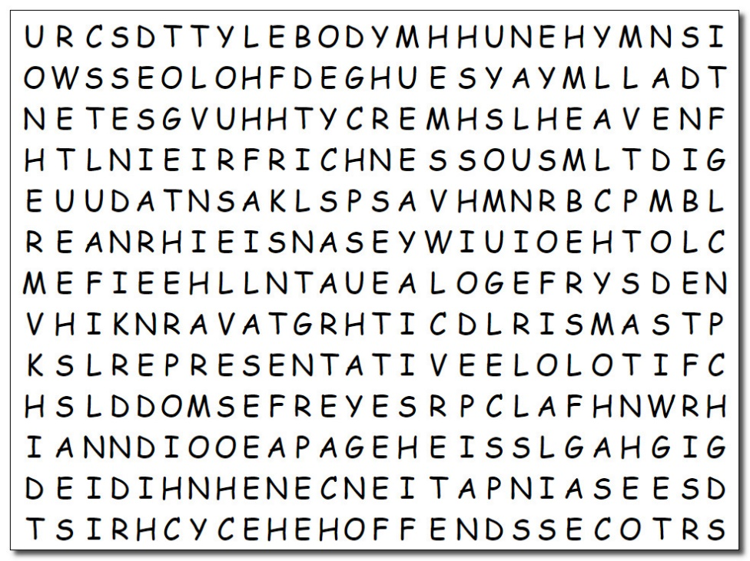
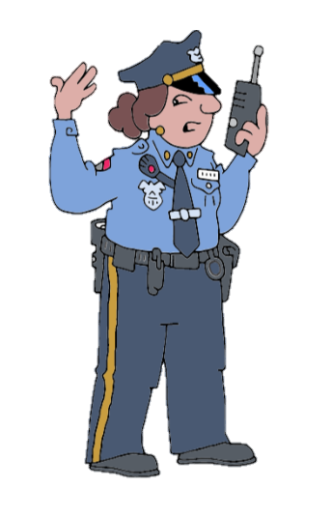
Family Activities
We have a situation here … these words have mounted an insurrection! We need help to find ‘em and put ‘em in their place. If you need assistance, go to https://tinyurl.com/5d9pbesb and you’ll find further opportunities to bring law and order to your families!

Slide 19
Live the Message
May 16

