Slide 1
Live Courageously
September 24

Slide 2

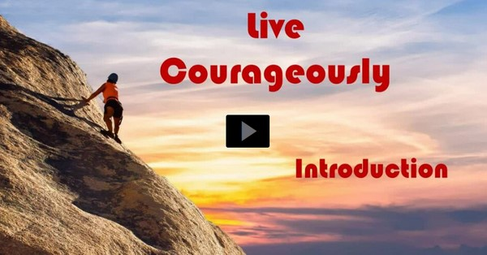
Video Introduction
View Video

Slide 3


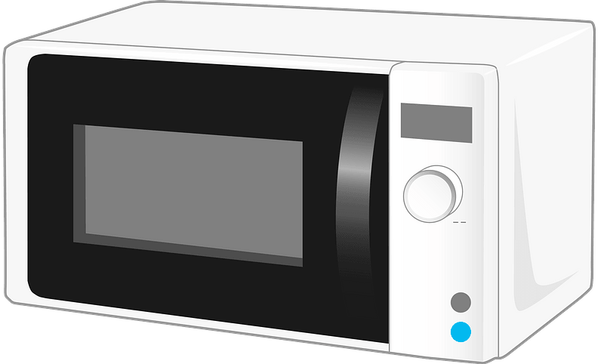
Think about it …
What change or innovation in your lifetime have you gladly embraced?
Some things we readily embrace, some we will never adopt.
  There are some absolutes and standards to which we must hold firm.
  Do the right thing in God’s Strength

Slide 4
Listen for Daniel’s resolve.
Daniel 6:6-10 (NIV) So the administrators and the satraps went as a group to the king and said: "O King Darius, live forever! 7 The royal administrators, prefects, satraps, advisers and governors have all agreed that the king should issue an edict and enforce the decree that anyone who prays to

Slide 5
Listen for Daniel’s resolve.
any god or man during the next thirty days, except to you, O king, shall be thrown into the lions' den. 8 Now, O king, issue the decree and put it in writing so that it cannot be altered--in accordance with the laws of the Medes and Persians, which cannot be repealed." 9 So King Darius put the decree in writing.

Slide 6
Listen for Daniel’s resolve.
Now when Daniel learned that the decree had been published, he went home to his upstairs room where the windows opened toward Jerusalem. Three times a day he got down on his knees and prayed, giving thanks to his God, just as he had done before.

Slide 7
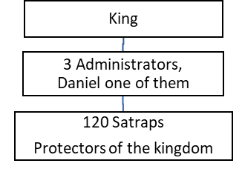
Resolve to Obey and Honor God
Note the organizational chart and Daniel’s place in the hierarchy.

Slide 8
Resolve to Obey and Honor God
Why do you think the other
administrators and satraps
opposed him?
When the leaders went to the king, what did they propose?
Why do you think Darius signed the decree?

Slide 9

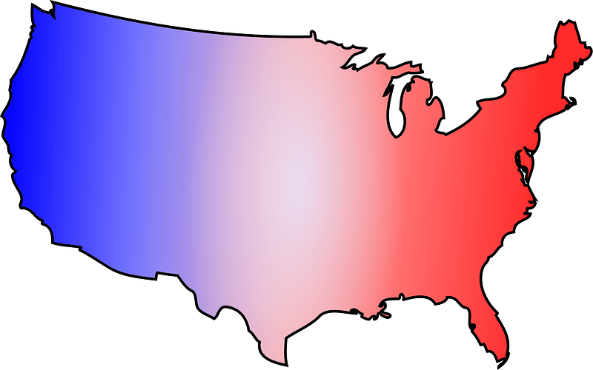

Resolve to Obey and Honor God
How did Daniel respond to the decree?
How have cultural changes presented new challenges to practicing our faith?

Slide 10
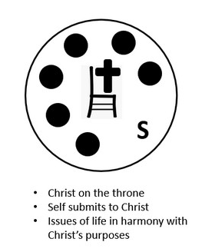
Resolve to Obey and Honor God
Consider that Daniel is the only person (aside from Jesus) about whom the scripture has nothing bad to say. This apparent faultless behavior is possible for believers today!
  God’s Holy Spirit lives within us
  He guides our decisions
  He empowers us for right choices
  and holy living

Slide 11
Listen for what the conspirators did.
Daniel 6:11 – 13 (NIV) Then these men went as a group and found Daniel praying and asking God for help. 12 So they went to the king and spoke to him about his royal decree: "Did you not publish a decree that during the next thirty days anyone who prays to any god or man except to you, O king, would be thrown into the lions' den?"

Slide 12
Listen for what the conspirators did.
The king answered, "The decree stands--in accordance with the laws of the Medes and Persians, which cannot be repealed." 13 Then they said to the king, "Daniel, who is one of the exiles from Judah, pays no attention to you, O king, or to the decree you put in writing. He still prays three times a day."

Slide 13
Honoring God May Incur Opposition
On what grounds did the officials build their case against Daniel?
Why was the king distressed upon receiving the charges? (See verse 14)
Why did Daniels enemies hold the upper hand in this situation?

Slide 14
Honoring God May Incur Opposition
In what ways have you seen individuals experience opposition to their faith?
What are some ways in which Daniel could have changed his prayer habits to avoid trouble?
What do you think God’s perspective might have been had Daniel dodged the decree somehow?
God’s perspective for our situations is the same for us today as it was for Daniel.
When we make the right choices, God is glorified!

Slide 15
Listen for how King Darius responded.
Daniel 6:16-17; 21 - 23 (NIV) So the king gave the order, and they brought Daniel and threw him into the lions' den. The king said to Daniel, "May your God, whom you serve continually, rescue you!" 17 A stone was brought and placed over the mouth of the den, and the king sealed it

Slide 16
Listen for how King Darius responded.
with his own signet ring and with the rings of his nobles, so that Daniel's situation might not be changed. … 21 Daniel answered, "O king, live forever! 22 My God sent his angel, and he shut the mouths of the lions. They have not hurt me, because I was found

Slide 17
Listen for how King Darius responded.
innocent in his sight. Nor have I ever done any wrong before you, O king." 23 The king was overjoyed and gave orders to lift Daniel out of the den. And when Daniel was lifted from the den, no wound was found on him, because he had trusted in his God.

Slide 18
Our Commitment Is a Witness
What was evident to the king about the quality of Daniels’s relationship to God?
How did this instance become an opportunity for Daniel to witness to the goodness of God?

Slide 19
Our Commitment Is a Witness
How can our lives express confidence that God is greater than those who oppose us?
How does the way we respond to difficulties become an opportunity to testify to God’s faithfulness?

Slide 20
Application
Express gratitude to God.
  When you first rise in the morning this week, think of one thing, person, or situation you are thankful for.
  Spend time during the day expressing your appreciation to God.
  Choose something different tomorrow.

Slide 21
Application
Pray faithfully.
  If you have not already done so, set aside a space in your house to be your prayer “closet.”
  Each day this week, spend time there, reading God’s Word and praying.

Slide 22
Application
Examine your life.
  Are there standards the world has set that are contrary to God’s Word, but you have embraced these anyway?
  Consider what changes you can or should make to help you be faithful to what is God’s will.
  What is one change will you make first?

Slide 23
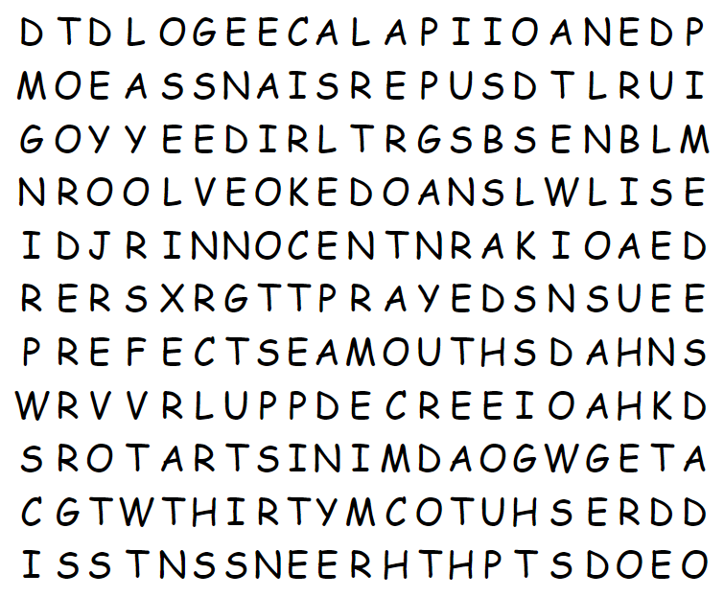
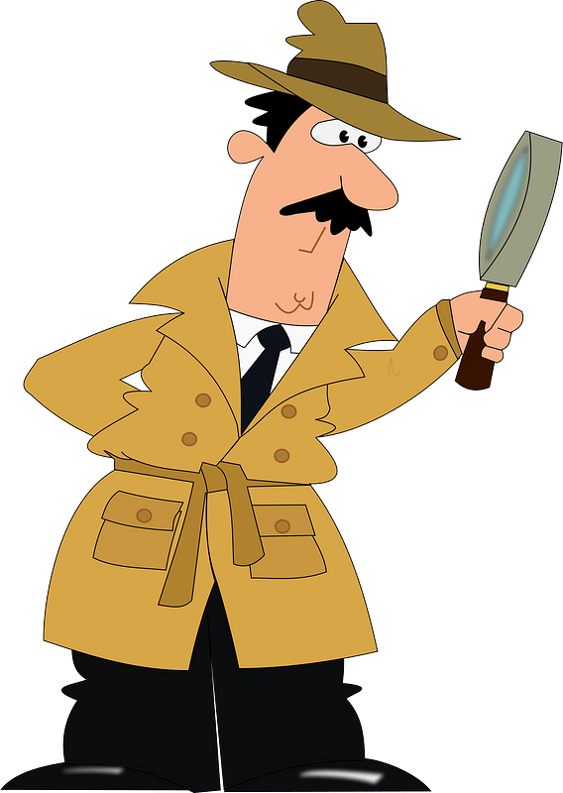
Family Activities
This one is either PRAY or PRAYED. I think these are all words from the Bible lesson. See how many you can find. They go up, down, left, right, and diagonal. If you get stuck go to https://tinyurl.com/yrb4aztr If you would rather do the Crossword, it’s there also.

Slide 24
Live Courageously
September 24

