Slide 1
Let the Dead
Bury their Dead
May 12

Slide 2
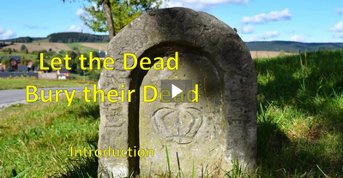
Introduction
View the Introduction Video

Slide 3



Think about it …
What kind of events or causes produce the effect of people “jumping on the bandwagon”?
It is easy to get involved in some popular cause.
  Today we study how Jesus responded to three people who wanted to join Him as disciples.
  If we would follow Jesus, He requires priority over all other commitments

Slide 4
Listen for the “no guarantee.”
Luke 9:57-58 (NIV) As they were walking along the road, a man said to him, "I will follow you wherever you go." 58 Jesus replied, "Foxes have holes and birds of the air have nests, but the Son of Man has no place to lay his head."

Slide 5
No Guarantee of Comfort
For what kinds of reasons might the man have volunteered to follow Jesus “wherever you go”?
What words and phrases did Jesus use to try to discourage the man?
Why do you think Jesus responded the way He did? What did Jesus want the man to understand about being His disciple?

Slide 6
No Guarantee of Comfort
What kind of personal comforts are important to our lives in our culture today?
How can these things hold us back from following Jesus more completely?

Slide 7
Listen for one man’s excuse.
Luke 9:59-60 (NIV) He said to another man, "Follow me." But the man replied, "Lord, first let me go and bury my father." 60 Jesus said to him, "Let the dead bury their own dead, but you go and proclaim the kingdom of God."

Slide 8
Delayed Obedience
Who took the initiative in this encounter? What was the request?
The man wanted to “go and bury my father.” What different possibilities might this have implied?
What was Jesus’ unusual reply?

Slide 9
Delayed Obedience
What is the major assignment given to those who follow Jesus?
What reason for not committing to discipleship does this man exemplify? What loyalties conflict with our allegiance to God?
Why did Jesus encourage the one man to place such little value on family responsibilities?

Slide 10
Listen for another excuse.
Luke 9:61-62 (NIV) Still another said, "I will follow you, Lord; but first let me go back and say good-by to my family." 62 Jesus replied, "No one who puts his hand to the plow and looks back is fit for service in the kingdom of God."

Slide 11
Moving Forward vs. Looking Back
How was this man’s offer similar to the first man’s offer?
How was his request similar to the second man’s?
How does the proverb in verse 62 fit the situation of the third man?

Slide 12
Moving Forward vs. Looking Back
What reason for not committing to discipleship does this man exemplify?
What excuses might people make in our culture today when asked to serve the Lord?

Slide 13

Moving Forward vs. Looking Back
Telling Jesus “later” is the same as saying “no.”
Agree or disagree?
I disagree …
Agree | Disagree

Slide 14
Moving Forward vs. Looking Back
Why is preoccupation with temporal affairs a hindrance to receiving spiritual blessings from following Jesus?
What are some practical steps in how we respond to Jesus call to follow Him?

Slide 15
Application
Let go of the past.
  The rearview mirror is a useful tool in driving, but there is a reason that it is not the size of the windshield.
  Do not let the past become more important than where God is leading you today.
  Focus on Christ daily as you follow Him and embrace what lies ahead.

Slide 16
Application
Evaluate your priorities.
  Realize following Jesus includes no guarantee of comfort.
  Look for ways your desire for personal comfort has hindered you from truly following Jesus.
  Remove those hindrances and allow Jesus to have top priority.

Slide 17
Application
Follow Jesus with immediate obedience.
  If there is an area in your life where you have delayed your obedience, understand that this is disobedience.
  Repent and act immediately on what you know Christ is calling you to do.

Slide 18
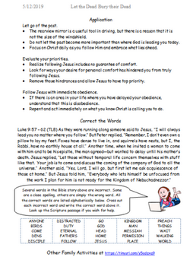

Family Activities
Before we print the handout, we need your help to make necessary editing corrections. Oh no … you’ve already received it? Well there’s some other important Family Activities you should attend to at
https://tinyurl.com/y5adzxq9

Slide 19
Let the Dead
Bury their Dead
May 12

