Slide 1
Lead Others to Serve
August 29

Slide 2

Video Introduction
View Video

Slide 3
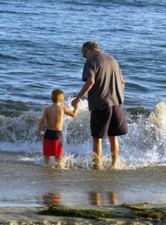


What was that they said?
What words of wisdom do you treasure from someone you love and trust?
We all need guidance and advice as we grow into maturity.
  Today we see that role of mentoring in the lives of Elijah and Elisha
  We are similarly called to lead others to serve the Lord.

Slide 4
Listen for the call of a prophet.
1 Kings 19:19-21 (NIV) So Elijah went from there and found Elisha son of Shaphat. He was plowing with twelve yoke of oxen, and he himself was driving the twelfth pair. Elijah went up to him and threw his cloak around him. 20 Elisha then left his oxen and ran after Elijah. "Let me kiss my father and mother good-by," he said,

Slide 5
Listen for the call of a prophet.
"and then I will come with you." "Go back," Elijah replied. "What have I done to you?" 21 So Elisha left him and went back. He took his yoke of oxen and slaughtered them. He burned the plowing equipment to cook the meat and gave it to the people, and they ate. Then he set out to follow Elijah and became his attendant.

Slide 6
Lead Others to Follow
What evidence do we see in these verses that indicate Elijah had either recovered from his discouragement or had, as the Lord would have him, decided to move forward to be a faithful servant even when discouraged?
What positive message for us is seen in his going to Elisha?
Identify some insights about Elisha that can be gleaned from these verses.

Slide 7
Lead Others to Follow
What did Elisha do that symbolized his acknowledgment of the gravity of the call of God on his life?
What might one of us have to leave behind in order to follow God?
What can we learn from Elisha’s response toward serving God?

Slide 8
Listen for Elijah’s departure.
2 Kings 2:6-11 (NIV) Then Elijah said to him, "Stay here; the LORD has sent me to the Jordan." And he replied, "As surely as the LORD lives and as you live, I will not leave you." So the two of them walked on. 7 Fifty men of the company of the prophets went and stood at a distance, facing the place where Elijah and Elisha had stopped at the Jordan. 8 Elijah took his cloak,

Slide 9
Listen for Elijah’s departure.
rolled it up and struck the water with it. The water divided to the right and to the left, and the two of them crossed over on dry ground. 9 When they had crossed, Elijah said to Elisha, "Tell me, what can I do for you before I am taken from you?" "Let me inherit a double portion of your spirit," Elisha replied. 10 "You have asked a difficult thing," Elijah said,

Slide 10
Listen for Elijah’s departure.
"yet if you see me when I am taken from you, it will be yours--otherwise not." 11 As they were walking along and talking together, suddenly a chariot of fire and horses of fire appeared and separated the two of them, and Elijah went up to heaven in a whirlwind.

Slide 11
Serve with the End in Mind
Why might Elijah have urged Elisha to stay in place rather than travel with him?
What does Elisha’s refusal say about his commitment to his mentor and to the Lord? Why do you suppose the younger prophet refused to be elsewhere when his master was taken by the Lord?

Slide 12
Serve with the End in Mind
When Elijah offered to do something special, Elisha asked for a double portion of Elijah’s spirit. What do you think that meant?
What spiritual legacy would you like to pass on to those who will follow you?

Slide 13
Serve with the End in Mind
How have others challenged you to a lifestyle of faithfully following God?
How can the deeds of believers who have gone before us encourage us today?

Slide 14
Listen for events after the whirlwind.
2 Kings 2:12-14 (NIV) Elisha saw this and cried out, "My father! My father! The chariots and horsemen of Israel!" And Elisha saw him no more. Then he took hold of his own clothes and tore them apart. 13 He picked up the cloak that had fallen from Elijah and went back and stood

Slide 15
Listen for events after the whirlwind.
on the bank of the Jordan. 14 Then he took the cloak that had fallen from him and struck the water with it. "Where now is the LORD, the God of Elijah?" he asked. When he struck the water, it divided to the right and to the left, and he crossed over.

Slide 16
An Ongoing Ministry
How did Elisha respond to what he saw?
What was the first proof that Elisha was indeed the heir of Elijah’s prophetic ministry?
What’s challenging about passing leadership on to the next generation?
How can we prepare others for our eventual departure?

Slide 17
Application
List.
  Consider the legacy you want to leave for God and list actions you will take toward that goal.
  Serve with the end in mind.

Slide 18
Application
Encourage.
  Choose one new believer you can encourage.
  Cultivate a relationship of pouring your faith and wisdom into his or her life.

Slide 19
Application
Mentor.
  Evaluate how you can cultivate new leaders in a ministry where you now serve.
  Begin intentionally training them to reproduce your work or replace you in your role.

Slide 20
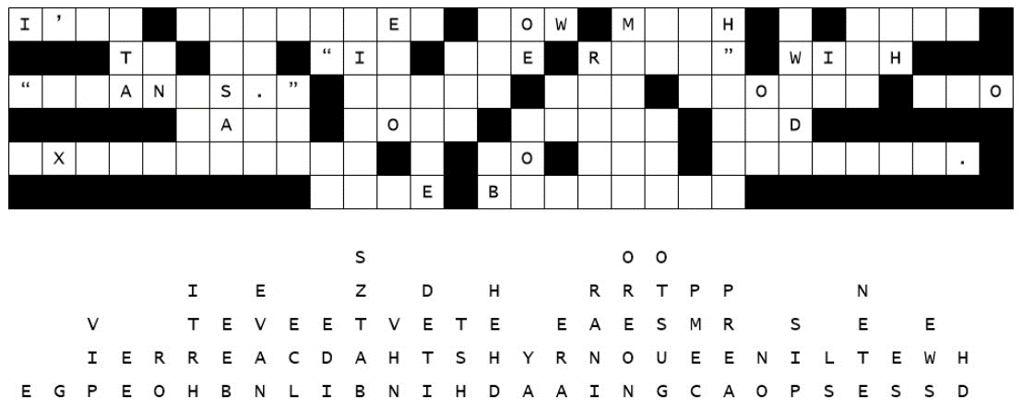

Family Activities
It’s happened again, Sarge. Someone released the letters. Get this Bible Study group on it ASAP. They may need assistance from https://tinyurl.com/4h4k52xc . They might also want to check out other Family Bible Activities

Slide 21
Lead Others to Serve
August 29

