Slide 1
Keep Serving Faithfully
May 22

Slide 2
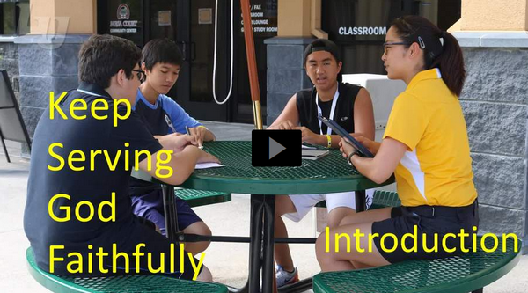
Video Introduction
Watch Video

Slide 3
Think about it …
When have you seen a “never quit” attitude on display?
Jesus challenges us in today’s scripture to have that “never quit” attitude.
We are to serve Christ faithfully as we wait for His return.

Slide 4
Listen for why to be ready.
Matthew 24:42-44 (NIV) "Therefore keep watch, because you do not know on what day your Lord will come. 43 But understand this: If the owner of the house had known at what time of night the thief was coming, he

Slide 5
Listen for why to be ready.
would have kept watch and would not have let his house be broken into. 44 So you also must be ready, because the Son of Man will come at an hour when you do not expect him.

Slide 6
Stay Alert
What life principle does Jesus give concerning His return?
How does He illustrate that principle?
How would you prepare if you knew a thief would try to burglarize your home today?
So, what does it look like to prepare for Jesus’ return? How can you tell when you are being watchful?

Slide 7
Stay Alert
Even if we claim to believe in Christ, what are some ways we live as though we were atheists?
We use the term “imminent” to describe Jesus return. What are synonyms for “imminent”? (Use your phones to look this up)
Contrast believing in the imminent return of Christ with an attitude of “whenever … who knows?”
“Whenever … who knows?” | Imminent Return

Slide 8
Listen for benefits of remaining faithful.
Matthew 24:45-47 (NIV) "Who then is the faithful and wise servant, whom the master has put in charge of the servants in his household to give them their food at the proper time? 46 It will be good for that servant whose master finds him doing so when he returns. 47 I tell you the truth, he will put him in charge of all his possessions.

Slide 9
Remain Faithful
What appears to be the intent of the parable Jesus told in these verses?
What are some traits of a faithful and wise servant that we can glean from verse 45?
What seemed to be the attitude of the owner of the household when he returned?

Slide 10
Remain Faithful
How did the owner respond to the faithful servant?
Why is it important to faithfully work until Jesus returns?
What are some ways we can be faithful and wise servants of the Lord in your home, community, church, or other settings, so that you will not be ashamed when the Lord returns?

Slide 11
Listen for bad choices.
Matthew 24:48-51 (NIV) But suppose that servant is wicked and says to himself, 'My master is staying away a long time,' 49 and he then begins to beat his fellow servants and to eat and drink with drunkards. 50 The master of that

Slide 12
Listen for bad choices.
servant will come on a day when he does not expect him and at an hour he is not aware of. 51 He will cut him to pieces and assign him a place with the hypocrites, where there will be weeping and gnashing of teeth.

Slide 13
Live to Serve Others
Why is the servant in this portion of Jesus’ story characterized as wicked or evil?
What was his attitude toward the owner’s absence?
How did the owner respond?
How does this part of the story support the message Jesus wanted to convey about expecting the Lord’s return?

Slide 14
Live to Serve Others
What are some obstacles that make it harder to stay focused on remaining faithful?
How can we help others prepare for Christ’s return?

Slide 15
Application
Reflect:
Take a moment and reflect on your life.
Are you faithfully serving God with your life?
Have you fully committed to His call on your life?
Spend some time in prayer asking God how you can better serve Him.

Slide 16
Application
Memorize:
Memorize Matthew 24:46: “Blessed is that servant whom the master finds doing his job when he comes.”
Let this verse motivate you to remain faithful while you wait for His return.

Slide 17
Application
Exercise:
If this session has convicted you to serve more faithfully, speak with your pastor and see if there are ministry opportunities that are going unanswered.
If you are serving faithfully, enlist someone you can mentor.

Slide 18
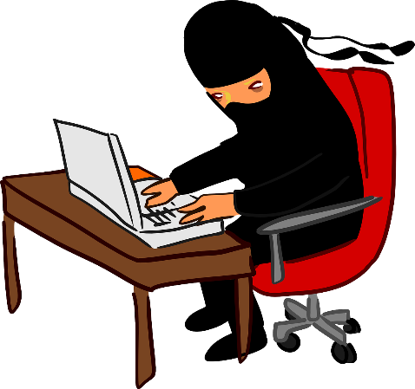
Family Activities
Spiros the Spy requests your assistance in decoding this message for the leader of your nursery department. They need encouragement. You can get technical assistance at https://tinyurl.com/2p8ap4xx
along with other items of intrigue.

Slide 19
Keep Serving Faithfully
May 22

