Slide 1
Jonathan
August 11

Slide 2
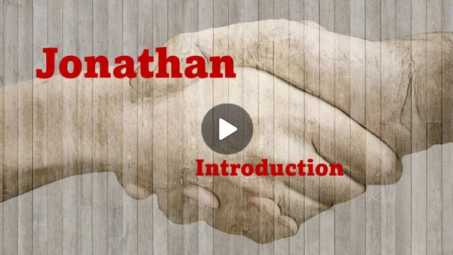
Video Introduction
View Video

Slide 3
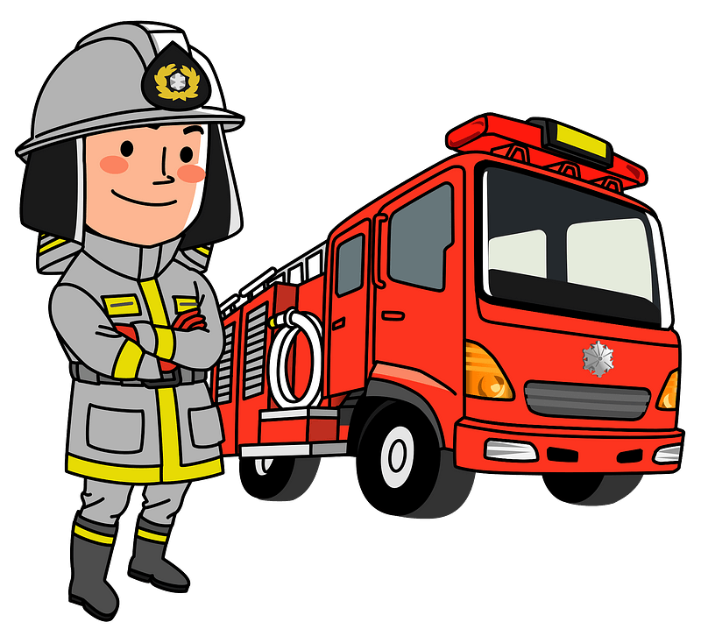
Admit it, now …
As a child, what did you want to be when you grew up?
Sometimes we just wish for something because it looked adventuresome.
Sometimes there is also parental or cultural pressure to choose a vocation
Today we look at how Saul’s son, Jonahtan dealt with such pressures

Slide 4
Listen for expressions of friendship.
1 Samuel 18:1-4 (NIV) After David had finished talking with Saul, Jonathan became one in spirit with David, and he loved him as himself. 2 From that day Saul kept David with him and did not let him return to

Slide 5
Listen for expressions of friendship.
his father's house. 3 And Jonathan made a covenant with David because he loved him as himself. 4 Jonathan took off the robe he was wearing and gave it to David, along with his tunic, and even his sword, his bow and his belt.

Slide 6
Role Expectations
Why might we expect Jonathan to have rejected David as a friend?
What kinds of difficulties could have arisen between the oldest son of the king and a skillful and popular soldier also living in the palace?
How did he demonstrate a commitment to their friendship that may have defied the role expectations others had for him?

Slide 7
Role Expectations
What traits might have made Jonathan and David feel as if they were "one spirit"?
What kinds of things could you give to a friend to demonstrate great loyalty and trust in them?

Slide 8
Role Expectations
What are the benefits of having your “soul knit” to someone else in friendship?
When might God call you to give selflessly to benefit someone else?

Slide 9
Listen for Saul’s influence on Jonathan
1 Samuel 19:1-4 (NIV) Saul told his son Jonathan and all the attendants to kill David. But Jonathan was very fond of David 2 and warned him, "My father Saul is looking for a chance to kill you. Be on your guard tomorrow morning; go into hiding and stay there. 3 I will go out and

Slide 10
Listen for Saul’s influence on Jonathan
stand with my father in the field where you are. I'll speak to him about you and will tell you what I find out." 4 Jonathan spoke well of David to Saul his father and said to him, "Let not the king do wrong to his servant David; he has not wronged you, and what he has done has benefited you greatly.

Slide 11
Unwarranted Accusations
Note what Saul determined to do to David and how he proposed to execute his desire.
Wanted to get rid of David
Instructed his attendants to kill him

Slide 12
Unwarranted Accusations
How does it feel when two people you are close to are at odds with one another?
What action did Jonathan take that was showing his faithfulness to his covenant with David even if it appeared he was defying the expectations of this father?
How did he plead David’s case to his father, the king?

Slide 13
Unwarranted Accusations
What do you think … was Jonathan being loyal to David at the cost of dishonoring his father, or did he act in a way that had peaceful resolution at its objective?
Loyal to David Dishonoring to Saul | Object Was Peaceful Resolution

Slide 14
Listen for Jonathan’s realization of the future.
1 Samuel 23:15-18 (NIV) While David was at Horesh in the Desert of Ziph, he learned that Saul had come out to take his life. 16 And Saul's son Jonathan went to David at Horesh and helped him find strength in God. 17 "Don't be afraid," he said.

Slide 15
Listen for Jonathan’s realization of the future.
"My father Saul will not lay a hand on you. You will be king over Israel, and I will be second to you. Even my father Saul knows this." 18 The two of them made a covenant before the LORD. Then Jonathan went home, but David remained at Horesh.

Slide 16
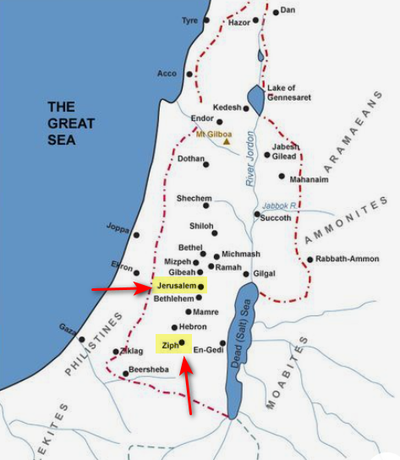
God’s Perspective
Who initiated the meeting and what was his purpose?
What was the encouragement Jonathan offered to David?

Slide 17
God’s Perspective
How was this final covenant in conflict with what would normally be expected?
How can you learn, like Jonathan, to be content with the role God has called you to fulfill?

Slide 18
Application
Encourage a leader.
Leadership can be quite lonely.
Do you have a Sunday School teacher who can use some assistance?
Do you know a pastor who needs prayer?
Write a note. Text a Scripture passage and be a blessing to him.

Slide 19
Application
Write a life mission statement.
Do you know God’s will for your life?
Are you planning with His plan in mind?
What is the big goal of your life?
If you could write your tombstone, what would you put on it?
Spend some time in prayer and fasting and get clarity from God regarding your role in life. Then write an end-vision with some attainable goals.

Slide 20
Application
Stand up for someone.
Do you have family or friends you can help with a squabble?
Is your spouse accepted by your immediate family?
Is there someone in your community who could use a defender?
Be intentional to encourage them and let them know you’ve got their back.
Don’t be afraid to publicly take a stand on their behalf.

Slide 21
Family Activities
N.S.A. needs your help. We have space aliens attacking billboards. You need to figure out where the fallen letters go. Follow the instructions on your handout. Technical help (and the secret crossword) are found at https://tinyurl.com/5fj4rn3w

Slide 22
Jonathan
August 11

