Slide 1
Jesus Saves
February 8

Slide 2


Video Introduction
View Video

Slide 3



It’s so good …
What’s your favorite thing to eat straight out of the oven? What are the ingredients that make it so good?
There’s a necessary ingredient in life that makes it so good…
Salvation through Jesus Christ!
Jesus saves all who trust in Him

Slide 4
Listen for facts about Jesus
Acts 2:22-24 (NIV) "Men of Israel, listen to this: Jesus of Nazareth was a man accredited by God to you by miracles, wonders and signs, which God did among you through him, as you yourselves know. 23 This man was handed over to you by God's set purpose

Slide 5
Listen for facts about Jesus
and foreknowledge; and you, with the help of wicked men, put him to death by nailing him to the cross. 24 But God raised him from the dead, freeing him from the agony of death, because it was impossible for death to keep its hold on him.

Slide 6
Jesus – Sent as Savior
What did Peter say about the life on earth of Jesus of Nazareth?
What miracles do you remember hearing or reading that Jesus performed?
What did Jesus’ miracles show both to the people who experienced them personally and to us who read about them?

Slide 7
Jesus – Sent as Savior
What do these verses say about how God was in control of Jesus’ life, death, and resurrection?
What are the essentials of the gospel message? Let’s list them in order.
What can we learn from Peter’s approach to sharing the gospel?

Slide 8
Listen for praise for Jesus
Acts 2:32-36 (NIV) God has raised this Jesus to life, and we are all witnesses of the fact. 33 Exalted to the right hand of God, he has received from the Father the promised Holy Spirit and has poured out what you now see and hear. 34 For David did not ascend to

Slide 9
Listen for praise for Jesus
heaven, and yet he said, "'The Lord said to my Lord: "Sit at my right hand 35 until I make your enemies a footstool for your feet."' 36 "Therefore let all Israel be assured of this: God has made this Jesus, whom you crucified, both Lord and Christ."

Slide 10
Jesus – Exalted as Lord
Peter gave an eyewitness testimony.
God resurrected Jesus from the dead.
Many people saw this personally.

Slide 11
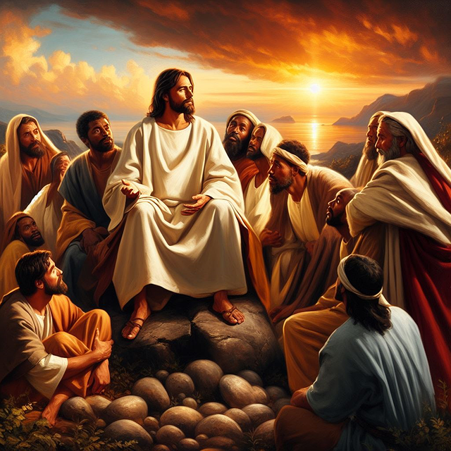
Jesus – Exalted as Lord
Why is it important that many people in the early church were personal witnesses to Jesus’ resurrection?

Slide 12
Jesus – Exalted as Lord
Peter offers scriptural support for claim that Jesus was ascended and exalt from Psalms
“The Lord said to my Lord: ‘Sit at my right hand …’”
God the Father says to God the Son, “Sit at my right hand”
Jesus was a descendant of David
So David is expressing his worship of “my Lord”, the Messiah

Slide 13
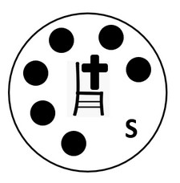
Jesus – Exalted as Lord
What are the personal implications of recognizing Jesus as Lord?
What can cause people to struggle with the certainty that Jesus is Lord?
What do we learn from this passage about the Holy Spirit?

Slide 14
Listen for the response to Peter’s preaching.
Acts 2:37-41 (NIV) When the people heard this, they were cut to the heart and said to Peter and the other apostles, "Brothers, what shall we do?" 38 Peter replied, "Repent and be baptized, every one of you, in the name of Jesus Christ for the forgiveness of your sins. And you will receive the gift of the Holy Spirit. 39 The promise

Slide 15
Listen for the response to Peter’s preaching.
is for you and your children and for all who are far off--for all whom the Lord our God will call." 40 With many other words he warned them; and he pleaded with them, "Save yourselves from this corrupt generation." 41 Those who accepted his message were baptized, and about three thousand were added to their number that day.

Slide 16
Jesus – Trust Him
How did the hearers respond to Peter’s words?
What did Peter tell his audience to do?
What effect did Peter’s sermon have?
What would the apostles have been teaching?
What should we be using for teaching today?

Slide 17
Application
Examine.
Consider your heart and life
See if what’s missing is a personal relationship with Jesus.
If so, repent of your sins, trust Jesus.
Experience the greatest miracle of salvation.

Slide 18
Application
Identify.
Find one area in your life where you need to repent for sin.
Where do you need to surrender to Jesus’s lordship in a a relationship or a habit?
Take actionable steps toward reconciliation or change, trusting in Jesus for strength.

Slide 19
Application
Share.
Communicate the testimony of how Jesus has saved you with someone this week.
Whether in person or online, be bold in declaring the good news that Jesus saves those who are lost.

Slide 20
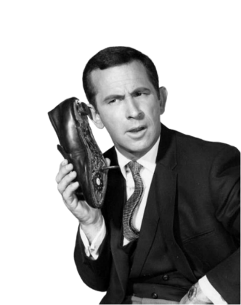

Family Activities
Missed it by that much ! We’ve just received an encoded message that was secretly delivered to the Baptist consulate in Galbarncent. Use the key to decode the symbols. It’s easy, even I can do it. Tech help and more at the link on your handout. Hey now, we never had this conversation!

Slide 21
Jesus Saves
February 8

