Slide 1
Jesus Rose Again to Give Me Life
April 9

Slide 2


Vide Introduction
View Video

Slide 3

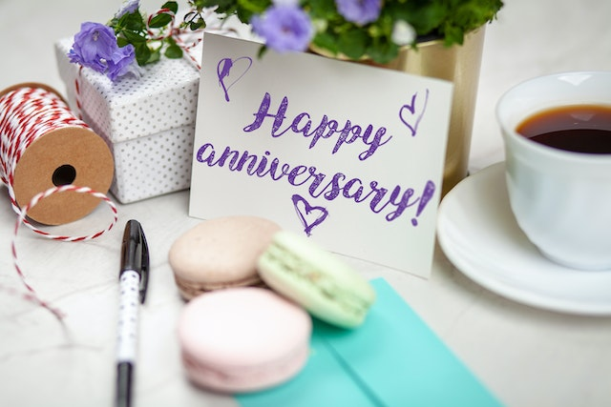

What a surprise …
How has someone recently surprised you with what he or she did or said?
Jesus’ followers were surprised to discover an empty tomb.
  Jesus’ resurrection is more than just an exciting surprise.
  Jesus’ resurrection offers eternal life for you and me.
SURPRISE!

Slide 4

Listen for Mary’s surprise.
John 20:1-2 (NIV) Early on the first day of the week, while it was still dark, Mary Magdalene went to the tomb and saw that the stone had been removed from the entrance. 2 So she came running to Simon Peter and the other disciple, the one Jesus loved, and said, "They have taken the Lord out of the tomb, and we don't know where they have put him!"

Slide 5
The Tomb Was Empty
Even though the tomb was empty, what conclusions did she reach that caused her message to be misguided?
If you had been either Mary, Peter, or John, what thoughts would have run through your mind when you discovered the empty tomb?
How do people often respond to life’s unexpected events?

Slide 6
The Tomb Was Empty
Why do we sometimes fail to fully understand how God is working in a situation?
Mary was searching for Jesus’ remains in the tomb, but not finding them. Where do you see people searching for Jesus, searching for God but not finding Him?

Slide 7
The Tomb Was Empty
It is entirely possible to place your faith and trust in Jesus by believing in His death and resurrection without fully understanding the theology regarding salvation.
Consider elements of our faith that we believe but don’t fully understand …
  The Trinity
  The indwelling of the Holy Spirit
  Why God would love us enough to die for us
  The how of creation and the universe
  The when of the Second Coming of Christ

Slide 8
Listen for Mary’s discovery.
John 20:11-16 (NIV) but Mary stood outside the tomb crying. As she wept, she bent over to look into the tomb 12 and saw two angels in white, seated where Jesus' body had been, one at the head and the other at the foot. 13 They asked her, "Woman, why are you crying?" "They have taken

Slide 9
Listen for Mary’s discovery.
my Lord away," she said, "and I don't know where they have put him." 14 At this, she turned around and saw Jesus standing there, but she did not realize that it was Jesus. 15 "Woman," he said, "why are you crying? Who is it you are looking for?" Thinking he was the gardener,

Slide 10
Listen for Mary’s discovery.
she said, "Sir, if you have carried him away, tell me where you have put him, and I will get him." 16 Jesus said to her, "Mary." She turned toward him and cried out in Aramaic, "Rabboni!" (which means Teacher).

Slide 11
Jesus Showed Himself as Alive
What was her concern and erroneous conclusion expressed both to the angels in the tomb and the person she supposed to be the gardener?
Mary didn’t recognize Jesus at first. What are some reasons we might fail to see Jesus’ presence at work in our lives?
When have you had an encounter with God that you didn’t recognize at first?

Slide 12
Jesus Showed Himself as Alive
What can we do to better recognize God’s presence at work in our lives and in the world around us?
We see Mary going from crying, to clinging, to telling about Jesus’ resurrection. What changed her (and should change our) direction?

Slide 13
Listen for Jesus’ command to Mary
John 20:17-18 (NIV) Jesus said, "Do not hold on to me, for I have not yet returned to the Father. Go instead to my brothers and tell them, 'I am returning to my Father and your Father, to my God and your God.'"

Slide 14
Listen for Jesus’ command to Mary
Mary Magdalene went to the disciples with the news: "I have seen the Lord!" And she told them that he had said these things to her.

Slide 15
Tell Others
What act of Mary is implied by Jesus’s words in verse 17?
Why would Mary have wanted to cling to Jesus?
What prohibition did Jesus give and what was His reason?

Slide 16
Tell Others
Jesus told Mary to go tell the disciples of His resurrection. This was also part of the “don’t cling to me” command. What has God called us to do?
Why does telling others of our experiences with the risen Lord help to change our grief to joy?

Slide 17
Application
Trust Christ.
  Knowing the truth of the resurrection of Christ is not enough.
  Commit to Him, trusting Him by faith.
  Turn to the inside front cover of your Bible Study book where you can read the greatest message of hope that has ever been shared.
  Talk to someone about your desire to follow the resurrected Christ.

Slide 18
Application
Write your testimony.
  Write out how you came to know Christ as your Savior.
  Include how you became convinced and convicted of your spiritual need and how it could only be satisfied by Jesus.
  Feel free to update your testimony as more thoughts and details come to mind. Keep your written testimony in your Bible.
  It will be a treasure and a witness to your family in the years to come.

Slide 19
Application
Pray and share.
  Write down the names of three people you know who need to hear the gospel.
  Pray daily for these three people and ask God for the opportunity to share the gospel with them soon

Slide 20
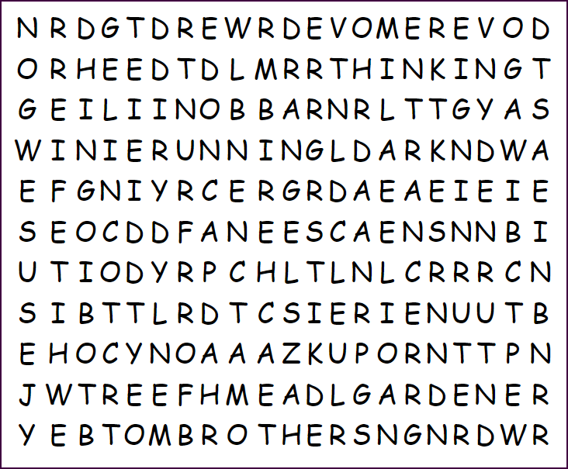

Family Activities
What is a “MEREVOD”? Oh … that’s not one of the words from our Bible Study, is it. See how many you can find. Just remember what the Word Search Lady says … “Humph”! Well, you can look for help at https://tinyurl.com/y4huh38t There’s other cool stuff there also.

Slide 21
Jesus Rose Again to Give Me Life
April 9

