Slide 1
Jesus Restored My Life
March 12

Slide 2


Video Introduction
View Video

Slide 3
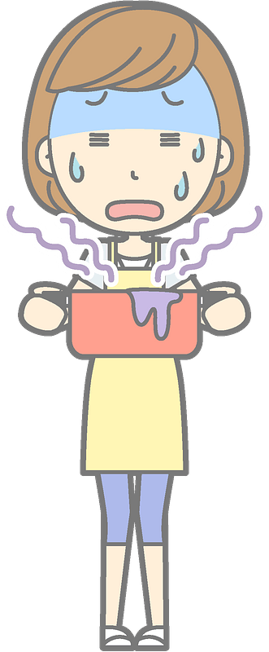

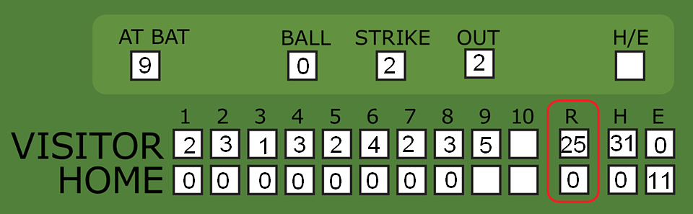
It was scary …
When have you had a situation where you felt helpless or despaired about something?
Bad things can happen in our lives … things go bad, things get broken.
  Jesus restores what is broken in your life.

Slide 4
Listen for who could help.
John 5:2-7 (NIV) Now there is in Jerusalem near the Sheep Gate a pool, which in Aramaic is called Bethesda and which is surrounded by five covered colonnades. 3 Here a great number of disabled people used to lie--the blind, the lame, the paralyzed. 5 One who was there had been an invalid for thirty-eight years.

Slide 5
Listen for who could help.
When Jesus saw him lying there and learned that he had been in this condition for a long time, he asked him, "Do you want to get well?" 7 "Sir," the invalid replied, "I have no one to help me into the pool when the water is stirred. While I am trying to get in, someone else goes down ahead of me."

Slide 6
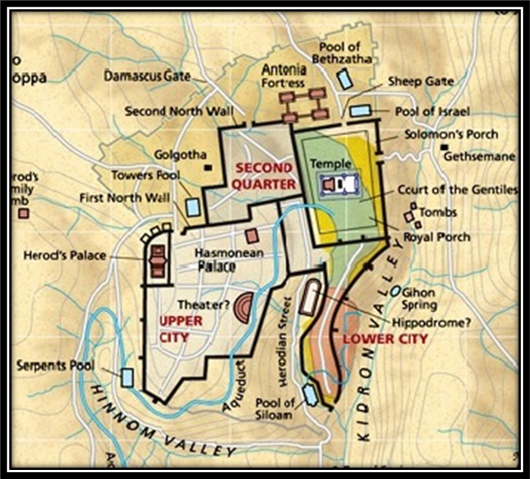
No One Else Could Help
Note the setting for the encounter described in these verses.
  Near the Sheep Gate
  Beside a pool
  Surrounded by 5 colonnades or porches
Map from American Bible Society

Slide 7
No One Else Could Help
Who were people gathered around the pool, why were they gathered there?
What was the situation of one particular man lying at the pool?
What did Jesus ask him? How did the man respond?

Slide 8
No One Else Could Help
Why did Jesus ask him if he wished to get well? Isn’t that an obvious question? Why is this question important/necessary?
The man may have felt like life had treated him unfairly. In what way do you think life is unfair?

Slide 9
No One Else Could Help
When/why do we tend to get impatient with God’s timing in our lives?
This man was depending on a random water flow and some way to jump into the pool. On what in life, other than God, do we sometimes depend?

Slide 10
Listen for what only Jesus could do.
John 5:8-11 (NIV) Then Jesus said to him, "Get up! Pick up your mat and walk." 9 At once the man was cured; he picked up his mat and walked. The day on which this took place was a Sabbath,

Slide 11
Listen for what only Jesus could do.
and so the Jews said to the man who had been healed, "It is the Sabbath; the law forbids you to carry your mat." 11 But he replied, "The man who made me well said to me, 'Pick up your mat and walk.'"

Slide 12
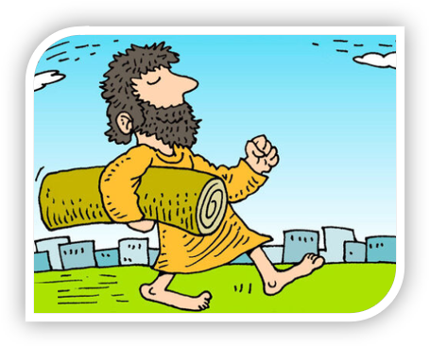
Beyond Anything Imaginable
Note the three-pronged admonition did Jesus give to the man.
  Get up
  Pick up your mat
  Walk
Art by Richard Gunther

Slide 13
Beyond Anything Imaginable
What might have encouraged the man to stand, even though he hadn’t been able to do so for 38 years?
What were the religious leaders more concerned about?

Slide 14
Beyond Anything Imaginable
Why do you suppose Jesus choose to heal this man on the Sabbath?
Why do some people care more about keeping certain "religious" rules than they do about developing a meaningful relationship with Jesus?

Slide 15
Listen for unity within the Trinity.
John 5:19-21 (NIV) Jesus gave them this answer: "I tell you the truth, the Son can do nothing by himself; he can do only what he sees his Father doing, because whatever the Father does the Son also does. 20 For the Father loves the

Slide 16
Listen for unity within the Trinity.
Son and shows him all he does. Yes, to your amazement he will show him even greater things than these. 21 For just as the Father raises the dead and gives them life, even so the Son gives life to whom he is pleased to give it.

Slide 17
Jesus Is Pleased to Give Life
To whom did Jesus point as the source of His power to act?
What can we learn from the fact that the Son gives life to “whom He wishes” or “to whom He is pleased to give it”?
  2 Peter 3:9 (NIV) The Lord is not slow in keeping his promise, as some understand slowness. He is patient with you, not wanting anyone to perish, but everyone to come to repentance.

Slide 18
Jesus Is Pleased to Give Life
What did Jesus say that suggests what the Father does through the Son is not limited? What was at least one greater work that the Son would do?
How can we join God and participate in His work?

Slide 19
Application
Watch.
  Jesus was watching what His Father was doing.
  Ask God to open your eyes to people and needs around you this week.
  You may be surprised at what you see and hear.

Slide 20
Application
Think.
  Think about some of the “God stories” you have heard in recent weeks.
  Where has God been working?
  Who has God been using?
  Write down any insights about what these stories and testimonies tell you of how God works.
  Praise God for the work He is doing around you.

Slide 21
Application
Tell.
  Is your greatest “God story” the moment Jesus saved you from your sin?
  If you are a believer, you have a testimony.
  While each story is unique, they all have Jesus at the center, saving a sinner at their root.
  Share your testimony with someone this week. See how to give a 15 second testimony: https://youtu.be/hkprflNySS8

Slide 22


Family Activities
Another decoding job for this week. Use the key to figure out how the shapes match the letters.

Slide 23
Jesus Restored My Life
March 12

