Slide 1
Jesus Met My Greatest Need
March 5

Slide 2
Video Introduction
View Video

Slide 3
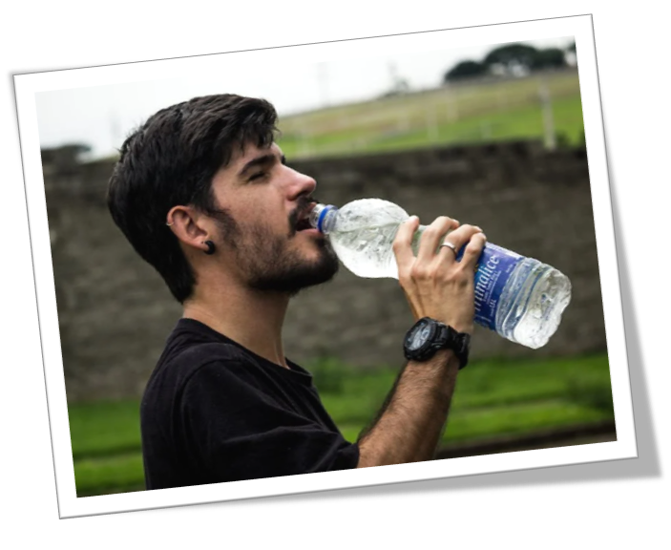
When was it? Where was it?
What is the thirstiest you have been?
Usually our physical thirst is met at the end of the ordeal.
Physical thirst is one thing, spiritual thirst is another
Only Jesus can truly satisfy my thirst.

Slide 4
Listen for why the woman was surprised.
John 4:7-14 (NIV) When a Samaritan woman came to draw water, Jesus said to her, "Will you give me a drink?" 8 (His disciples had gone into the town to buy food.) 9 The Samaritan woman said to him, "You are a Jew and I am a Samaritan woman. How can you ask me for a drink?" (For Jews do not associate with Samaritans.)

Slide 5
Listen for why the woman was surprised.
Jesus answered her, "If you knew the gift of God and who it is that asks you for a drink, you would have asked him and he would have given you living water." 11 "Sir," the woman said, "you have nothing to draw with and the well is deep. Where can you get this living water? 12 Are you greater than our father Jacob, who gave us the well

Slide 6
Listen for why the woman was surprised.
l and drank from it himself, as did also his sons and his flocks and herds?" 13 Jesus answered, "Everyone who drinks this water will be thirsty again, 14 but whoever drinks the water I give him will never thirst. Indeed, the water I give him will become in him a spring of water welling up to eternal life."

Slide 7
Jesus Reveals a Greater Thirst
Why was Jesus alone at the well near Sychar?
What might account for the woman being at the well at this unusual time of the day?
Why was the Samaritan woman surprised that Jesus spoke to her?
After his initial request for a drink of water, what additional references to water does Jesus make?

Slide 8
Jesus Reveals a Greater Thirst
How do you know that the woman misunderstood what Jesus was saying? She may have even been sarcastic in her response.
How is the world’s need for salvation and eternal life like thirst?
How can confusion about spiritual things open the door for more discussion?

Slide 9
Jesus Reveals a Greater Thirst
Think about some everyday objects – how might we use these to communicate Truth or confront people with a need in their lives?
Everyday Object | Communicate How Jesus Meets a Need
Car Garden Road Detour Fishing Rod Food

Slide 10
Listen for Jesus revealing what He knows.
John 4:15-18 (NIV) The woman said to him, "Sir, give me this water so that I won't get thirsty and have to keep coming here to draw water." 16 He told her, "Go, call your husband and come back." 17 "I have no husband,"

Slide 11
Listen for Jesus revealing what He knows.
she replied. Jesus said to her, "You are right when you say you have no husband. 18 The fact is, you have had five husbands, and the man you now have is not your husband. What you have just said is quite true."

Slide 12
Jesus Reveals Our Sin
What indicates the woman still did not have a spiritual understanding of what Jesus was saying to her?
Why do you think Jesus asked her to call her husband?
Why is it difficult to confront people about sin in their lives?

Slide 13
Jesus Reveals Our Sin
Why is it essential that this woman, and any of us, be confronted with the sin in our lives?
Why would sharing your own testimony of how Jesus forgave your sins ease the transition into confronting sin?

Slide 14
Listen for how the woman’s life was changed.
John 4:25-26 (NIV) The woman said, "I know that Messiah" (called Christ) "is coming. When he comes, he will explain everything to us." 26 Then Jesus declared, "I who speak to you am he."

Slide 15
Jesus Reveals He Is the Messiah
What were the woman’s expectations of the Messiah?
How was/is Jesus more than what she understood Messiah to be?
The woman tries to change the subject of her need to the concept of the Messiah. In what ways do people try to change the subject when you witness to them?

Slide 16
Jesus Reveals He Is the Messiah
Note Jesus’ response to the sidetracking comment about Messiah … “I who speak to you am he” Why is this statement the climax of the encounter?
Why is it important to continue to bring people’s focus back on Jesus rather than try to debate all the sidetrack issues?

Slide 17
Application
Remember.
When did Christ come into your life? Think about that moment.
Thank Jesus for saving you.
If you cannot identify that moment or you have not yet begun a relationship with Christ, reach out to your pastor or another believer and ask for help.

Slide 18
Application
Connect.
Who around you may feel isolated like the woman at the well?
Take a moment this week and write a note, make a call, or send a text.
Let that person know you love and care about him or her.
Jesus saw the woman and her need. Help someone feel seen.

Slide 19
Application
Fast.
If you are medically able, skip a meal or two one day this week.
Jesus moved the woman from thinking about a physical need to a spiritual need.
Fasting can help us prioritize the need for spiritual food more than physical food.

Slide 20
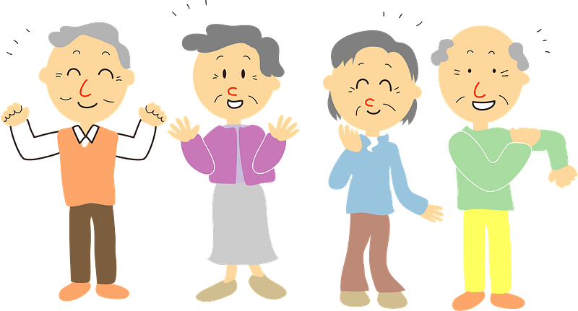
Family Activities
Help is available at https://tinyurl.com/y6f72ks6
The clues and words are from our Bible Study.
I love crosswords.
I hope there’s hints.

Slide 21
Jesus Met My Greatest Need
March 5

