Slide 1
Jesus Matters
February 1

Slide 2

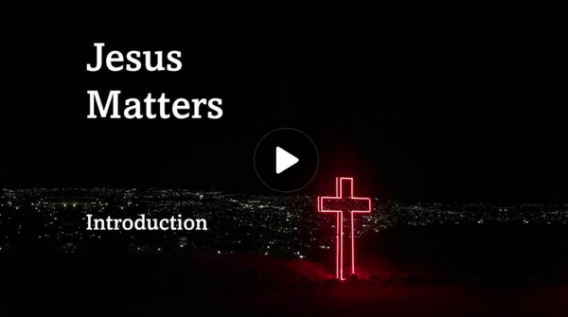
Video Introduction
View Video

Slide 3
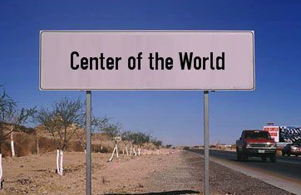



Where is your sign?
Consider a road sign that
reads, “Center of the
World.” If you were to
erect a sign with this
title based on your life,
where would it be? Why?

Slide 4
Where is your sign?
Consider a road sign that
reads, “Center of the
World.” If you were to
erect a sign with this
title based on your life,
where would it be? Why?

Slide 5
Your Sign?
Might be where you spend all your time!
Today we look at where Christ should be in relation to the center of our lives … in relation to our life’s “city limits.”
  Know this: Jesus matters!
  Is he inside or outside?
  Is he at the center or on the periphery

Slide 6

Listen for a description of Christ.
Colossians 1:15-17 (NIV) He is the image of the invisible God, the firstborn over all creation. 16 For by him all things were created: things in heaven and on earth, visible and invisible, whether thrones or powers or rulers or authorities; all things were created by him and for him. 17 He is before all things, and in him all things hold together.

Slide 7
Jesus: Creator of All Things
Some Bible scholars think these verses represent words of an early Christian hymn. Why do you think Paul used a song to express these truths about Jesus?
What is Christ’s relationship to God?
He is the image of the invisible God, the firstborn over all creation. For by him all things were created: … all things were created by him and for him.

Slide 8
Jesus: Creator of All Things
How is Jesus the “image of the invisible God”?
What is Christ’s relationship to Creation?
For by him all things were created: things in heaven and on earth, visible and invisible, whether thrones or powers or rulers or authorities; all things were created by him and for him. He is before all things, and in him all things hold together.

Slide 9
Jesus: Creator of All Things
How do "all things . . . hold together" under Christ?
For by him all things were created: things in heaven and on earth, visible and invisible, whether thrones or powers or rulers or authorities; all things were created by him and for him. He is before all things, and in him all things hold together.

Slide 10
Jesus: Creator of All Things
What elements of God’s creation can impact your life this week?
How do your beliefs about Jesus – who He is/was – affect your daily life?

Slide 11
Listen for what Jesus is and does.
Colossians 1:18-20 (NIV) And he is the head of the body, the church; he is the beginning and the firstborn from among the dead, so that in everything he might have the supremacy. 19 For God was

Slide 12
Listen for what Jesus is and does.
pleased to have all his fullness dwell in him, 20 and through him to reconcile to himself all things, whether things on earth or things in heaven, by making peace through his blood, shed on the cross.

Slide 13
Jesus: Ruler over All Things
What does it mean for Christ to be the head of the church rather than just an important member?
Paul says Jesus is “the beginning” and “the firstborn from the dead.”
  “Firstborn” does not mean He is a created being.
So, how do these phrases establish His authority over life, death, and history itself?

Slide 14
Jesus: Ruler over All Things
Paul repeats the word “all” multiple times in this passage.
  “For God was pleased to have all his fullness dwell in him, and through him to reconcile to himself all things,”
Why do you think Paul is being so emphatic here?

Slide 15
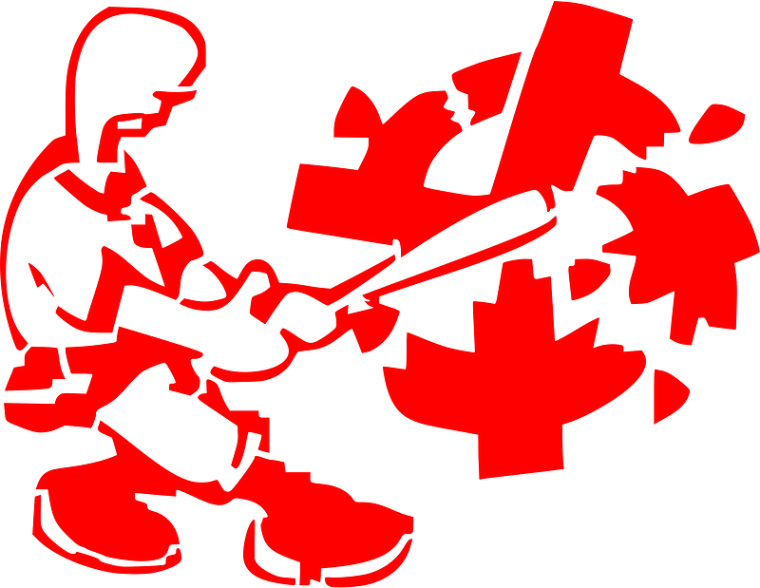
Jesus: Ruler over All Things
In moments when the world feels chaotic or unjust, how does knowing that Jesus reigns now bring peace or confidence in the coming week?

Slide 16
Listen for a change in status.
Colossians 1:21-23 (NIV) Once you were alienated from God and were enemies in your minds because of your evil behavior. 22 But now he has reconciled you by Christ's physical body through death to present you holy in his sight, without blemish and free from accusation--

Slide 17
Listen for a change in status.
if you continue in your faith, established and firm, not moved from the hope held out in the gospel. This is the gospel that you heard and that has been proclaimed to every creature under heaven, and of which I, Paul, have become a servant.

Slide 18
Jesus: Reconciler of All Things
According to Colossians 1:21, what does it mean to be alienated from God and enemies in your mind because of your evil behavior?
Once you were alienated from God and were enemies in your minds because of your evil behavior.

Slide 19
Jesus: Reconciler of All Things
How does Colossians 1:22 describe the reconciliation between believers and God through Christ's death?
But now he has reconciled you by Christ's physical body through death to present you holy in his sight, without blemish and free from accusation

Slide 20

Jesus: Reconciler of All Things
How does Paul's emphasis on the gospel's proclamation to all creation challenge us in our evangelism and outreach efforts?

Slide 21
Jesus: Reconciler of All Things
In what ways does the concept of hope play a role in the Christian faith, particularly as outlined in Colossians 1:23?
if you continue in your faith, established and firm, not moved from the hope held out in the gospel. This is the gospel that you heard and that has been proclaimed to every creature under heaven, and of which I, Paul, have become a servant.

Slide 22
Application
Observe.
  What do you notice about how Jesus made the stars, the trees, the flowers, and people?
  Take time to look around at all Jesus has created and be thankful. Be specific.
  What are you grateful for, and why? Thank God specifically.

Slide 23
Application
List.
  Make a list of any areas of your life that you have not surrendered to Him.
  We often become so used to being the boss of our lives.
  Beware that we forget He is to be the Ruler over everything in them.

Slide 24
Application
Share.
  Hopefully you’ve experienced the reconciliation and salvation Jesus provided through His death.
  If so, you know how life-changing that has been.
  Make it a priority this week to help someone else reconcile with God

Slide 25
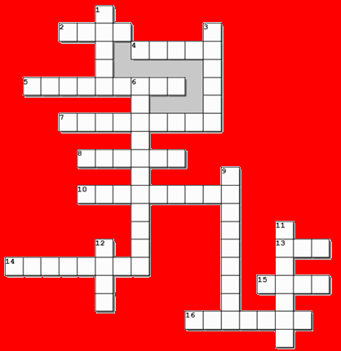
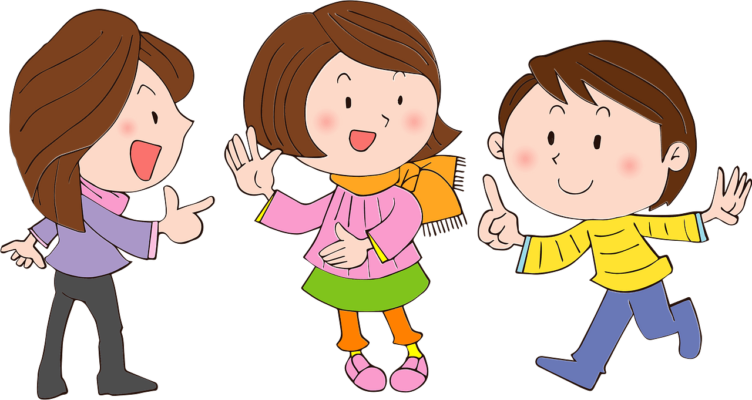
Family Activities
Guess what … the Crossword is back!
Yes, and the words and clues are from our Bible study!

Slide 26
Jesus Matters
February 1

