Slide 1
Jesus Gave Me Grace and Forgiveness
March 19

Slide 2
Video Introduction
View Video

Slide 3
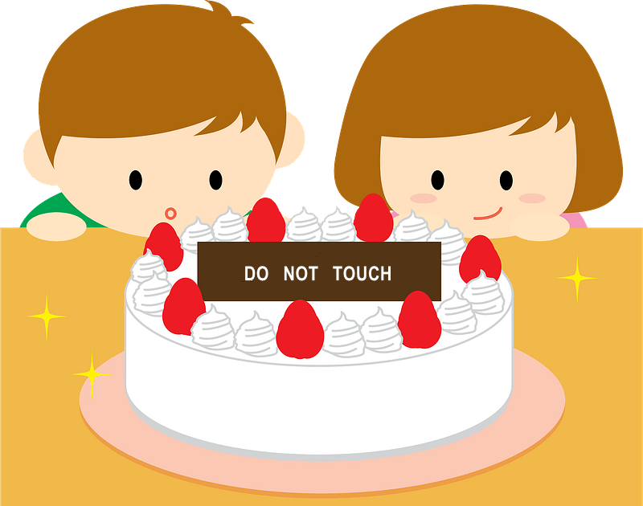
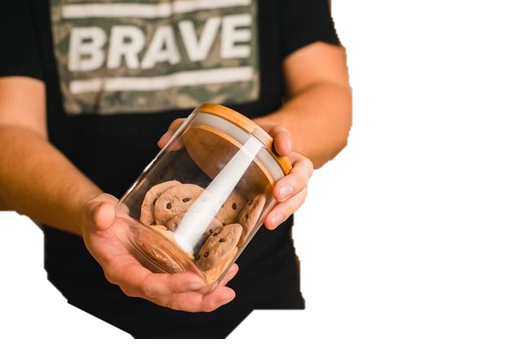
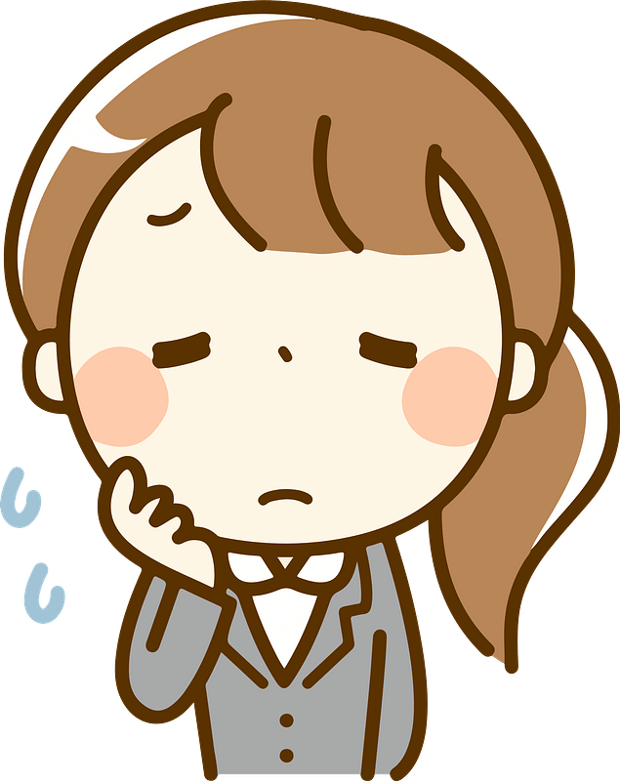
Admit it, now …
What was the funniest time you were caught “red-handed”?
With God we will always be found out
We deserve punishment. But God forgives!
Jesus takes our guilt and sets us free.

Slide 4
Listen for a trap.
John 8:2-6a (NIV) At dawn he appeared again in the temple courts, where all the people gathered around him, and he sat down to teach them. 3 The teachers of the law and the Pharisees brought in a woman caught in adultery. They made her stand

Slide 5
Listen for a trap.
before the group 4 and said to Jesus, "Teacher, this woman was caught in the act of adultery. 5 In the Law Moses commanded us to stone such women. Now what do you say?" 6 They were using this question as a trap, in order to have a basis for accusing him.

Slide 6
Break the Law, Pay the Penalty
What did Jesus sit down to do in the temple courts?
Whom did the scribes and Pharisees bring before Jesus?

Slide 7
Break the Law, Pay the Penalty
Note how this was a trap.
If Jesus said “stone her” it would be a violation of Roman law
Only Roman courts could sentence to capital punishment
If He said “let her go” he would be condoning adultery, seen as soft on sin
They wanted to put Jesus in a “lose-lose” situation

Slide 8
Break the Law, Pay the Penalty
Who is missing in this scene? What is suggested by this person’s absence?
Which sins do we tend to categorize as “big” sins (those that are worse than all others)?
Which sins do you think God classifies as “big” sins?

Slide 9
Break the Law, Pay the Penalty
With that in mind, in what way are each of us in the same situation as the woman in the story?
Why do we tend to hope some people will be caught in their sin?
Why is it necessary for sin to be punished?
How should we treat people who have sinned?

Slide 10
Listen for how Jesus responds.
John 8:6b -9 (NIV) But Jesus bent down and started to write on the ground with his finger. 7 When they kept on questioning him, he straightened up and said to them, "If any one of you is without sin, let him be the first

Slide 11
Listen for how Jesus responds.
to throw a stone at her." 8 Again he stooped down and wrote on the ground. 9 At this, those who heard began to go away one at a time, the older ones first, until only Jesus was left, with the woman still standing there.

Slide 12
Jesus Intervenes on Our Behalf
What unusual actions did Jesus take in response to those confronting Him?
The men walked away from the confrontation, one by one – why do you think they gave up in their accusations?
They are said to have left oldest to youngest. What do you think was the significance of this sequence?

Slide 13
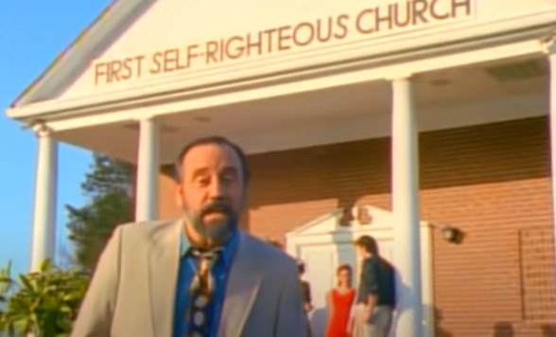
Jesus Intervenes on Our Behalf
Why is it sometimes easier to see others’ sins more than our own?
About what do we tend to be self-righteous?
Look up Ray Stevens song about the “Mississippi Squirrel Revival” at the “First Self Righteous Church”

Slide 14
Listen for Jesus’ response to the woman.
John 8:10-11 (NIV) Jesus straightened up and asked her, "Woman, where are they? Has no one condemned you?" 11 "No one, sir," she said. "Then neither do I condemn you," Jesus declared. "Go now and leave your life of sin."

Slide 15
Jesus Shows Grace and Forgiveness
What are Jesus’ comments to the lady after they are gone?
Why might she have felt a sense of relief on the one hand but of concern on the other?
Relief | Concern

Slide 16
Jesus Shows Grace and Forgiveness
What was the heart of Jesus’ message for the woman?
What opportunities do we have to extend God’s grace instead of condemnation?

Slide 17
Jesus Shows Grace and Forgiveness
Consider the relationship between forgiveness and right living?
We are not forgiven so we can keep on sinning
We are forgiven to be set free from both sin’s penalty and sin’s power over us
We are offered the strength to live a life free from sin through the power of the Holy Spirit within us

Slide 18
Application
Confess sin.
What are some ways sin has reared its ugly head in your life?
Take a moment and think about the consequences of that sin.
Confess it to Christ. “If we confess our sins, he is faithful and righteous to forgive us our sins and to cleanse us from all unrighteousness” (1 John 1:9).

Slide 19
Application
Write a prayer.
Most of us speak our prayers, but writing prayers can be a powerful exercise.
Write a prayer of thanksgiving to God for saving you from your sin. Mention His mercy and grace.
Ask Him to help you show grace to others even as He has shown grace to you.

Slide 20
Application
Extend grace.
Rarely a week goes by without a situation that causes us to get flustered.
Someone cuts you off in traffic, or a customer service representative pushes your last button.
Prepare yourself now to extend grace.
When you extend grace to others, you reflect Christ to those around you.

Slide 21
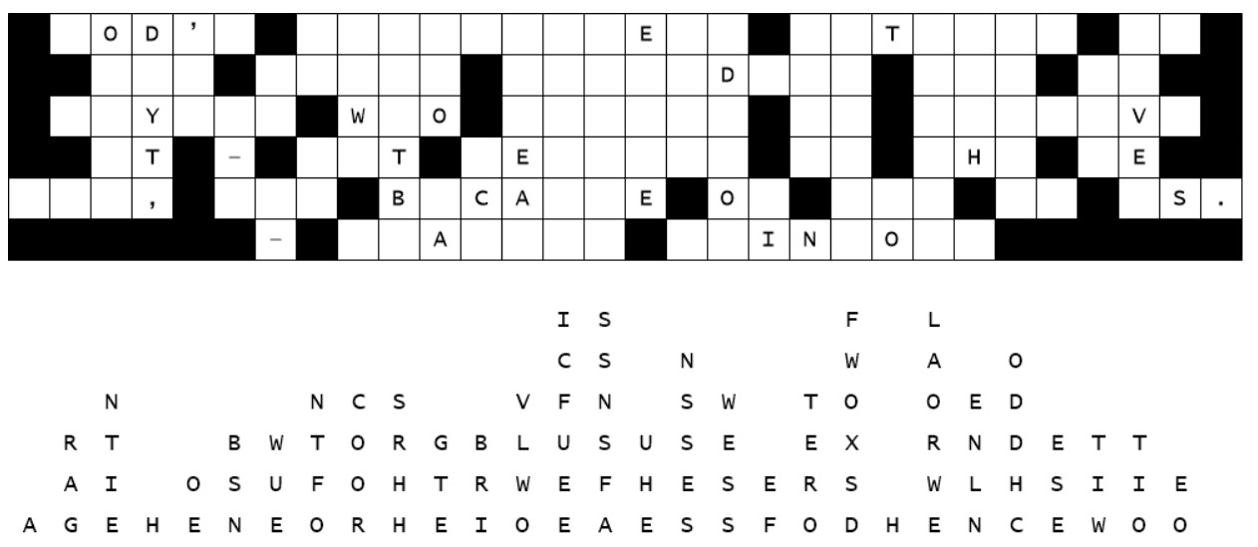
Family Activities
We have a 10-47, letters down. We need civilian assistance. Access technical support at https://tinyurl.com/2p8kac59 Further Family Activities also available at that site.

Slide 22
Jesus Gave Me Grace and Forgiveness
March 19

