Slide 1
Jesus Displayed
February 15

Slide 2

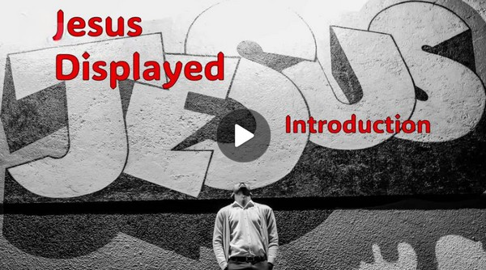
Video Introduction
View Video

Slide 3



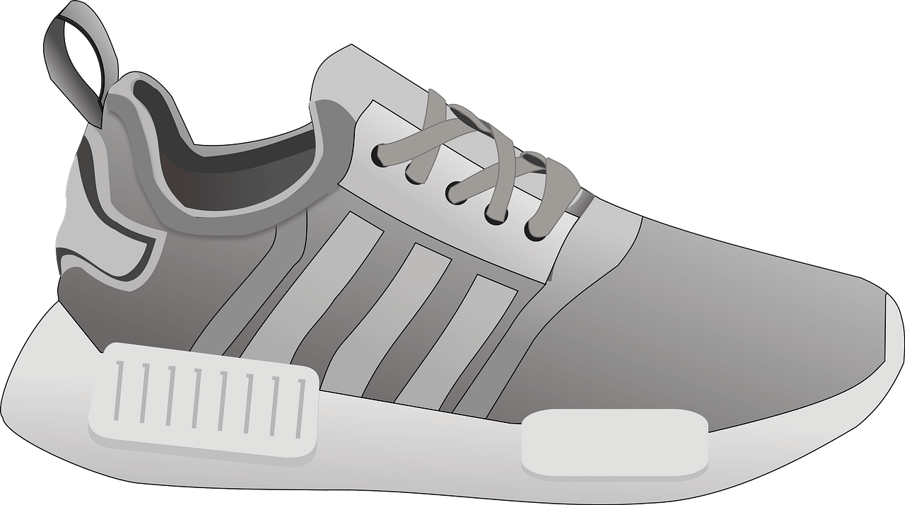
What would you say?
Finish the sentence: “Walk a mile in someone else’s shows, then …”
We can better share the gospel when we step into the shoes of others.
Today we look at Paul’s description of how he adapted to minister to different groups of people

Slide 4
Listen for Paul’s motivation.
1 Corinthians 9:16-18 (NIV) Yet when I preach the gospel, I cannot boast, for I am compelled to preach. Woe to me if I do not preach the gospel! 17 If I preach voluntarily, I have a reward; if not

Slide 5
Listen for Paul’s motivation.
voluntarily, I am simply discharging the trust committed to me. 18 What then is my reward? Just this: that in preaching the gospel I may offer it free of charge, and so not make use of my rights in preaching it.

Slide 6
Commissioned and Compliant
What words or phrases does Paul write that speak of his motivation to preach or not preach the Gospel? Why must he do it?
What two things does he say about preaching and being rewarded?
What does he say about the reward?

Slide 7
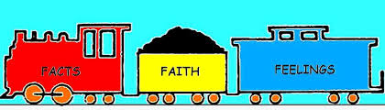
Commissioned and Compliant
Paul didn’t obey God merely because he had to—he found joy and reward in obedience. What helps move obedience from duty to desire?
How can obedience still be genuine when we don’t feel enthusiastic about what God is asking?

Slide 8

Commissioned and Compliant
At the same time, what is the danger of serving God outwardly while resisting Him inwardly?

Slide 9
Commissioned and Compliant
Our study today is speaking to the calling all believers have been given to be involved
In the communication of the Gospel locally, regionally, and around the world.
Why do you think believers sometimes view sharing Christ as an option instead of a command?

Slide 10
Listen for to whom Paul ministered.
1 Corinthians 9:19-23 (NIV) Though I am free and belong to no man, I make myself a slave to everyone, to win as many as possible. 20 To the Jews I became like a Jew, to win the Jews. To those under the law I became like one under the law (though I myself am not under the law), so as to win those under the law. 21 To those not having the

Slide 11
Listen for to whom Paul ministered.
law I became like one not having the law (though I am not free from God's law but am under Christ's law), so as to win those not having the law. 22 To the weak I became weak, to win the weak. I have become all things to all men so that by all possible means I might save some. 23 I do all this for the sake of the gospel, that I may share in its blessings.

Slide 12
Identify and Adapt
How did Paul make adjustments to increase his effectiveness in sharing the gospel?
Why did he do so?
How might Paul act in order to have opportunity to minister to Jews?
How might Paul act in order to have opportunity to minister to Gentiles?

Slide 13
Identify and Adapt
What is the difference between relating to those around you and compromising God’s values?
Relating | Compromising

Slide 14
Listen for sports analogies.
1 Corinthians 9:24-27 (NIV) Do you not know that in a race all the runners run, but only one gets the prize? Run in such a way as to get the prize. 25 Everyone who competes in the games goes into strict training. They do it to get a crown that will not last; but we do it to get a

Slide 15
Listen for sports analogies.
crown that will last forever. 26 Therefore I do not run like a man running aimlessly; I do not fight like a man beating the air. 27 No, I beat my body and make it my slave so that after I have preached to others, I myself will not be disqualified for the prize.

Slide 16
Discipled and Diligent
What does faithful living require of the believer?
What is the promise given to those who live by disciplined faith?
Where are some areas in our lives where we might realize the need for discipline and self-control in your life?

Slide 17
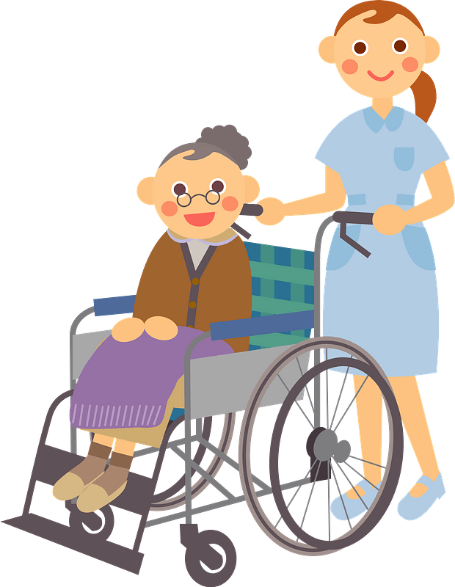
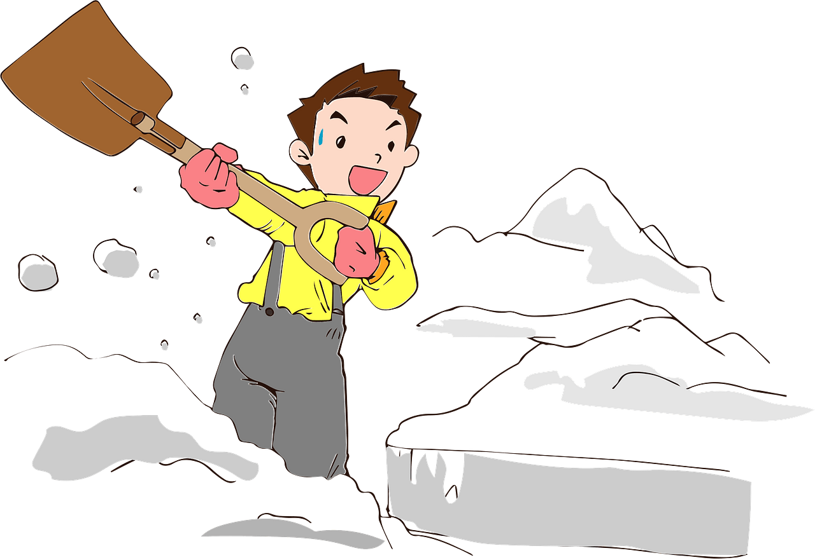

Discipled and Diligent
How could our church make adaptations so we can “step into the shoes of others” to gain a greater hearing of the gospel?

Slide 18
Application
Pray.
If you’re afraid, ask Jesus to take away your fear so that you can tell others about Him.

Slide 19
Application
Learn.
One way you might overcome the fear of witnessing is to learn how to do so effectively by asking someone who is consistent and confident.
Ask them to show you how to share the gospel confidently and effectively.
Learn the 15 second testimony method. https://tinyurl.com/5emdvbns

Slide 20
Application
Share.
When you see an opportunity, take the leap and share the life-changing truth of the gospel.
Discipline your heart and mind to look for and respond to those divine opportunities to share Jesus with others.

Slide 21


Family Activity
You can do this, mes amis. It is, how you say, just the exercise of the little gray cells. This is a message of the highest importance !

Slide 22
Jesus Displayed
February 15

