Slide 1
Jesus Died for Me
April 2

Slide 2


Video Introduction
View Video

Slide 3

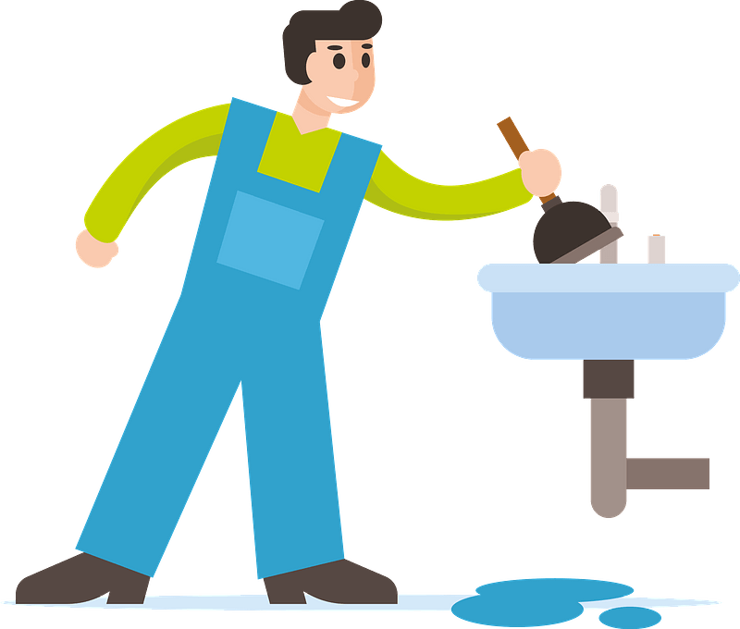
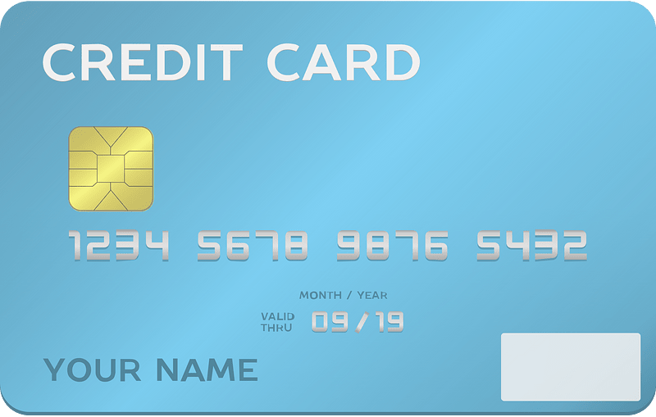


Remember that time?
When have you been frustrated by your inability to fix something?
Some things we just cannot fix on our own.
  A broken relationship with God is certainly one of those things.
  Forgiveness is possible only because Jesus died for our sins.

Slide 4
Listen for what would disturb Jewish Leaders.
John 19:16-19 (NIV) Finally Pilate handed him over to them to be crucified. So the soldiers took charge of Jesus. 17 Carrying his own cross, he went out to the place of the Skull (which in Aramaic is called Golgotha).

Slide 5
Listen for what would disturb Jewish Leaders.
Here they crucified him, and with him two others--one on each side and Jesus in the middle. 19 Pilate had a notice prepared and fastened to the cross. It read: JESUS OF NAZARETH, THE KING OF THE JEWS.

Slide 6
Innocent Yet Crucified
Pilate delivered Jesus up to be crucified. Note what transpired previous to his doing so.
  Pilate had interviewed Jesus, found Him innocent
  Suggested they release a prisoner (Jesus) as was done each year at this time.
  They said, “No, release Barabbas” (leader of an insurrection that ended in a death).
  Told the religious leaders he would rather release innocent Jesus.
  They threatened to riot if he didn’t crucify Jesus.
  Pilate handed Jesus over to the soldiers for execution.

Slide 7
Innocent Yet Crucified
What symbolism do you see in that Jesus, innocent though He was, was crucified with others whom we learn in other Gospel writings were known criminals?
Pilate placed a sign above Jesus that said “JESUS OF NAZARETH, THE KING OF THE JEWS” Why do you think Pilate was probably not sincere in the title he gave Jesus?

Slide 8
Innocent Yet Crucified
Actually, Jesus wants to be King of your life. Who or what are the "kings" that people worship today? What person or thing often competes with God for rule of one’s life?
What reaction have you experienced to a dramatic production that depicted the crucifixion of Jesus?
What emotions do you experience when you read about Jesus’s crucifixion?

Slide 9
Listen for the last moments of Jesus death.
John 19:28-30 (NIV) Later, knowing that all was now completed, and so that the Scripture would be fulfilled, Jesus said, "I am thirsty." 29 A jar of wine vinegar was there, so they soaked a sponge in it, put the sponge on a stalk of

Slide 10
Listen for the last moments of Jesus death.
the hyssop plant, and lifted it to Jesus' lips. 30 When he had received the drink, Jesus said, "It is finished." With that, he bowed his head and gave up his spirit.

Slide 11
The Cross Completed Jesus’ Task
Jesus received something to drink at this point but had refused earlier.
  Previously offered wine had a drug in it – would dull the pain
  He refused it, chose to forego full punishment of the pain He would experience in our place
  This wine was basically hydration He desired
  Could be to moisten His lips, mouth, throat so He could make a last statement, “It is finished”

Slide 12
The Cross Completed Jesus’ Task
Jesus’ final words were, “It is finished”. What is its significance, even to us?
Why is the crucifixion of Jesus an essential element of the gospel?
How have you been impacted by the death of Jesus?

Slide 13

The Cross Completed Jesus’ Task
How would you describe the importance of the cross to someone who needed to hear it?

Slide 14
Listen for how Jesus was buried after his death on the cross.
John 19:38-42 (NIV) Later, Joseph of Arimathea asked Pilate for the body of Jesus. Now Joseph was a disciple of Jesus, but secretly because he feared the Jews. With Pilate's permission, he came and took the body away. 39 He was accompanied by Nicodemus, the man who earlier had visited Jesus at night.

Slide 15
Listen for how Jesus was buried after his death on the cross.
Nicodemus brought a mixture of myrrh and aloes, about seventy-five pounds. 40 Taking Jesus' body, the two of them wrapped it, with the spices, in strips of linen. This was in accordance with Jewish burial customs. 41 At the place

Slide 16
Listen for how Jesus was buried after his death on the cross.
where Jesus was crucified, there was a garden, and in the garden a new tomb, in which no one had ever been laid. 42 Because it was the Jewish day of Preparation and since the tomb was nearby, they laid Jesus there.

Slide 17
No Hoax … Jesus Died, Was Buried.
Who were the men who buried Jesus and what were some things they had in common?
Note: they were pressed for time in completing Jesus’s burial.
  Jesus body taken down at 3:00
  Needed to avoid all “work” by 6:00
  This was the beginning of the sabbath, the “day of preparation”

Slide 18
No Hoax … Jesus Died, Was Buried.
How does the involvement of Nicodemus and Joseph of Arimathea give credibility to the death of Jesus? What do the actions of these men affirm about the state of Jesus?
Joseph of Arimathea and Nicodemus now demonstrated their loyalty and faith in who Jesus was. Why do some Christians wait so long to go public with their relationship with Jesus?

Slide 19
No Hoax … Jesus Died, Was Buried.
How have you benefitted from someone’s testimony about Jesus?
Be challenged to tell your story of faith in Christ
  Be reminded of how to give a 15 second testimony https://youtu.be/TOjV3B8vEJo

Slide 20
Application
A word of thanks.
  Consider all Jesus has done for you. He left heaven for you, lived the sinless life that you could not live, and died on a cross for your sin.
  Take a moment to thank Jesus for His sacrifice.
  If you are not a believer, confess your sin, repent, and ask Jesus to transform your life through faith.

Slide 21
Application
A word of comfort.
  If you know someone in your church or community who has recently lost a loved one, write the person a letter.
  Be ready to offer encouragement, comfort, and support as needed.

Slide 22
Application
A word of forgiveness.
  Jesus died to forgive you of your sin.
  Is there anyone you need to forgive?
  Ask God to reveal any grudges or unforgiveness in your heart.
  Ask Him to help you forgive that person.

Slide 23
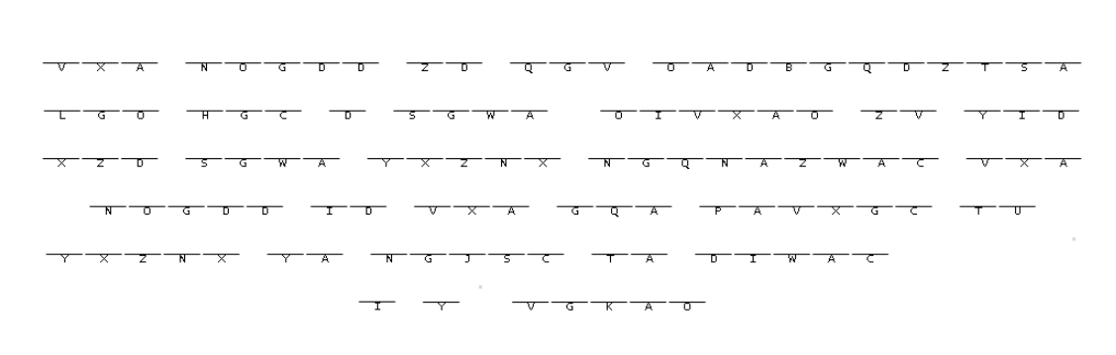
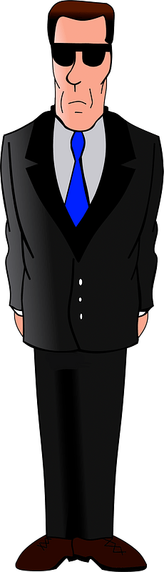

Family Activities
This message was smuggled into our embassy in Sintsland Hrainmais. You have the key in your Bible Study handout. We need your help to decode it. Technical assistance and additional uplifting activities are available at https://tinyurl.com/3j7xytrd

Slide 24
Jesus Died for Me
April 2

