Slide 1
Is Jesus the Only Way to God?
November 5

Slide 2
Video Introduction
View Video

Slide 3
What do you think?
When have you wished you had a different option than what was available?
When it comes to spiritual options, we do have the right choice available.
Because Jesus is the Son of God, He is the only one who can bring us to God.

Slide 4
Listen for showing love for God.
1 John 5:1-5 (NIV) Everyone who believes that Jesus is the Christ is born of God, and everyone who loves the father loves his child as well. 2 This is how we know that we love the children of God: by loving God and carrying out his commands. 3 This is love for God: to obey his commands.

Slide 5
Listen for showing love for God.
And his commands are not burdensome, 4 for everyone born of God overcomes the world. This is the victory that has overcome the world, even our faith. 5 Who is it that overcomes the world? Only he who believes that Jesus is the Son of God.

Slide 6
God’s Child by Believing in Jesus
What does it mean to be born of God?
What is the relationship of being born of God, believing in Jesus as the Christ, loving others, and loving God?
How do believers demonstrate their love for God?
Verse 3 says loving God will be displayed by obedience of God’s commands. What are some commands of God with which you struggle to obey?

Slide 7
God’s Child by Believing in Jesus
How then can John say that God’s commands are not burdensome?
What makes a person willing to give to or to love sacrificially the people they know?
What makes a person willing to love sacrificially someone you don’t know personally?

Slide 8
Listen for testimony about Jesus.
1 John 5:6-10 (NIV) This is the one who came by water and blood--Jesus Christ. He did not come by water only, but by water and blood. And it is the Spirit who testifies, because the Spirit is the truth. 7 For there are three that testify: 8 the Spirit, the water and the blood; and the three are in agreement. 9 We accept man's testimony, but

Slide 9
Listen for testimony about Jesus.
God's testimony is greater because it is the testimony of God, which he has given about his Son. 10 Anyone who believes in the Son of God has this testimony in his heart. Anyone who does not believe God has made him out to be a liar, because he has not believed the testimony God has given about his Son.

Slide 10
God Testifies, Jesus Is His Son
What do you think John meant in v.6 when he said Jesus came "by water and blood?“
If we believe human witnesses, what does that say about how we are to respond to God’s testimony?
If we reject the witness of God, what are we saying about Him?

Slide 11
God Testifies, Jesus Is His Son
How does a person become convinced that Jesus is the Son of God?
What three things are in agreement?
How does each testify to Truth?

Slide 12
Listen for how to be sure of eternal life.
1 John 5:11-13 (NIV) And this is the testimony: God has given us eternal life, and this life is in his Son. 12 He who has the Son has life; he who does not have the Son of God does not have life. 13 I write these things to you who believe in the name of the Son of God so that you may know that you have eternal life.

Slide 13
Eternal Life Only through Jesus
Consider what it means to believe on the Name of the Son of God.
People’s names in many cultures carry meaning
They express the traits parents might hope for this new life
Jesus (Greek version of Joshua) means “God delivers”
Names also carry authority – our signature on a check or credit card charge
Belief in the name of Jesus, means we claim the offer of salvation on the authority of who Jesus is – the Son of God, Himself

Slide 14
Eternal Life Only through Jesus
How would describe the life one has through Jesus?
How does this life contrast with the life a non-believer has?
We often limit our concept of “eternal life” as being life after death or after Jesus returns. How does having eternal life affect your life now?

Slide 15
Application
Trust.
Trust God for the miracle of a changed life.
If you want to know how to become a follower of Christ, talk with your group leader.
You can also read the inside front cover of this book.

Slide 16
Application
Identify.
Identify exclusive beliefs: Do a study of the beliefs of Naturalism, Animism, Pantheism, and Non-Christian Theism.
As you study, make a chart that identifies specifically at what points their beliefs are exclusive.

Slide 17
Application
Defend.
If you know someone who complains about the exclusive nature of Christianity, discover what faith system they believe.
Engage the person in a discussion about the exclusivity of his or her beliefs, then compare that with the exclusive claims of Christianity.

Slide 18
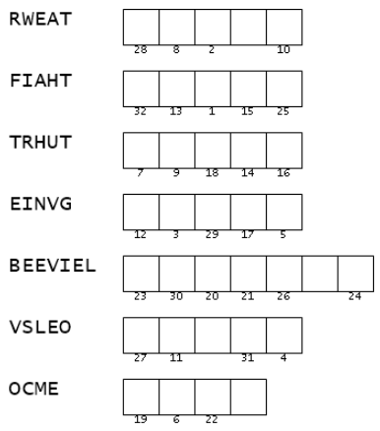
Family Activities
Can you help BB8? The words made by these scrambled letters are in your Bible passage for today. Is “WRATE” a word? For technical background, go to https://tinyurl.com/d8vvp3np You can find other Family Activities there also.

Slide 19
Is Jesus the Only Way to God?
November 5

