Slide 1
Is Jesus God?
December 22

Slide 2
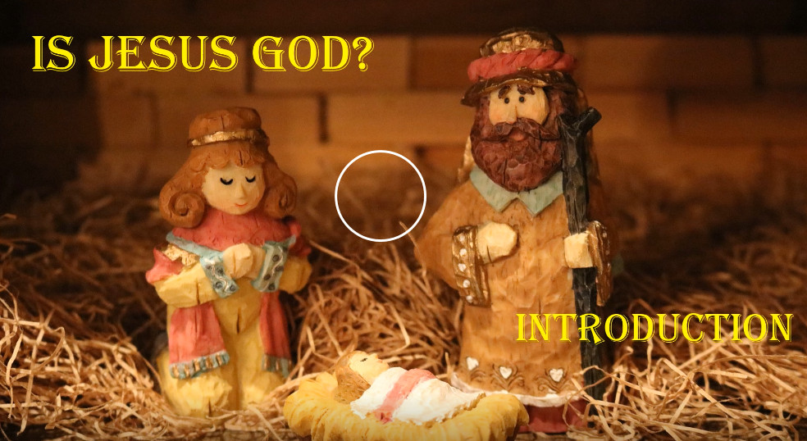
View Video

Slide 3

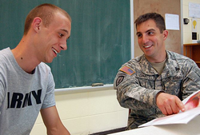
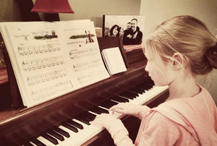
Remember when …
What’s a decision you’re glad you made as a teenager or young adult?”
Consider the decision Mary was confronted with.
  She chose to follow God’s will, surprising as it was
  This Bible study considers the world changing life of the Baby she bore.
  Everything about Jesus’ birth points to His divinity.

Slide 4
Listen for an emotional response.
Luke 1:26-29 (NIV) In the sixth month, God sent the angel Gabriel to Nazareth, a town in Galilee, 27 to a virgin pledged to be married to a man named Joseph, a descendant of David. The virgin's name was Mary. 28 The angel went

Slide 5
Listen for an emotional response.
to her and said, "Greetings, you who are highly favored! The Lord is with you." 29 Mary was greatly troubled at his words and wondered what kind of greeting this might be.

Slide 6
The Virgin Birth
Let’s list the who, when, where, etc. that are covered in a news story.
What does it mean to be “espoused” or “pledged”?

Slide 7
The Virgin Birth
Why is that an important detail of the narrative?
Why was Mary troubled?
On what grounds did Gabriel urge Mary not to be afraid?

Slide 8
The Virgin Birth
Since Luke did not cite any Old Testament reference to a virgin birth, what might have been the significance of Luke’s identifying Mary as a virgin?
Since Jesus existed before time, why is it significant that He come as a baby?

Slide 9
Listen for titles given.
Luke 1:30-33 (NIV) But the angel said to her, "Do not be afraid, Mary, you have found favor with God. 31 You will be with child and give birth to a son, and you are to give him the name Jesus. 32 He will be great and will be called the

Slide 10
Listen for titles given.
Son of the Most High. The Lord God will give him the throne of his father David, 33 and he will reign over the house of Jacob forever; his kingdom will never end."

Slide 11
Born a Human, Eternally a King
Now in these verses, on what grounds did Gabriel urge Mary not to be afraid?
What description to we see here about the child Mary would bear?

Slide 12
Born a Human, Eternally a King
What is the significance of the names and titles given to this child?
Name | Significance
Jesus
Son of the Most High
Given throne of David
Kingdom included the House of Jacob

Slide 13
Born a Human, Eternally a King
Note that the “Kingdom of God” is the realm where God rules. Therefore, in what way is Jesus to be King today?
How is this kingdom different from other kingdoms?
How do believers, this kingdom’s subjects, know what the King wants of them? There are few apparent angel appearances today.

Slide 14
Listen for evidence of divinity.
Luke 1:34-35 (NIV) "How will this be," Mary asked the angel, "since I am a virgin?" 35 The angel answered, "The Holy Spirit will come upon you, and the power of the Most High will overshadow you. So the holy one to be born will be called the Son of God.

Slide 15
Son of God, Divinity
Why was Mary puzzled by Gabriel’s announcement?
What was the essence of her question to the angel?
How did Gabriel explain her conception?
How would you explain the virgin birth to someone who finds it hard to believe?

Slide 16
Son of God, Divinity
What difference does it make whether or not a person believes that the child born to Mary was really God and not just a man?
How can we help our families have a Christ-centered Christmas this year?

Slide 17
Application
Trust.
  God can work a miracle and change your life so trust Him.
  If you want to know how to become a follower of Christ, talk with your group leader.
  You can also read the inside front cover of this book.

Slide 18
Application
Pray.
  Ask the Lord to increase your faith.
  Trust Him with what you know from His Word.

Slide 19
Application
Defend.
  If you have a friend who sees Jesus simply as a good man or a good teacher, share with him or her the reality of the virgin birth of Christ.
  Pray that eyes would be opened to the impact that trust can have on one’s life as you defend the truth.

Slide 20
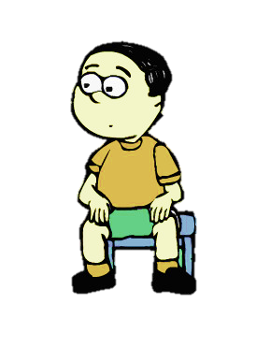


Family Activities
Whoa ! A Fallen Phrases Puzzle … You’ve got some work to do. There’s other cool stuff too at https://tinyurl.com/t6694wx , including an online jigsaw puzzle.

Slide 21
Is Jesus God?
December 22

