Slide 1
Is Hell Real?
November 19

Slide 2
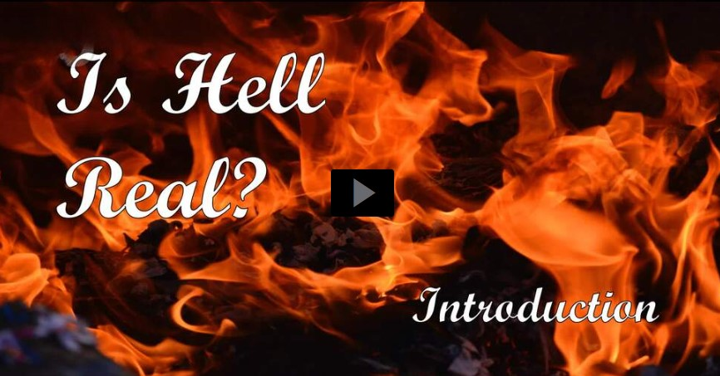
Video Introduction
View Video

Slide 3
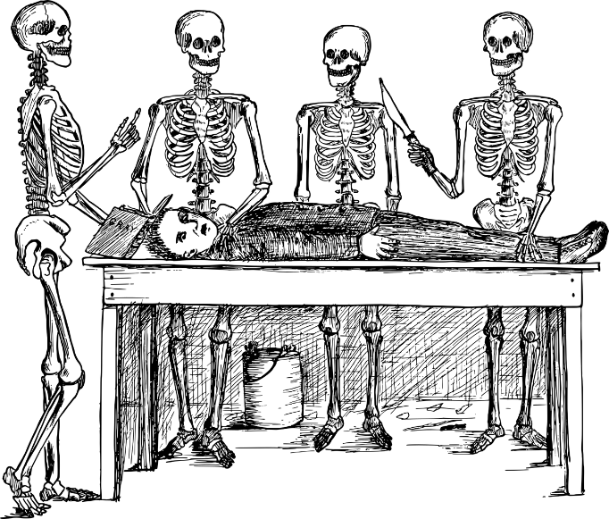
Be careful, now …
What are some topics you refer not to talk about around the dinner table?
Hell is often an uncomfortable topic.
But it is real; eternal punishment awaits those who do not follow Christ.
And we can let people know they don’t have to go there.

Slide 4
Listen for Paul’s boast.
2 Thessalonians 1:3-7a (NIV) We ought always to thank God for you, brothers, and rightly so, because your faith is growing more and more, and the love every one of you has for each other is increasing. 4 Therefore, among God's churches we boast about your perseverance and faith in all the persecutions and trials you

Slide 5
Listen for Paul’s boast.
are enduring. 5 All this is evidence that God's judgment is right, and as a result you will be counted worthy of the kingdom of God, for which you are suffering. 6 God is just: He will pay back trouble to those who trouble you 7 and give relief to you who are troubled, and to us as well.

Slide 6
God Watches over Believers
Why did Paul express thanks to God for the Thessalonian brothers and sisters?
One of the translations says their faith was “flourishing.” What examples does Paul give that described how their faith was flourishing?
What can we do to keep our faith growing and flourishing?

Slide 7
God Watches over Believers
What are the characteristics of perseverance and faith amid persecution?
How will such “flourishing faith” work to increase our love for others?

Slide 8
God Watches over Believers
Paul declared that their patience was proving …
God’s judgment is right, just
They were worthy of the kingdom/rule of God
Their suffering was worth it

Slide 9
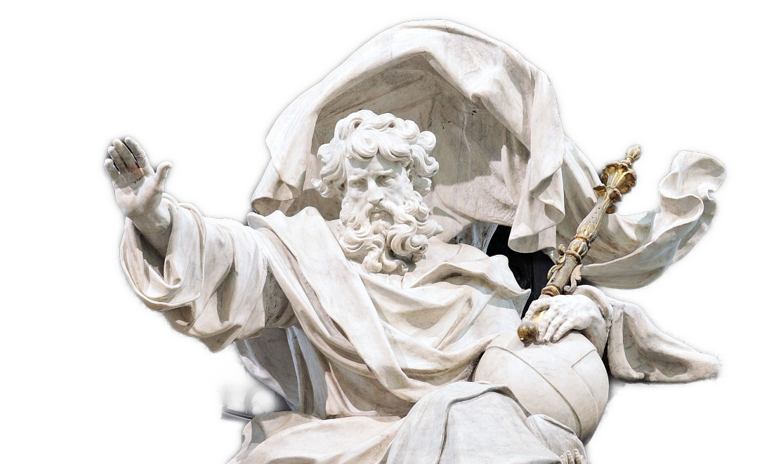
God Watches over Believers
What would be the Lord’s response to unbelievers who opposed the gospel, Christ, and His people?

Slide 10
Listen for eternal consequences.
2 Thessalonians 1:7b-10 (NIV) This will happen when the Lord Jesus is revealed from heaven in blazing fire with his powerful angels. 8 He will punish those who do not know God and do not obey the gospel of our Lord Jesus. 9 They will be punished with everlasting destruction and

Slide 11
Listen for eternal consequences.
shut out from the presence of the Lord and from the majesty of his power on the day he comes to be glorified in his holy people and to be marveled at among all those who have believed. This includes you, because you believed our testimony to you.

Slide 12
Unbelievers Face Eternal Destruction
What three phrases did he use to describe the Lord’s revelation?
Upon whom will He exact vengeance and why?
Note what unbelievers be denied that will make the punishment so severe.
Shut out from the presence of the Lord
Separated from the majesty of His power

Slide 13
Unbelievers Face Eternal Destruction
How does Paul’s description of eternal punishment compare to our typical ideas about what hell is like?
Our Ideas of Eternal Punishment | Paul’s Description of Eternal Punishment

Slide 14
Unbelievers Face Eternal Destruction
What is your initial reaction to the penalty of eternal destruction, eternal separation from God?
In verses 6-7, the text speaks of God's righteous judgment. How can we reconcile the idea of God's judgment with His love and mercy?

Slide 15
Listen for Paul’s prayer request.
2 Thessalonians 1:11-12 (NIV) With this in mind, we constantly pray for you, that our God may count you worthy of his calling, and that by his power he may fulfill every

Slide 16
Listen for Paul’s prayer request.
good purpose of yours and every act prompted by your faith. 12 We pray this so that the name of our Lord Jesus may be glorified in you, and you in him, according to the grace of our God and the Lord Jesus Christ.

Slide 17
Called and Equipped
For what did Paul pray on behalf of the Thessalonian believers?
What is the relationship between believing the gospel and living godly lives?

Slide 18
Called and Equipped
According to Paul, what is to be the desired outcome of faithful Christian living?
What can we learn from this prayer about the importance of spiritual growth and the role of faith in our lives? How can we apply these principles in our own walk with God?

Slide 19
Application
Trust.
Are you sure where you will spend eternity?
If not, you can settle that by faith in Christ, Trust Him to save you.
You can receive help with this by speaking with your Bible Study leader.

Slide 20
Application
Study.
Identify the passages in Scripture that refer to hell.
Read them and write a description of hell based on your findings.
Thank God for delivering you through Christ from a punishment you deserve.

Slide 21
Application
Tell.
We’re often reticent to tell others about Jesus.
Let the reality of hell motivate you to share the love and salvation of Christ.
Pray for the opportunity to share Christ.
When that opportunity presents itself, walk boldly into it with the power of Christ.

Slide 22
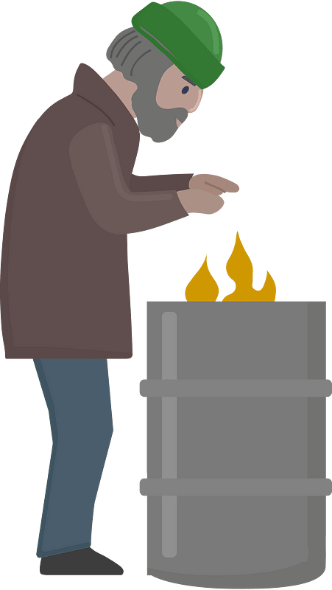
Family Activities
Shhh … don’t let anyone know, but I’m your friend, Spiros the Spy. I’m undercover in Iro Liangorial and we received this message from a local operative. We need your help to decode it. If you folks over in the back insist, you can get the Crossword (and decoding help) at https://tinyurl.com/mr2u38jw

Slide 23
Is Hell Real?
November 19

