Slide 1
Interdependent Independence
July 3

Slide 2
Video Introduction
View Video

Slide 3
What do you think ?
What are some rights or freedoms as a citizen of the country you call home?
Which of these rights (if any) would you be willing to give up if you believed that exercising it might harm someone else?

Slide 4
The Point
Personal freedom is a big deal in our culture
Today we consider what we have the right to do
AND how our actions in doing these things will impact others
Let your responsibility to others drive how you exercise your rights.

Slide 5
Listen for a qualifying statement.
1 Corinthians 10:23-24 (NIV) "Everything is permissible"--but not everything is beneficial. "Everything is permissible"--but not everything is constructive. 24 Nobody should seek his own good, but the good of others.

Slide 6
What Is Beneficial to Others
In what way is Paul’s opening statement in verse 23 true?
So, how did he qualify it?
"Everything is permissible"--but not everything is beneficial. "Everything is permissible"--but not everything is constructive.

Slide 7
What Is Beneficial to Others
Why might the statement need such qualifying or balance when applied to the life of a believer?
When is it hard to seek the good of others over yourself in your daily life?
How does focus on the Kingdom of God change the way we see our rights?

Slide 8
What Is Beneficial to Others
How does Christian use of freedom contrast with our society’s idea of freedom?
Society’s Concept of Freedom | Believer's Concept of Freedom

Slide 9
Listen for when not to offend unnecessarily
1 Corinthians 10:25-30 (NIV) Eat anything sold in the meat market without raising questions of conscience, 26 for, "The earth is the Lord's, and everything in it." 27 If some unbeliever invites you to a meal and you want to go, eat whatever is put before you without

Slide 10
Listen for when not to offend unnecessarily
raising questions of conscience. 28 But if anyone says to you, "This has been offered in sacrifice," then do not eat it, both for the sake of the man who told you and for conscience' sake-- 29 the

Slide 11
Listen for when not to offend unnecessarily
other man's conscience, I mean, not yours. For why should my freedom be judged by another's conscience? 30 If I take part in the meal with thankfulness, why am I denounced because of something I thank God for?

Slide 12
Don’t Offend Others Unnecessarily
Paul asks the question, “Why should my freedom be judged by another’s conscience?” What does it mean for your freedom to be “judged by another person’s conscience”?
Paul talks about the problem of whether or not to eat food offered to idols. What practices today are similar to this early church conundrum?

Slide 13
Don’t Offend Others Unnecessarily
Why would being considerate of others be more important than knowing and claiming you are theologically correct in the actions you choose?
How did Paul counsel the Corinthians to regard food sacrificed to idols?
Eat anything sold in the meat market without raising questions of conscience, for, "The earth is the Lord's, and everything in it."

Slide 14
Don’t Offend Others Unnecessarily
How could weaker believers be hurt by seeing more mature Christians do something the weaker believers considered wrong?
How should we limit our freedom out of sensitivity to weaker Christians?

Slide 15
Listen for another reminder how to act.
1 Corinthians 10:31-33 (NIV) So whether you eat or drink or whatever you do, do it all for the glory of God. 32 Do not cause anyone to stumble, whether Jews, Greeks or the church of God-- 33 even as I try to please everybody in every way. For I am not seeking my own good but the good of many, so that they may be saved.

Slide 16
Do What Gives a Witness for Christ
Whom are believers to try to influence?
What are some practical ways we can glorify God in our day-to-day living?
What types of personal sacrifices might a believer choose to make in order to share the gospel?

Slide 17
Application
Read.
Choose to read God’s Word daily, so you can know better how to represent Christ.
The more clearly you see Jesus, the better you can reflect Him.

Slide 18
Application
Glorify.
Live your life on mission.
Live in such a way that you are intentional in giving God the glory in all aspects of your life.

Slide 19
Application
Glorify.
Live your life on mission.
Live in such a way that you are intentional in giving God the glory in all aspects of your life.

Slide 20
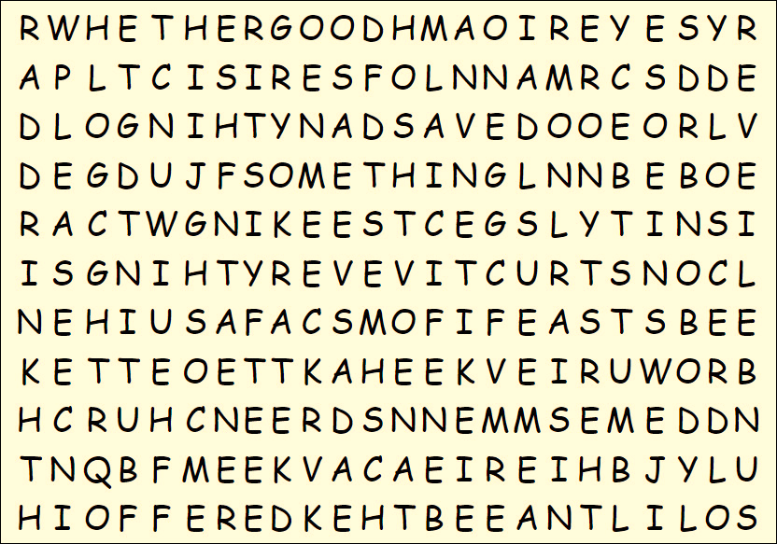
Family Activities
I thought I found one of the words, “KEEST”, but the Word Search Lady says, “NO”. Now I owe her a book report. You can do better. You can beat her if you go for help. found at https://tinyurl.com/24w8utbj along with other fun Family Activities

Slide 21
Interdependent Independence
July 3

