Slide 1
Intentional Love
September 23

Slide 2

Consider these events …
View the Video

Slide 3
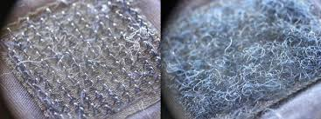
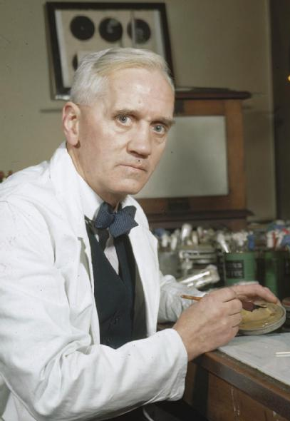
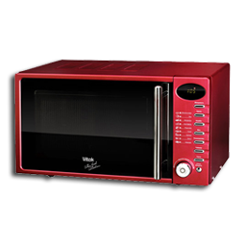
What did these events have in common?
Discovery of penicillin
Invention of the microwave oven
Idea for Velcro

Slide 4
What did these events have in common?
Some events are “happy accidents”
  However we cannot approach our Christian lives that way, following Jesus is an intentional act of obedience.
  Today we study how God calls us to out of our way to love others.

Slide 5
Listen for Jesus’ teaching style.
Luke 10:25-28 (NIV) On one occasion an expert in the law stood up to test Jesus. "Teacher," he asked, "what must I do to inherit eternal life?" 26 "What is written in the Law?" he replied. "How do you read it?" 27 He answered:

Slide 6

Listen for Jesus’ teaching style.
"'Love the Lord your God with all your heart and with all your soul and with all your strength and with all your mind'; and, 'Love your neighbor as yourself.'" 28 "You have answered correctly," Jesus replied. "Do this and you will live."

Slide 7
Love for God, Love for Others
What different motivations do people have for asking questions about God and of God?
Actually, this question is arguably the most important question any person can ask. Give your opinion why you think the lawyer was or was not sincere in asking it.
Sincere | Not Sincere

Slide 8
Love for God, Love for Others
If it was not a sincere question, but a test … what kind of test do you think this was?
Note that Jesus responds with a question of His own (a good teaching technique). How did the legal expert summarize the demands of the Law?
What does it mean to “love your neighbor as yourself”?

Slide 9
Love for God, Love for Others
What conditions do we sometimes put on giving love to one another?
This man was an expert on scripture and the Mosaic Law. How might spending too much time simply studying the Bible lead to an unbalanced spiritual life?
Actually too many of us do not spend time in scripture – extremes in either direction (too little scripture study or too much only study) are unhealthy.

Slide 10
Listen for who did not show love.
Luke 10:29-32 (NIV) But he wanted to justify himself, so he asked Jesus, "And who is my neighbor?" 30 In reply Jesus said: "A man was going down from Jerusalem to Jericho, when he fell into the hands of robbers. They stripped him of his clothes, beat him and went away, leaving him half dead.

Slide 11
Listen for who did not show love.
A priest happened to be going down the same road, and when he saw the man, he passed by on the other side. 32 So too, a Levite, when he came to the place and saw him, passed by on the other side.

Slide 12
Indifference Is Failure to Love
How do you understand the intent of his question ‘who is my neighbor?’
Put yourself in the position of the priest or Levite. What would be the pros and cons of stopping to help this man?
What natural inclinations make it easier for you to act like the priest and the Levite than like the Samaritan? In what ways do we sometimes justify not helping others in need?

Slide 13
Indifference Is Failure to Love
How do we overcome barriers like these?
Agree or disagree … “You can never be too impulsive in acting on the motivation of love.”
Agree | Disagree

Slide 14
Listen for a surprise hero.
Luke 10:33-37 (NIV) But a Samaritan, as he traveled, came where the man was; and when he saw him, he took pity on him. 34 He went to him and bandaged his wounds, pouring on oil and wine. Then he put the man on his own donkey, took him to an inn and took care of him. 35 The next day he took out two silver coins and gave them to the

Slide 15
Listen for a surprise hero.
innkeeper. 'Look after him,' he said, 'and when I return, I will reimburse you for any extra expense you may have.' 36 "Which of these three do you think was a neighbor to the man who fell into the hands of robbers?" 37 The expert in the law replied, "The one who had mercy on him." Jesus told him, "Go and do likewise."

Slide 16
Love Others Even if It’s Inconvenient
What all did the traveling Samaritan do for the injured man?
Why would a Samaritan be considered an unlikely hero in the story?
What attitude differentiated the Samaritan’s response from that of the priest and Levite?

Slide 17
Love Others Even if It’s Inconvenient
What groups within our community are experiencing tensions and perhaps even problems between themselves and others?
What groups within our community are experiencing tensions and perhaps even problems between themselves and others?

Slide 18
Application
Get to know someone.
  How intentional are you when you come to worship?
  This week, intentionally seek someone out you aren’t familiar with and ask that person a few questions to get to know him or her.

Slide 19
Application
Trim your schedule.
  How much margin is in your life?
  Evaluate your finances and schedule, and cut back so that you have room to meet the needs of others God brings your way.

Slide 20
Application
Encourage someone.
  Who is one person you know that is struggling, but to whom you have been indifferent?
  Schedule a time to sit down with that person this week.

Slide 21
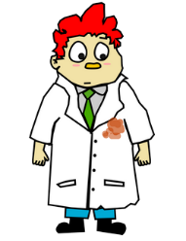


Family Activities
My discovery was accidental. Don’t you wait for chocolate to melt in your pocket … go to the Family Activities page at https://tinyurl.com/y9bbynlv and intentionally involve your family in the puzzles and discussions there

Slide 22
Intentional Love
September 23

