Slide 1
Integrity
August 31

Slide 2

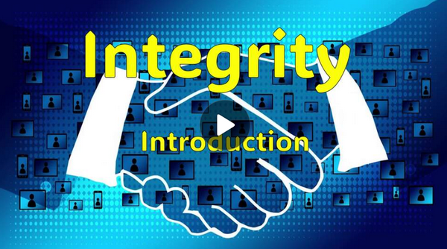
Video Introduction
View Video

Slide 3
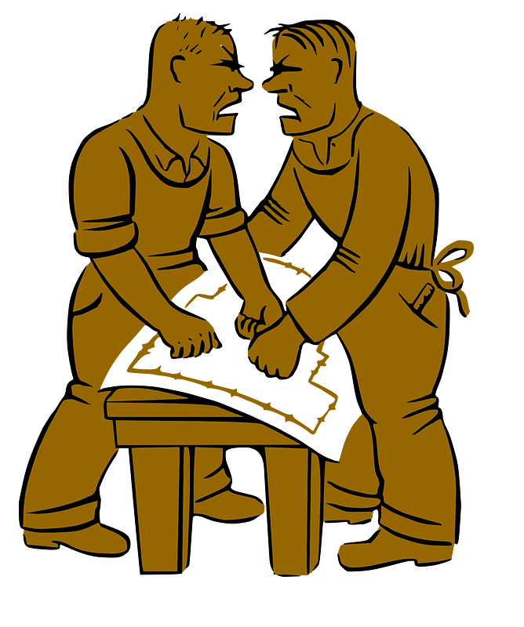
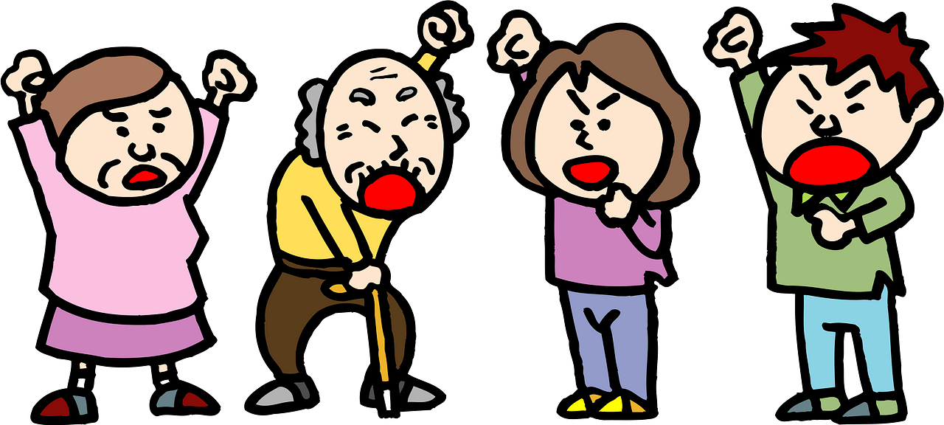

Sez you …
What are some moral issues in our culture today where there seems to be great confusion or disagreement?
Today we want to look at …
Why it is important to have integrity in your life
We are called to be the same Christ-centered person no matter what the issue.

Slide 4
Listen for how to treat others.
1 Peter 3:8-12 (NIV) Finally, all of you, live in harmony with one another; be sympathetic, love as brothers, be compassionate and humble. 9 Do not repay evil with evil or insult with insult, but with blessing, because to this you were called so that you may inherit a blessing. 10 For, "Whoever would love life and

Slide 5
Listen for how to treat others.
see good days must keep his tongue from evil and his lips from deceitful speech. 11 He must turn from evil and do good; he must seek peace and pursue it. 12 For the eyes of the Lord are on the righteous and his ears are attentive to their prayer, but the face of the Lord is against those who do evil."

Slide 6
Pursue Goodness and Righteousness
List the ways are believers to act toward one another.
Remember that musical harmony is when people sing different notes but still sound good together. How does this apply to our personal relationships?

Slide 7
Pursue Goodness and Righteousness
How are believers to respond to those who intend evil toward them?
Why is it so hard to not repay evil with evil?
What advice from the Old Testament did Peter give?

Slide 8
Pursue Goodness and Righteousness
What motivation does this Old Testament passage give for living this way?
Why are these teachings difficult to live out?
What concrete actions can we use to promote harmony?

Slide 9
Listen for why to be encouraged.
1 Peter 3:13 – 15 (NIV) Who is going to harm you if you are eager to do good? 14 But even if you should suffer for what is right, you are blessed. "Do not fear what they fear; do not be frightened."

Slide 10
Listen for why to be encouraged.
15 But in your hearts set apart Christ as Lord. Always be prepared to give an answer to everyone who asks you to give the reason for the hope that you have. But do this with gentleness and respect,

Slide 11
Centered in Christ’s Lordship
What did Peter write about suffering for what is right?
Peter said, “do not fear what they fear.” What do you suppose “they” fear?
Why is it more important to do right than to fear these things?

Slide 12
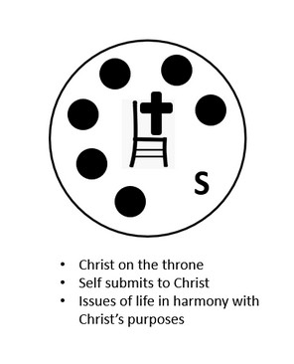
Centered in Christ’s Lordship
When do sufferings and difficulties give us the opportunity to share our faith?
What is the meaning of “set apart Christ as Lord”?

Slide 13
Listen for why to keep a clear conscience.
1 Peter 3:16 - 17 (NIV) keeping a clear conscience, so that those who speak maliciously against your good behavior in Christ may be ashamed of their slander. 17 It is better, if it is God's will, to suffer for doing good than for doing evil.

Slide 14
Withstand Scrutiny or Criticism
What are the positive outcomes hoped for as a result of doing the right thing and acknowledging Christ’s lordship?
What do you think it means to have a “clear conscience” as a Christian?

Slide 15
Withstand Scrutiny or Criticism
Verse 16 mentions being falsely accused for good behavior. Why is it important to respond with integrity rather than defensiveness or retaliation?
What are some modern situations where Christians are tempted to compromise their integrity when facing the slander Peter mentions?
Why is it better to suffer for doing good than for doing evil?

Slide 16
Application
Examine …
The different compartments of your life
Rate the consistency of behavior between each one and your Christian faith.
Is there a strong connection, or maybe an emerging one?
Would you have to describe it as weak or non-existent?

Slide 17
Application
Reach out …
To someone whom you know has been criticized or mocked for their good behavior.
Write a note or send a text of encouragement to them.

Slide 18
Application
Develop a plan …
For how you will deepen your character as a follower of Jesus,
Based on this session as well as the whole study on character.
Show it to a close friend and ask them to periodically check on your progress.

Slide 19
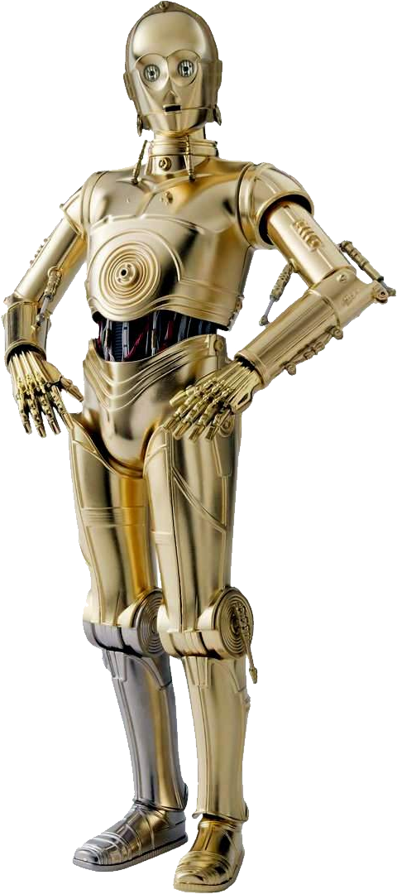
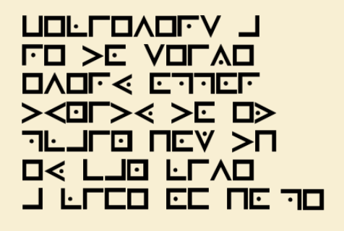
Family Activities
"Oh dear! Master Yoda has entrusted you with a most important task. You must carefully follow his instructions to decrypt the message originating from the Inor Caly system. Should you require independent assistance—or perhaps access to the color page—please do proceed to https://tinyurl.com/3uhp6afy

Slide 20
Integrity
August 31

