Slide 1
Indwelt by the Spirit
June 19

Slide 2

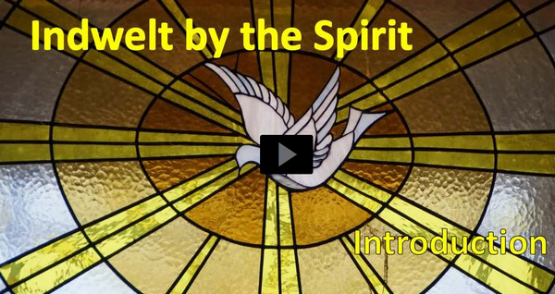
Video Introduction
View Video

Slide 3
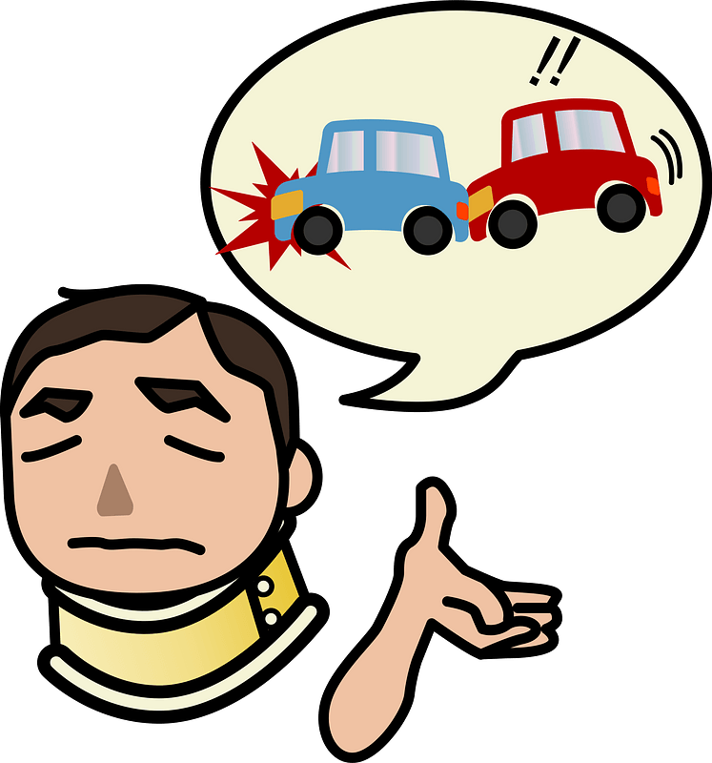
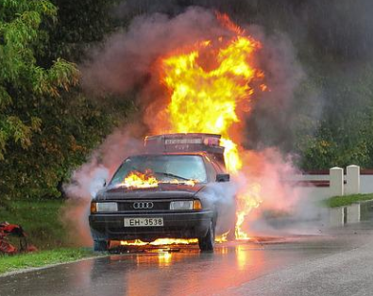
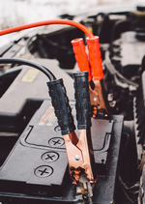
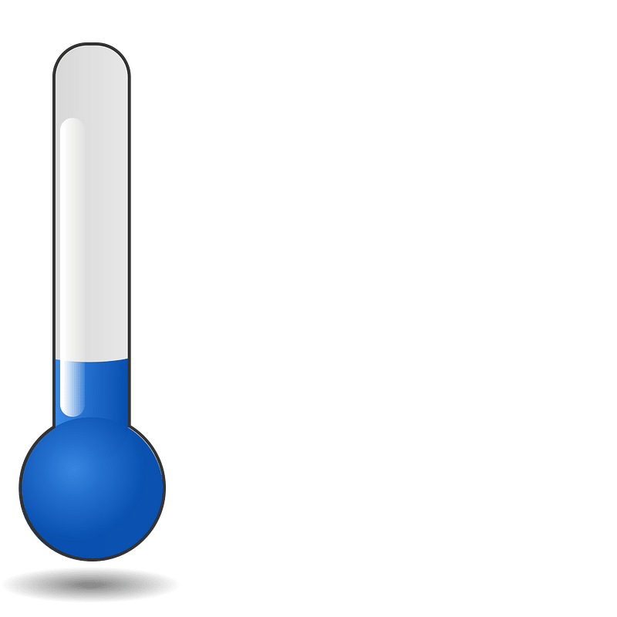
What a nightmare …
What’s the worst car trouble you’ve experienced?
We’ve all had times when we’ve felt alone, especially with a non-working car all by ourselves.
  But even then, as followers of Christ, we’re never truly alone.
  The presence of God is with us in the person of the Holy Spirit.
  The Holy Spirit’s presence in our lives affirms our relationship with God.
-40

Slide 4
Listen for who is in control.
Romans 8:9-11 (NIV) You, however, are controlled not by the sinful nature but by the Spirit, if the Spirit of God lives in you. And if anyone does not have the Spirit of Christ, he does not belong to Christ. 10 But if Christ is in you, your body is dead because of sin, yet

Slide 5
Listen for who is in control.
your spirit is alive because of righteousness. 11 And if the Spirit of him who raised Jesus from the dead is living in you, he who raised Christ from the dead will also give life to your mortal bodies through his Spirit, who lives in you.

Slide 6
The Spirit Indwells Every Believer
What are some situations when we feel like our sinful nature is in control?
What does Paul say is true about every believer?
Paul says, “your body is dead because of sin, but your spirit is alive because of righteousness.” How does verse 11 explain that statement?

Slide 7
The Spirit Indwells Every Believer
Paul is saying a person can be dead and have life at the same time.
  Our bodies are dead to sin (separated from a sinful lifestyle)
  Our spirits are made spiritually alive (united with Christ) by the presence of the Holy Spirit

Slide 8
The Spirit Indwells Every Believer
What does the indwelling of the Holy Spirit mean for the Christian? What are some signs that tell us the Holy Spirit is at work in a Christian’s life?

Slide 9
The Spirit Indwells Every Believer
Note evidence Paul speaks of in other of his letters.
  The Spirit produces Spiritual Fruit within/through our lives … love, joy, peace, patience, kindness, goodness, gentleness, faithfulness, and self-control
  Each believer is given a Spiritual Gift … a special skill or ability that God will use to minister to others

Slide 10
The Spirit Indwells Every Believer
To review, let’s contrast the two forces that control people as described in these verses.
Controlled by Sinful Nature | Controlled by the Spirit of God

Slide 11
Listen for how the Holy Spirit leads.
Romans 8:12-14 (NIV) Therefore, brothers, we have an obligation--but it is not to the sinful nature, to live according to it. 13 For if you live according to the sinful nature, you will die; but if by the Spirit you put to death the misdeeds of the body, you will live, 14 because those who are led by the Spirit of God are sons of God.

Slide 12

Led by the Spirit
What two contrasting images—one showing what we are not and the other what we are—does Paul use to describe our relationship with God?
Paul says we are not obligated
to the sinful nature. What
obligation do we have?

Slide 13
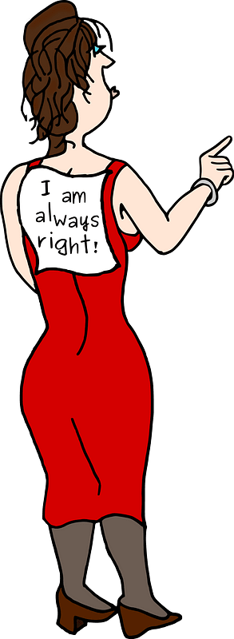
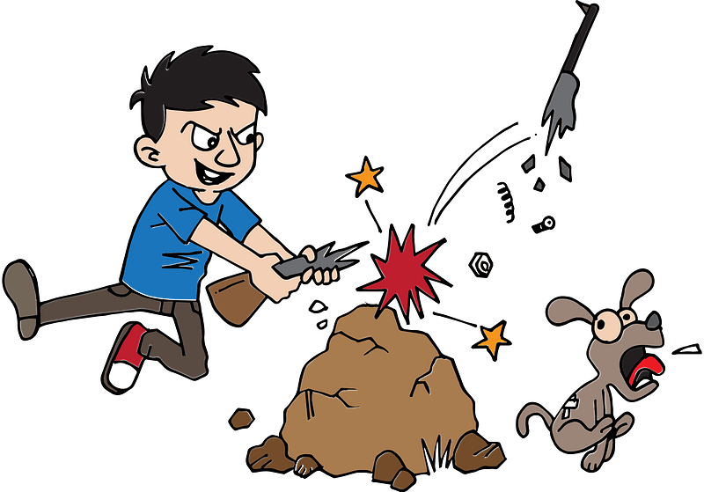

Led by the Spirit
What are other results of the Spirit of Christ living within the life of the believer?
From what kinds of actions and attitudes can God’s Spirit set us free?
but if by the Spirit you put to death the misdeeds of the body, you will live, because those who are led by the Spirit of God are sons of God.

Slide 14
Led by the Spirit
The Holy Spirit is continually at work in our lives
  He convicts/convinces us of the righteousness available for our daily living
  He enables us to replace patterns of sin with patterns of righteousness

Slide 15
Led by the Spirit
How can believers distinguish between being led by the Holy Spirit and the desire to live according to the flesh?
Live According to the Flesh | Led by the Holy Spirit

Slide 16
Listen for words about “family”.
Romans 8:15-17 (NIV) For you did not receive a spirit that makes you a slave again to fear, but you received the Spirit of sonship. And by him we cry, "Abba, Father." 16 The Spirit himself testifies with

Slide 17
Listen for words about “family”.
our spirit that we are God's children. 17 Now if we are children, then we are heirs--heirs of God and co-heirs with Christ, if indeed we share in his sufferings in order that we may also share in his glory.

Slide 18
Affirmed as a Child of God
What words did you read that had to do with family elements?
Consider the special relationship an adopted child has with the adoptive parents.
  He/she was chosen on purpose
  The adoptive parents did not make a “mistake”
  Birth parents must “take what they get”

Slide 19
Affirmed as a Child of God
So, what kinds of feelings does being “chosen on purpose” by God bring to you?
What are some privileges and responsibilities of being God's Child?
Privileges | Responsibilities

Slide 20
Application
Think.
  Putting to death the deeds of the body is a lifelong, ongoing process in the life of a believer.
  Is there an attitude or behavior that needs to be put to death in your life?
  Determine and select one such attitude or behavior.
  Ask the Holy Spirit to strengthen you regarding this area of your life.

Slide 21
Application
Decide.
  Based on what you’ve selected, create an action plan designed to address this issue.
  Good action plans answer the questions who, what, when, where, why, and how.

Slide 22
Application
Act.
  Choose a date to begin and then follow the plan.
  If necessary, copy the action plan and place it where you can see it regularly.

Slide 23

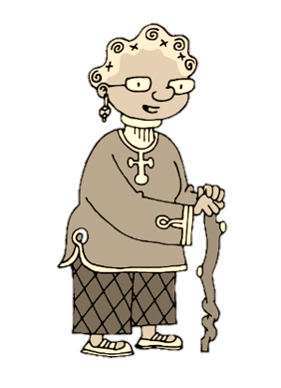
Family Activities
Well … finally! I’ve been waiting for the Crossword Puzzle for weeks and weeks. I like how the clues and words are found in the same Scripture passage as the lesson. And if I get stuck, I can go to https://tinyurl.com/5393wvb3 for help. Oh yes … there are other things to do for the whole family!

Slide 24
Indwelt by the Spirit
June 19

