Slide 1
Humility
August 10

Slide 2

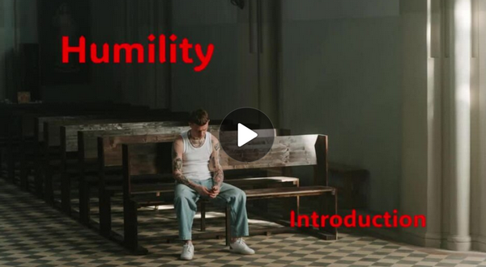
Video Introduction
View Video

Slide 3



Admit it, now …
When have you wanted to be first in line?
It’s our nature to want to be ahead of everyone else
Paul wrote that we shouldn’t always want to be first
Today we look at how to humbly place the needs of others before your own.

Slide 4
Listen for an if-then statement.
Philippians 2:1-2 (NIV) If you have any encouragement from being united with Christ, if any comfort from his love, if any fellowship with the Spirit, if any tenderness and compassion, 2 then make my joy complete by being like-minded, having the same love, being one in spirit and purpose.

Slide 5
Love Lays Groundwork
What four qualities mark unity with Christ that are mentioned in verse 1?
According to verse 2, how can Christians show their unity in Christ in practical ways?
What are the benefits of being united in spirit and intent on one purpose in our church?

Slide 6
Love Lays Groundwork
What circumstances in life tempt you to ignore the instructions in these verses?
How do petty quarrels hold an individual back in his or her Christian walk?
How can Christ help you keep peace with others?
How can we value others over ourselves in practical ways?

Slide 7
Listen for how to live humbly.
Philippians 2:3-4 (NIV) Do nothing out of selfish ambition or vain conceit, but in humility consider others better than yourselves. 4 Each of you should look not only to your own interests, but also to the interests of others.

Slide 8
Serve Others
What did Paul say about self-centeredness?
How does humility contribute to unity?
When have you benefitted from someone who looked out for your interests?

Slide 9
Serve Others
What does humility look like in relationship to others?
In verse 2 Paul spoke of his joy being made complete. In what way would humility and unity help fulfill Paul’s joy?

Slide 10
Listen for how Jesus models humility.
Philippians 2:5-11 (NIV) Your attitude should be the same as that of Christ Jesus: 6 Who, being in very nature God, did not consider equality with God something to be grasped, 7 but made himself nothing, taking the very nature of a servant, being made in human likeness. 8 And being found in appearance as a man, he humbled himself and

Slide 11
Listen for how Jesus models humility.
became obedient to death-- even death on a cross! 9 Therefore God exalted him to the highest place and gave him the name that is above every name, 10 that at the name of Jesus every knee should bow, in heaven and on earth and under the earth, 11 and every tongue confess that Jesus Christ is Lord, to the glory of God the Father.

Slide 12
Jesus Models Love and Humility
Paul exhorted believers to have the same attitude as Christ. List things Christ set aside when He became a man?
In what ways did Jesus limit Himself?
How is Christ the best example of humility and unselfishness for us?

Slide 13
Jesus Models Love and Humility
Why did Christ take on the limitations of being human even though He was of the same nature as God?
Verse 9 says Christ will be exalted, His sovereignty will be demonstrated, everyone will confess that Jesus is Lord. How can we demonstrate that confession daily in our lives?

Slide 14
Application
Look around.
Notice examples of humility in the normal pattern of a day.
You might be surprised at how often it is practiced.

Slide 15
Application
Look within.
Study your own life and recall occasions in which you acted in an arrogant fashion.
Think about better responses that could have been made.

Slide 16
Application
Look up.
Find examples of humility on the part of Bible characters.
Use a concordance or other study aids to compile a list of men and women in the Scripture whose humility mirrored the example of Jesus.

Slide 17

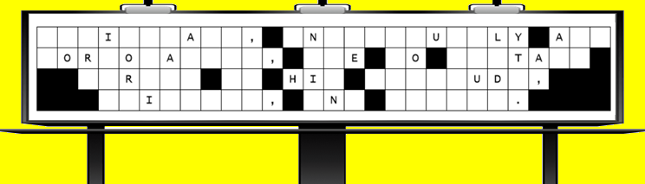

Family Activities
We need your help to undo the dastardly work of that evil villain, Barron Von Sneer. He’s meddled with your church sign. Help is available (along with the Crossword) at https://tinyurl.com/yf946h4h

Slide 18
Humility
August 10

