Slide 1
How Can I Honor God in My Suffering
February 23

Slide 2
Introduction Video
View Video

Slide 3
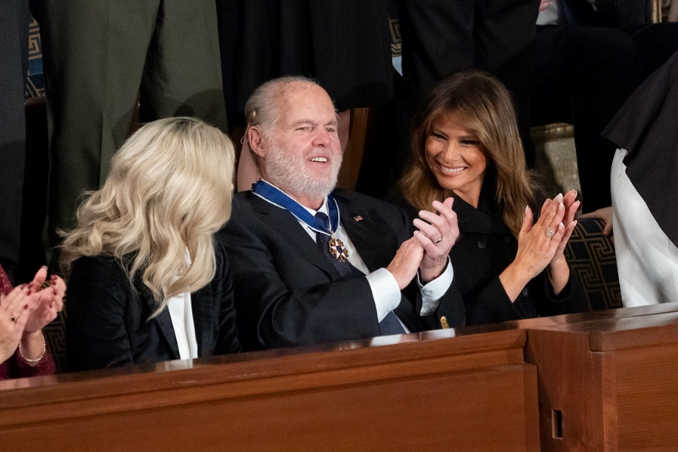
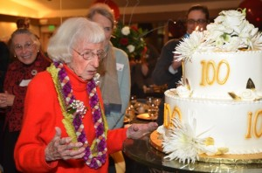
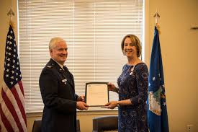
Remember that time …
When have you seen someone honored in a memorable way?
Winners or notable people are given honor.
As believers, we should honor God daily.
Every part of life—including difficulties—is an opportunity to honor and give glory to God.

Slide 4
Listen for what is the treasure.
2 Corinthians 4:7-11 (NIV) But we have this treasure in jars of clay to show that this all-surpassing power is from God and not from us. 8 We are hard pressed on every side, but not crushed; perplexed, but not in despair; 9 persecuted, but not abandoned; struck down, but not destroyed.

Slide 5
Listen for what is the treasure.
We always carry around in our body the death of Jesus, so that the life of Jesus may also be revealed in our body. 11 For we who are alive are always being given over to death for Jesus' sake, so that his life may be revealed in our mortal body.

Slide 6
Let Jesus Be Displayed during Suffering
In what ways are we like “clay jars”?
What is the “treasure” Paul is speaking of?
Why does God choose to use the weak or the simple to proclaim His word and to carry out His mission?

Slide 7
Let Jesus Be Displayed during Suffering
List the words Paul used to describe the suffering and the corresponding survival he and his ministry partners experienced.
Suffering | State of Survival

Slide 8
Let Jesus Be Displayed during Suffering
What did the positive outcome of each prove or demonstrate?
What other image did Paul use to define the nature of his service for Christ?
Why was he willing to suffer or to be delivered continually unto death for Jesus’ sake?
When have you seen someone glorify God when afflicted, perplexed, persecuted, or struck down?

Slide 9
Listen for a Psalm quoted.
2 Corinthians 4:12-15 (NIV) So then, death is at work in us, but life is at work in you. 13 It is written: "I believed; therefore I have spoken." With that same spirit of faith we also believe and therefore speak, 14 because we know that the one who raised the Lord Jesus

Slide 10
Listen for a Psalm quoted.
from the dead will also raise us with Jesus and present us with you in his presence. 15 All this is for your benefit, so that the grace that is reaching more and more people may cause thanksgiving to overflow to the glory of God.

Slide 11
Give Thanks And Praise God
What good outcome came to the Corinthians because Paul was willing to suffer?
In what way did Paul identify with the psalmist in Psalm 116:10 (KJV)?
What did Paul offer as the reason he had confidence even in the midst of suffering?

Slide 12
Give Thanks And Praise God
What obstacles sometimes keep us from viewing suffering as an opportunity to share the gospel?
According to verse 15, why did Paul endure all that he endured?
How can suffering lead to the spread of the gospel?

Slide 13
Listen for why to stand strong.
2 Corinthians 4:16-18 (NIV) Therefore we do not lose heart. Though outwardly we are wasting away, yet inwardly we are being renewed day by day. 17 For our light and momentary troubles are achieving for us an eternal glory that far outweighs them all. 18 So we fix our eyes not on what is seen, but on what is unseen. For what is seen is temporary, but what is unseen is eternal.

Slide 14
Stand Strong to Glorify God
What contrasts are found in these verses? List all the contrasting words and phrases in the passage.
Statement | Contrast

Slide 15
Stand Strong to Glorify God
To what did Paul reaffirm his commitment?
How does focusing on the eternal help us endure the temporary?
Why do you think it is so easy for believers to forget about the eternal and focus or concentrate on the temporary?

Slide 16
Stand Strong to Glorify God
What can we do to “see the unseen” and focus by faith on the eternal?
How can believers help one another as we deal with daily struggles of our temporal lives and the “wasting away” Paul talks about?

Slide 17
Application
Pray.
Ask God for help when you endure suffering.
Ask Him to draw you closer to Him.
Ask a few close friends to pray for you and remind you of God’s love for you.

Slide 18
Application
Journal.
One way to discover how God is at work is to use a journal to write down your prayers and observations.
In time, you can look back at your writing to see what He taught you and how you have grown in Christ.

Slide 19
Application
Share.
Tell someone else of your experience with God during a time of difficulty or suffering.
It’s your story to share. Look at it as a gift to someone who is suffering now.
Pray and ask God to make you aware of any opportunities to use your story to encourage or help others

Slide 20
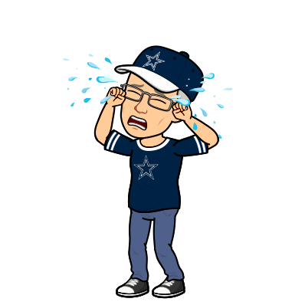
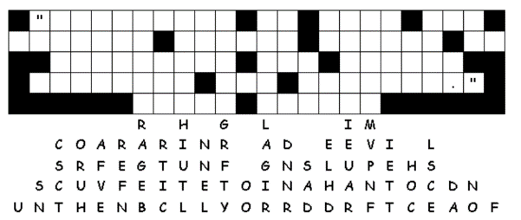
Family Activities
It’s tragic … all the letters have fallen out of the grid… oh the inhumanity! And such an important message for you to consider. If you get stuck or are determined to do the crossword instead, go to https://tinyurl.com/syhyyty. There’s also other worthwhile activities there for the whole family.

Slide 21
How Can I Honor God in My Suffering
February 23

