Slide 1
How Can God Use Me When Others Suffer?
January 19

Slide 2
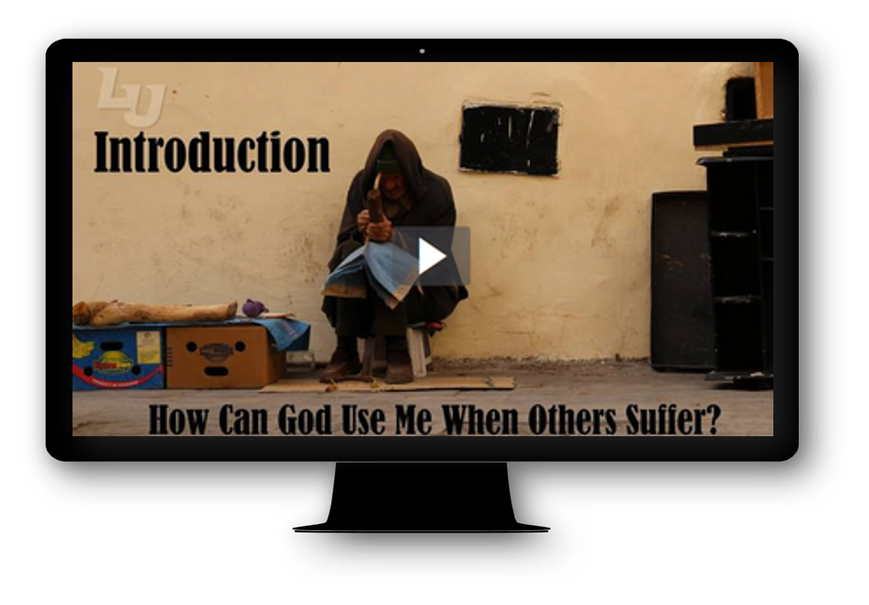
Introduction Video
View Video

Slide 3
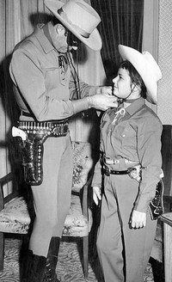

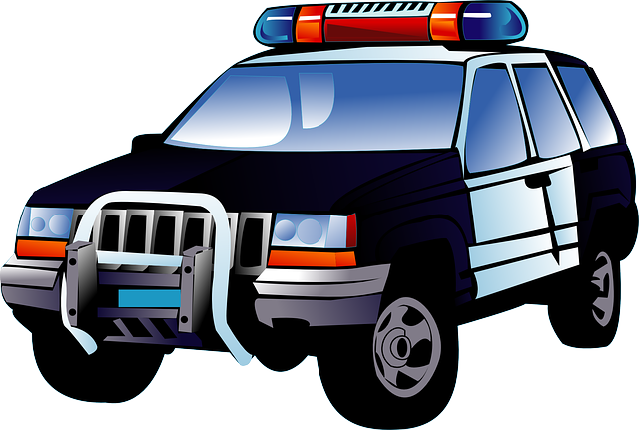
Think About It …
What are some movies or TV shows that speak to our desire for justice?”
We like it when the good guys win and the bad guys end up in jail.
  We call for justice when we are hurt.
  Who will fight for other people who suffer injustice?
  God calls believers to stand up for those who suffer from injustice.

Slide 4
Listen for God’s criticism.
Isaiah 58:3-5 (NIV) 'Why have we fasted,' they say, 'and you have not seen it? Why have we humbled ourselves, and you have not noticed?' "Yet on the day of your fasting, you do as you please and exploit all your workers. 4 Your fasting ends in quarreling and strife, and in striking each other with wicked fists.

Slide 5
Listen for God’s criticism.
You cannot fast as you do today and expect your voice to be heard on high. 5 Is this the kind of fast I have chosen, only a day for a man to humble himself? Is it only for bowing one's head like a reed and for lying on sackcloth and ashes? Is that what you call a fast, a day acceptable to the LORD?

Slide 6
Religious Rituals Insufficient
What question did the people have for God? Why did the people of Israel think they deserved God’s attention?
What criticism did God offer in His response? What fault in the fasting of God’s people prevented God from answering their prayers?
What rhetorical questions does God ask?

Slide 7
Religious Rituals Insufficient
What might constitute "doing as you please" on the Lord’s Day?
Why would God oppose these kinds of attitudes?
What are the benefits of religious activity in our lives?
Based on these verses, what would be the possible dangers of religious activities?

Slide 8
Listen for God’s preferences.
Isaiah 58:6-7 (NIV) "Is not this the kind of fasting I have chosen: to loose the chains of injustice and untie the cords of the yoke, to set the oppressed free and break every yoke? Is it not to share your food with the hungry and to provide the poor wanderer with shelter-- when you see the naked, to clothe him, and not to turn away from your own flesh and blood?

Slide 9
Others in Need of Justice
What words or phrases did God speak to redefine the kind of fast that was pleasing to Him?
What specific actions did He call for?
Where do you see injustice and oppression operating in today’s culture?

Slide 10
Others in Need of Justice
What obstacles might prevent us from working toward justice for others?
Where do you see God’s people effectively addressing these concerns?

Slide 11
Listen for results of obedience.
Isaiah 58:8-11 (NIV) Then your light will break forth like the dawn, and your healing will quickly appear; then your righteousness will go before you, and the glory of the LORD will be your rear guard. 9 Then you will call, and the LORD will answer; you will cry for help,

Slide 12
Listen for results of obedience.
and he will say: Here am I. "If you do away with the yoke of oppression, with the pointing finger and malicious talk, 10 and if you spend yourselves in behalf of the hungry and satisfy the needs of the oppressed, then your light will rise in the darkness,

Slide 13
Listen for results of obedience.
and your night will become like the noonday. 11 The LORD will guide you always; he will satisfy your needs in a sun-scorched land and will strengthen your frame. You will be like a well-watered garden, like a spring whose waters never fail.

Slide 14
Our Obedient Response
Identify the images that describe the blessings God gives to those who obey Him.
What would these promises mean in practical terms?
What requirements are specified so these things?

Slide 15
Our Obedient Response
What does it mean to you to "spend yourselves in behalf of the poor"?
What illustrations did God use in verse 11 to illustrate His blessings on them in their restored relationship?
What’s the connection between communicating the gospel message and the ways we meet the physical needs of others?

Slide 16
Application
Check your heart.
  Pray about your attitude toward others facing injustice.
  Confess any apathy, indifference, or prejudice.

Slide 17
Application
Check your surroundings.
  Ask God to reveal injustice right in front of you.
  Ask for courage and the direction to follow His lead.

Slide 18
Application
Check your opportunity.
  Work with others to help those facing injustice.
  For example, volunteer with a crisis pregnancy center or a ministry focused on aged adults.

Slide 19
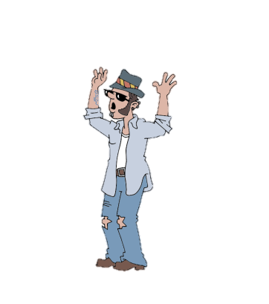
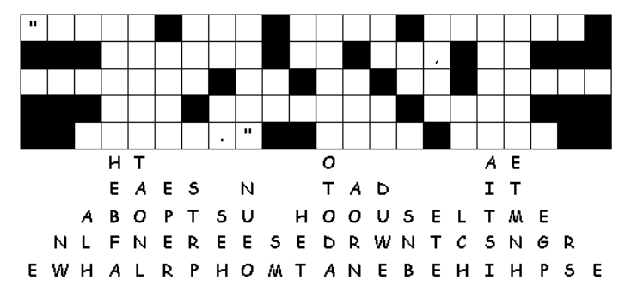




Family Activities
Whoa … dude … that rockslide did a number on the letters. It’s a Fallen Phrase. If that’s too much trauma for you, go to https://tinyurl.com/rsnaa93 for the solution or for your favorite crossword. Or maybe you’re into the color page?

Slide 20
How Can God Use Me When Others Suffer?
January 19

