Slide 1
Honor Your Neighbor
August 14

Slide 2
Video Introduction
View Video

Slide 3
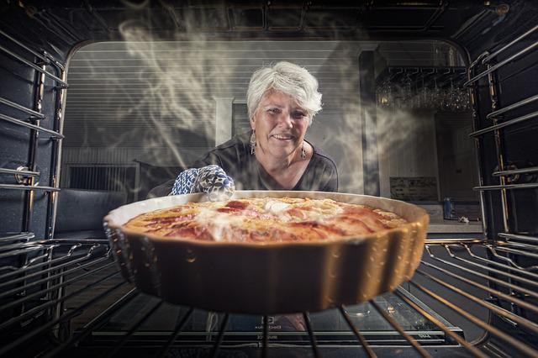
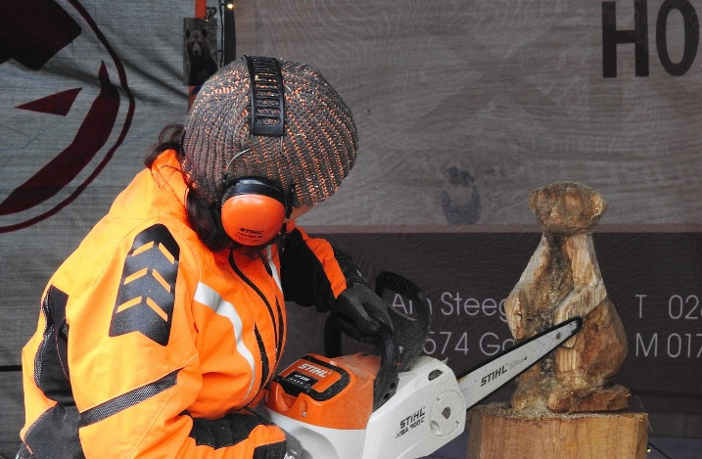
How about it …
When have you learned something by watching someone else?
We view the love of God for us and follow Jesus’ example
Love is seen in how we honor others.

Slide 4
Listen for attributes Paul encourages.
Romans 12:9-13 (NIV) Love must be sincere. Hate what is evil; cling to what is good. 10 Be devoted to one another in brotherly love. Honor one another above yourselves. 11 Never be lacking in zeal, but keep your spiritual fervor, serving the Lord. 12 Be joyful in hope, patient in affliction, faithful in prayer. 13 Share with God's people who are in need. Practice hospitality.

Slide 5
Seek the Best of Others
What are some ways Paul identified for how love will manifest itself in relationship to others?
What could it practically look like to take the lead in “honor others above self”?
What is the relationship between hope, affliction, and prayer?

Slide 6
Seek the Best of Others
Consider three of these commands. How might they be either the easiest or the hardest to obey?
What would your church look like if all members loved each other in the way described in these verses?
Command | Easiest to Obey | Hardest to Obey
Hospitality Joyful in hope Pray for each other

Slide 7
Listen for more attributes.
Romans 12:14-16 (NIV) Bless those who persecute you; bless and do not curse. 15 Rejoice with those who rejoice; mourn with those who mourn. 16 Live in harmony with one another. Do not be proud, but be willing to associate with people of low position. Do not be conceited.

Slide 8
Live in Harmony
If Paul were here today, what do you think he would say about why it is important do relate to others this way … especially within the church?
Suppose you are taking a college course with someone else, and they get a 97% on their test and you get a 71%. What is to be your disposition toward them when they are happy at the result and you are discouraged?

Slide 9
Live in Harmony
Reverse the scenario … you got the 97% and they got the 71% (or worse). How do you “mourn with those who mourn”?
What is to be the believer’s attitude or actions toward those of “low position”?
How does humility promote harmony in the church?

Slide 10
Listen for a difficult challenge.
Romans 12:17-21 (NIV) Do not repay anyone evil for evil. Be careful to do what is right in the eyes of everybody. 18 If it is possible, as far as it depends on you, live at peace with everyone. 19 Do not take revenge, my friends, but leave room for God's wrath, for it is written

Slide 11
Listen for a difficult challenge.
"It is mine to avenge; I will repay," says the Lord. 20 On the contrary: "If your enemy is hungry, feed him; if he is thirsty, give him something to drink. In doing this, you will heap burning coals on his head." 21 Do not be overcome by evil, but overcome evil with good.

Slide 12
Peaceful Relationships
How is this passage counter-cultural to what we see in the world today?
How could having a meal with your “enemy” bring peace to a relationship?
Paul says, Do not take revenge, my friends, but leave room for God's wrath. How is God better equipped for wrath or vengeance that we are?

Slide 13
Peaceful Relationships
Consider some of the evils that might be threatening to conquer you personally? What are some specific ways to overcome these evils?
Evils | Overcoming Evils
Fear or worry Anger Lust Greed

Slide 14
Application
Be humble.
Consider how the humility of self-forgetfulness might change the way you think and live.
Pray and ask God to help you be less self-focused so that you can honor and build up others.

Slide 15
Application
Forgive.
If someone has wronged you, forgive.
Leave the matter in God’s hands to carry out any justice.
Ask God to empower you to forgive them and to bless them.

Slide 16
Application
Outdo.
Write down three practical ways you can “outdo” others in showing honor.
These actions don’t have to be big gestures.
In fact, often it’s the small ways we consider others as more important than ourselves that make the biggest difference

Slide 17
Family Activities
Sorry, this is only a partial key for the message. Please do your best. Maybe you can figure out what the words are with a missing letter here or there. You must help because our regular decoders are at middle school church camp. If you get stuck, check out https://tinyurl.com/4zf6vcrp where there are also other activities of intrigue.

Slide 18
Honor Your Neighbor
August 14

