Slide 1
Honor Parents
September 20

Slide 2
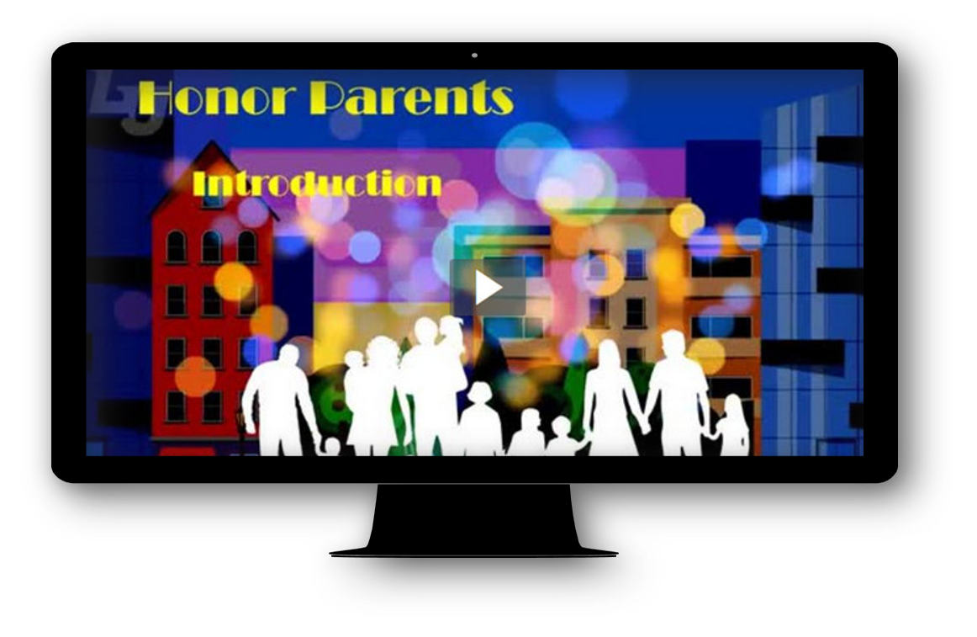
Video Introduction
View Video

Slide 3



Remember those times …
What is a favorite memory of time you spent with your parents?
It’s great to have some good family memories.
  God intends good family relationships in both directions.
  He calls for us to honor our parents as seen in our words and actions.

Slide 4

Listen for the result of obedience.
Exodus 20:12 (NIV) "Honor your father and your mother, so that you may live long in the land the LORD your God is giving you.

Slide 5
Honor Parents God Has
Placed in Your Life
How does the phrasing of the fifth commandment differ from that of most of the other commandments?
To whom was the commandment directed?
What are its implications for the future?
What are good ways to teach our children parental respect?

Slide 6
Honor Parents God Has
Placed in Your Life
What are some ways parents can be honored in both word and action by young (still living at home) children?
What are some ways parents can be honored in both word and action by adult children?
What are some similarities between honoring your parents and honoring God?

Slide 7
Listen for a negative example, dishonoring parents.
2 Samuel 15:7-12 (NIV) At the end of four years, Absalom said to the king, "Let me go to Hebron and fulfill a vow I made to the LORD. 8 While your servant was living at Geshur in Aram, I made this vow: 'If the LORD takes me back to Jerusalem, I will worship the LORD in Hebron.'" 9 The king said to him, "Go in peace." So he went to Hebron.

Slide 8
Listen for a negative example, dishonoring parents.
Then Absalom sent secret messengers throughout the tribes of Israel to say, "As soon as you hear the sound of the trumpets, then say, 'Absalom is king in Hebron.'" 11 Two hundred men from Jerusalem had accompanied Absalom. They had been invited as guests and went quite innocently,

Slide 9
Listen for a negative example, dishonoring parents.
knowing nothing about the matter. 12 While Absalom was offering sacrifices, he also sent for Ahithophel the Gilonite, David's counselor, to come from Giloh, his hometown. And so the conspiracy gained strength, and Absalom's following kept on increasing.

Slide 10
Backstory … David and Absalom
Previously Absalom had been out of favor
Campaigned to undermine his father’s position.
Intercepted people coming to Jerusalem
Told them king could/would not listen to claims
Open rebellion in Jerusalem unwise
Lied to king – “previous vow”, actually going away to organize the rebellion.

Slide 11
Honor, Truthfulness, and Integrity
In what way might David have been naive?
How is this story a negative illustration of the fifth commandment?
How does seeking a parent’s welfare honor them?

Slide 12
Honor, Truthfulness, and Integrity
How did your desire to honor your parents impact your decisions?
How does truthfulness and integrity honor parents?

Slide 13
Listen for David’s initial response to the revolt.
2 Samuel 15:13-14 (NIV) A messenger came and told David, "The hearts of the men of Israel are with Absalom." 14 Then David said to all his officials who were with him in Jerusalem, "Come! We must flee,

Slide 14
Listen for David’s initial response to the revolt.
or none of us will escape from Absalom. We must leave immediately, or he will move quickly to overtake us and bring ruin upon us and put the city to the sword."

Slide 15
“Honor” Seeks Welfare of Parents
What discouraging message came to David in Jerusalem?
Why did David feel it was necessary to leave the city? Why was his decision to flee Jerusalem a wise one?
What do you read between the lines to indicate David was not ready to relinquish the kingship?

Slide 16
The Rest of the Story
David and his company journeyed beyond the Jordan River
There they organized and prepared for battle.
The rebellion ended when David’s forces defeated Absalom’s forces.
Absalom was killed in the battle
Eventually David was restored to the throne of Israel (2 Sam. 18–19).

Slide 17
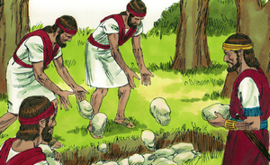
“Honor” Seeks Welfare of Parents
Not altogether a happy ending. What advice for us can we glean from these events?

Slide 18
Application
Repent.
  We have all failed in one way or another when it comes to showing our parents honor or living honorably so that our children will honor us.
  Confess and repent of any sins of dishonor you have had or any ways you have made it difficult for your children to honor you.

Slide 19
Application
Model.
  Determine to be a model of truthfulness and integrity in front of all people:
  Your children, your grandchildren, and the children of others.

Slide 20
Application
Act.
  Do something tangible to help and support parents with young children in your church.
  For senior adults whose parents are no longer living, you can show them honor by how you talk about them.
  If this is you, share with someone the role your parents played in your life and how God used them to shape you into the person you are today.

Slide 21

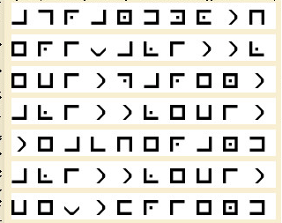
Family Activity
Uh-oh … that looks like an important message. I think it was sent to your Bible Study leader. You can help! And there’s more intrigue at https://tinyurl.com/y3esef24

Slide 22
Honor Parents
September 20

