Slide 1
Honor Marriage
October 4

Slide 2
Video Introduction
View Video

Slide 3
Consider …
How is marriage commonly portrayed in the media?
The concept of marriage as God intended is not common to our culture.
God intended one man, one woman for life.
Physical intimacy is reserved for one man and woman within the covenant of marriage.

Slide 4
Listen for Jesus’ clarification.
Exodus 20:14 (NIV) "You shall not commit adultery. Matthew 5:27-28 (NIV) "You have heard that it was said, 'Do not commit adultery.' 28 But I tell you that anyone who looks at a woman lustfully has already committed adultery with her in his heart.

Slide 5
Honor Marriage
What are some concerns at the heart of the seventh commandment?
Why was obedience to this command critical to Israel’s future?
What are the consequences when trust is broken in a relationship?
According to Jesus, how does adultery start?

Slide 6
Honor Marriage
Why are people willing to harbor and tolerate lust in their hearts?
When does looking at someone become inappropriate?

Slide 7
Honor Marriage
What is wrong with the argument, “It’s OK to look as long as you don’t touch”?
Yielding to the temptation of lust can become the precursor to involvement in the sin of adultery. What are some ways believers can guard their hearts to withstand the progressive invitations of sin?

Slide 8
Listen for actions that lead to temptation.
2 Samuel 11:1-3a (NIV) In the spring, at the time when kings go off to war, David sent Joab out with the king's men and the whole Israelite army. They destroyed the Ammonites and besieged Rabbah. But David remained in Jerusalem.

Slide 9
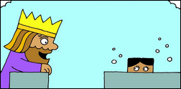
Listen for actions that lead to temptation.
One evening David got up from his bed and walked around on the roof of the palace. From the roof he saw a woman bathing. The woman was very beautiful, 3 and David sent someone to find out about her.

Slide 10
Guard Your Thoughts
What words and phrases in verse 1 define the setting for this incident in David’s life.
What happened one night when David couldn’t sleep?
In what way did David use his authority inappropriately?

Slide 11
Guard Your Thoughts
I’m tempted to disregard that
To be tempted is a sin!
What do you think?
Agree | Disagree

Slide 12
Guard Your Thoughts
David was tempted … why should we anticipate temptations?
What are some ways we can avoid even some temptations?
How can we guard our thoughts with faithfulness and purity?

Slide 13
Listen for David’s tragic decision.
2 Samuel 1:3b – 5 (NIV) The man said, "Isn't this Bathsheba, the daughter of Eliam and the wife of Uriah the Hittite?" 4 Then David sent messengers to get her. She came to him, and he slept with her. (She had purified herself from her uncleanness.) Then she went back home. 5 The woman conceived and sent word to David, saying, "I am pregnant."

Slide 14
Honor the Commitments of Others
What information did David’s servant share in identifying the woman?
At what points did David have the opportunity to bail out?
Why do you think he persisted at each juncture?

Slide 15
Honor the Commitments of Others
What can these passages teach us about the progression of sin in how we deal with other people?
How can we anticipate temptations and stop ourselves from succumbing to temptations?

Slide 16
Application
Examine your heart.
Being a senior adult does not mean you no longer deal with temptation and sin.
Honor for your marriage and for the relationships of others begins in the heart and mind.
Turn from any involvement with lust, pornography, or inappropriate feelings toward others.

Slide 17
Application
Examine your actions.
If you are guilty of the sin of adultery (either emotionally or physically) in the past or present, repent fully before God and turn your heart away from this sin and toward obedience to Christ.
If you have not committed sin in this regard, thank God and ask Him to guide you in a life that continually honors marriage.

Slide 18
Application
Honor.
Seek ways to honor marriage—both your own and the marriages of others.
This applies to all regardless of their marital status.
Identify specific things you can do this week to show honor to yourself, your spouse (if you are married), and God.
Identify ways you can honor others for their faithfulness in marriage.

Slide 19
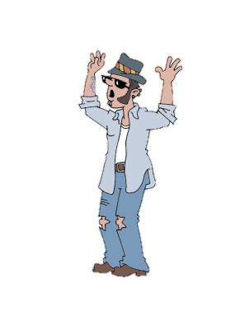
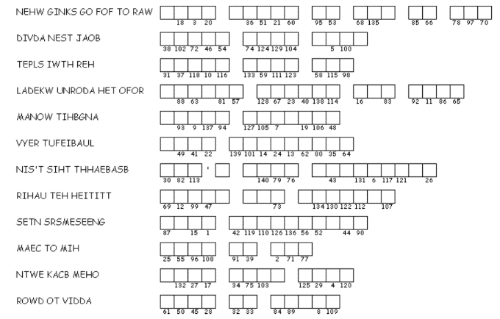
Family Activities
Whoa … dude! What a tangled mess. But, don’t be tempted to like skip this puzzle. There’s an important message in there somewhere. Seriously … if you, like get stuck, get help. It’s found at https://tinyurl.com/y3juqpgh and there’s like MORE !

Slide 20
Honor Marriage
October 4

