Slide 1
Honor Life
September 27

Slide 2
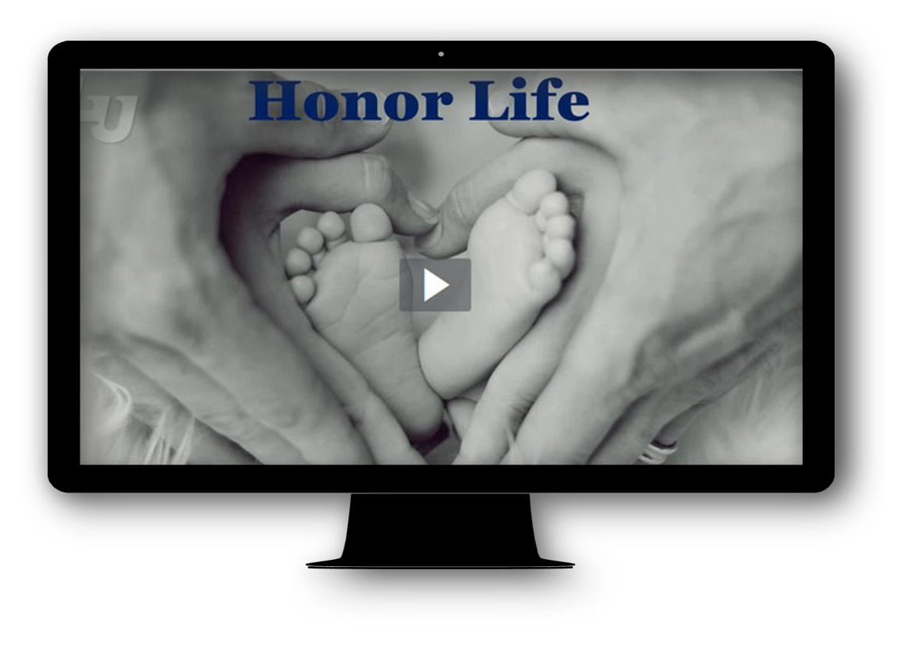
Video Introduction
View Video

Slide 3
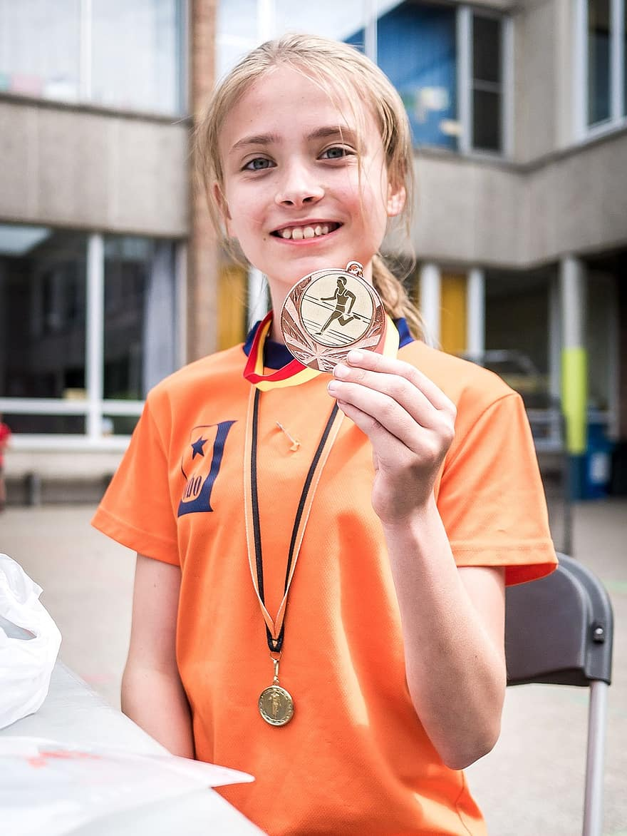
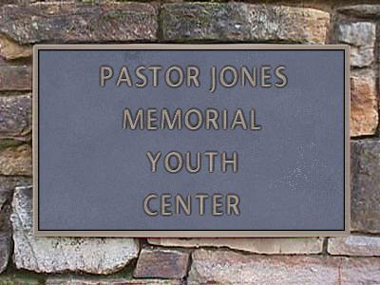
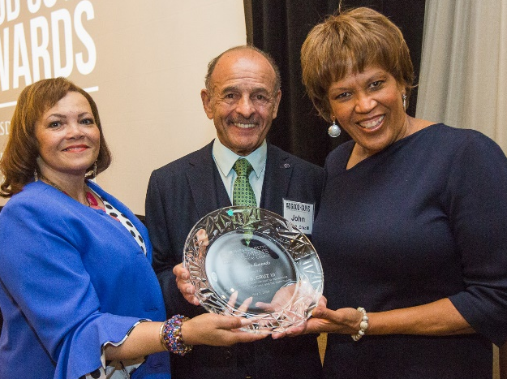
Think about it …
What are some ways you can show others they are valued?
We show honor and respect to those who deserve it.
  God honors and respects all life.
  We are called to honor and respect human life as God does.

Slide 4
Listen for God’s attitude toward human life.
Exodus 20:13 (NIV) "You shall not murder. Matthew 5:21-22 (NIV) "You have heard that it was said to the people long ago, 'Do not murder, and anyone who murders will be subject to judgment.' 22 But I tell you that anyone who is

Slide 5

Listen for God’s attitude toward human life.
angry with his brother will be subject to judgment. Again, anyone who says to his brother, 'Raca,' is answerable to the Sanhedrin. But anyone who says, 'You fool!' will be in danger of the fire of hell.

Slide 6
Human Life Is Precious to God
What is the intent of this commandment?
Why would violating it be an affront to God?
What are some ways our culture devalues human life?
According to Jesus, what is behind the physical act of murder that we are to avoid as much as the physical action?

Slide 7
Human Life Is Precious to God
Jesus talks about calling people names or making derogatory comments. Using terms like “fool” or “moron” may have lost the cultural impact or implication it did in Jesus day. What modern-day equivalents to "Raca" does our society level at others?

Slide 8
Human Life Is Precious to God
What are some of the negative consequences of these expressions of anger in our culture?
Why do you think Jesus zeroed in on the emotions behind our violent words and actions?

Slide 9
Listen for David’s encounter with Saul.
1 Samuel 26:7-11 (NIV) So David and Abishai went to the army by night, and there was Saul, lying asleep inside the camp with his spear stuck in the ground near his head. Abner and the soldiers were lying around him. 8 Abishai said to David, "Today God has delivered your enemy into your hands.

Slide 10
Listen for David’s encounter with Saul.
Now let me pin him to the ground with one thrust of my spear; I won't strike him twice." 9 But David said to Abishai, "Don't destroy him! Who can lay a hand on the LORD's anointed and be guiltless? 10 As surely as the LORD lives," he said,

Slide 11
Listen for David’s encounter with Saul.
"the LORD himself will strike him; either his time will come and he will die, or he will go into battle and perish. 11 But the LORD forbid that I should lay a hand on the LORD's anointed. Now get the spear and water jug that are near his head, and let's go."

Slide 12
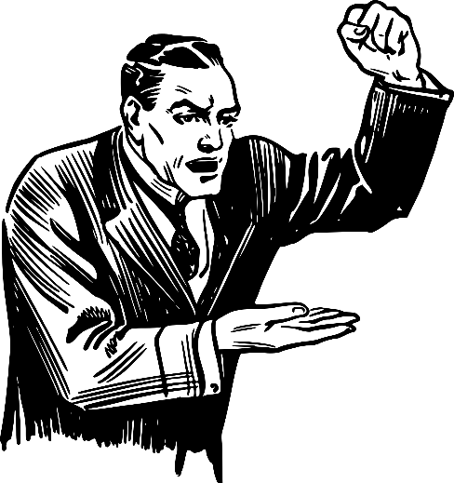
God Has Authority over Life
What was Abishai's reaction when he and David found Saul's entire camp asleep?
Agree or disagree …
David had every right to kill King Saul!
Agree | Disagree

Slide 13
God Has Authority over Life
How did David’s refusal to act with violence against Saul demonstrate respect for human life?
Why isn’t it wise to take every opportunity we are given for personal advancement and advantage?
What else can we learn from David’s words and actions in this passage?

Slide 14
Listen for David’s interchange with Saul
1 Samuel 26:22-25 (NIV) "Here is the king's spear," David answered. "Let one of your young men come over and get it. 23 The LORD rewards every man for his righteousness and faithfulness. The LORD delivered you into my hands today, but I would not lay a hand on the LORD's anointed.

Slide 15
Listen for David’s interchange with Saul
As surely as I valued your life today, so may the LORD value my life and deliver me from all trouble." 25 Then Saul said to David, "May you be blessed, my son David; you will do great things and surely triumph." So David went on his way, and Saul returned home.

Slide 16
Treat Every Life as Equally Valuable
Even if Saul continued to pursue David, what confidence did David express in the Lord?
What did David affirm yet again he would not do to Saul?
What were Saul’s parting words to David?
What is the significance of Saul’s statement to David?

Slide 17
Treat Every Life as Equally Valuable
In this situation, David showed that he valued life. Where do you currently have opportunities to lift up the value of life?
What can you do to affirm someone who is struggling to understand that he or she has value in God’s sight—and in yours as well?

Slide 18
Application
Check your attitude.
  If you privately consider some people more important than others, confess that to God and repent.
  While the world deems countless people as inferior or less important, we are called to see all people as God sees them.

Slide 19
Application
Check your words.
  Examine your involvement in devaluing life through the words you speak to others or about others.
  Words of anger, malice, bitterness, or even apathy do not honor the lives of those God loves.
  Repent and determine to speak only those words that build others up.

Slide 20
Application
Check your actions.
  Look for concrete ways you can affirm the value of life in your spheres of influence.
  Practical actions can include counseling at a pro-life pregnancy center, helping a parent with a disabled child, bringing joy to the forgotten in a nursing home, or engaging with the work of praying for and supporting the persecuted.

Slide 21

Family Activities
I’m not a doctor, but I play one on TV. And my diagnosis is that this textual failure has resulted from letters falling straight down in columns. Beware of possible infection from punctuation marks in some of the squares. They are used for social distancing of the words and phrases. Oh, yes … be sure to wear a mask while solving the puzzle. If you get stuck, go to https://tinyurl.com/y4426dnk where you’ll also discover healthful activities for the whole family!

Slide 22
Honor Life
September 27

