Slide 1
Honor God
September 13

Slide 2
Video Introduction
View Video

Slide 3
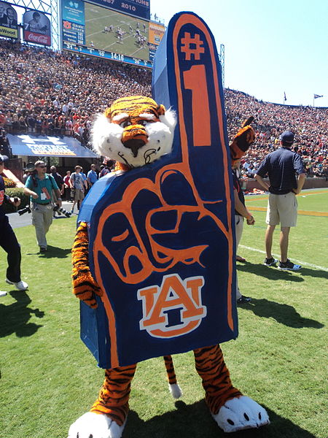
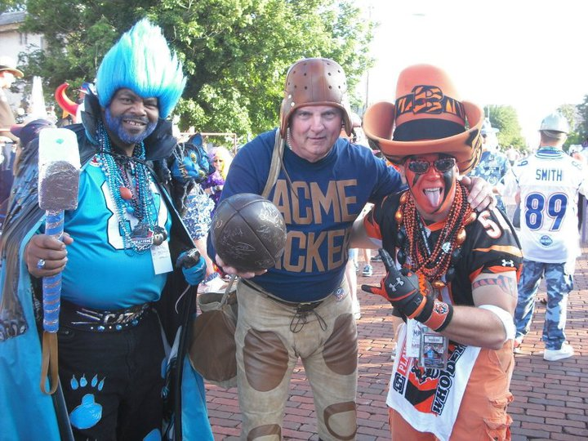
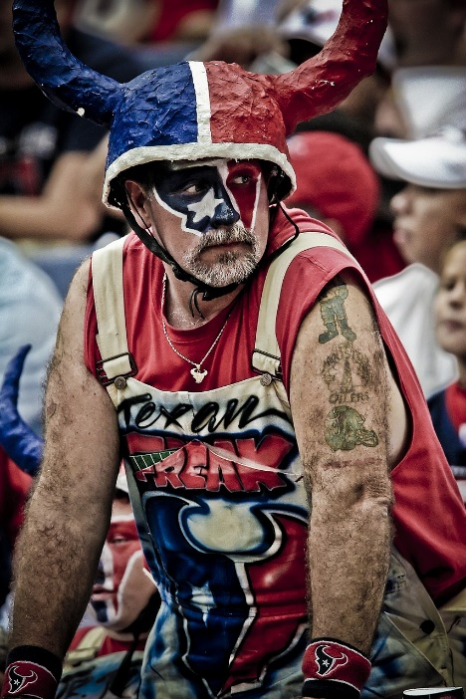
Think About It …
How can you recognize a genuine fan?
A fan is totally devoted to his or her team, as seen in attitude and actions.
We could make a comparison to our devotion to God.
Our relationship with God is seen in how we honor Him.

Slide 4
Listen for how to honor God.
Exodus 20:7-11 (NIV) "You shall not misuse the name of the LORD your God, for the LORD will not hold anyone guiltless who misuses his name. 8 "Remember the Sabbath day by keeping it holy. 9 Six days you shall labor and do all your work, 10 but the seventh day is a Sabbath to the LORD your God. On it you shall not do any work,

Slide 5
Listen for how to honor God.
neither you, nor your son or daughter, nor your manservant or maidservant, nor your animals, nor the alien within your gates. 11 For in six days the LORD made the heavens and the earth, the sea, and all that is in them, but he rested on the seventh day. Therefore the LORD blessed the Sabbath day and made it holy.

Slide 6
Honor God’s Name
Consider the significance of a name, especially in the Old Testament period?
Showed the individual’s character
Related to the birth or parents’ reaction to the birth
Signified family ties
Given to communicate God’s message

Slide 7
Honor God’s Name
So, why was (is) honoring God’s name important, beyond the fact God said we were to do so?
What are some ways that people today, even believers, can dishonor or misuse God’s name?
How is the Sabbath to be honored?
What is the rationale for resting from work?

Slide 8
Honor God’s Name
Why do we often struggle to slow down and take a break?
What benefits of practicing a day of Sabbath (or Lord’s Day) rest resonate with you?
What positive actions can you take to honor the Lord’s day?

Slide 9
Listen for how the psalmist honored God.
Psalm 145:1-3 (NIV) I will exalt you, my God the King; I will praise your name for ever and ever.2 Every day I will praise you and extol your name for ever and ever. 3 Great is the LORD and most worthy of praise; his greatness no one can fathom.

Slide 10
Honor God through Worship
What title did the psalmist give to God?
What actions did he commit to taking toward the Lord?

Slide 11
Honor God through Worship
Nonsense, it can be felt or thought internally.
What’s your opinion??
Praise must be openly communicated
it Can happen both ways … but it must happen !!!
Must be Communicated | Can be felt or thought internally

Slide 12
Honor God through Worship
How is God’s greatness “unsearchable?” How are his works “mighty”, “wonderful”, and “awe-inspiring”?
What can we do to help stay focused on God’s power during difficult or discouraging circumstances?

Slide 13
Listen for admonitions to parents, grandparents.
Psalm 145:4-7 (NIV) One generation will commend your works to another; they will tell of your mighty acts. 5 They will speak of the glorious splendor of your majesty, and I will meditate on your wonderful works. 6 They will tell of

Slide 14
Listen for admonitions to parents, grandparents.
the power of your awesome works, and I will proclaim your great deeds. 7 They will celebrate your abundant goodness and joyfully sing of your righteousness.

Slide 15
Honor God in Word and Deed
Beyond his personal commitment to honor God, what was the psalmist convinced must take place?
What are some words the psalmist used to speak of the work of the Lord among humankind?

Slide 16
Honor God in Word and Deed
When have you experienced God’s wondrous works and awe-inspiring acts?
In what ways is our faith passed on to the next generation?

Slide 17
Application
Repent.
Confess to God any times you misused the name of God and failed to honor Him with your life.
Turn away from these failures, turn back to honoring God.

Slide 18
Application
Journal.
Journaling is a great way of identifying the pressing thoughts on your heart and mind.
When you sit down to write, the natural flow of your thinking comes out.
Take a moment each day this week to journal about your relationship with God and thoughts about Him.
Let your own words reveal to you how much you honor and worship Him.

Slide 19
Application
Share.
If you are on social media, consider how you can post and share God-honoring posts this week.
Or consider how you can share a testimony of how great God is and the great acts He has done.
If you are not on social media, seek to share a testimony of God and His power in your life with others you communicate with during the week.
Go ahead and brag on God. He deserves it.

Slide 20
Family Activities
Yes, I’m telling you, this week’s puzzle is the Crossword! No … not the clueless crossword, the real crossword. You better come to Bible Study. If you want that other puzzle, go to Family Activities at https://tinyurl.com/yxf5sg79

Slide 21
Honor God
September 13

