Slide 1
Hate Your Family (?)
May 19

Slide 2
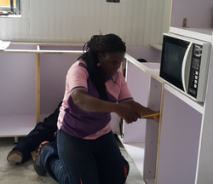
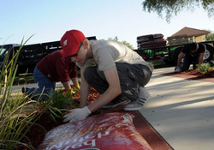
Think About It …
How have you counted the costs and prepared to tackle a recent project at home or at work?
Today we will consider Jesus’ warning to count the cost of loving Jesus and following Him.
It might cost time, skills, and even affect relationships
Loving Jesus should be so intense it makes everything else look like hate.

Slide 3
Listen for a strange command.
Luke 14:25-27 (NIV) Large crowds were traveling with Jesus, and turning to them he said: 26 "If anyone comes to me and does not hate his father and mother, his wife and children, his brothers and sisters--yes, even his own life--he cannot be my disciple. 27 And anyone who does not carry his cross and follow me cannot be my disciple.

Slide 4
Total Devotion
What amazing demand did Jesus make if a person were to be His disciple? What did Jesus say to emphasize that following Him would not be a life of ease?
A large crowd was traveling along, following Jesus. What’s the difference between being a part of the crowd and being a devoted disciple?
Crowd Following | Devoted Disciple

Slide 5
Total Devotion
Why do you suppose Jesus used such a strong word like “hate”? What does it mean to "hate" your parents, wife, children, siblings, and your own life?
What would it mean to “take up your cross”?
How might the crowds have reacted to Jesus’ terms of discipleship?

Slide 6
Total Devotion
How do even some Christians today react to Jesus’ terms of discipleship?
What are the daily implications for us to follow Jesus in our daily life as a devoted disciple?

Slide 7
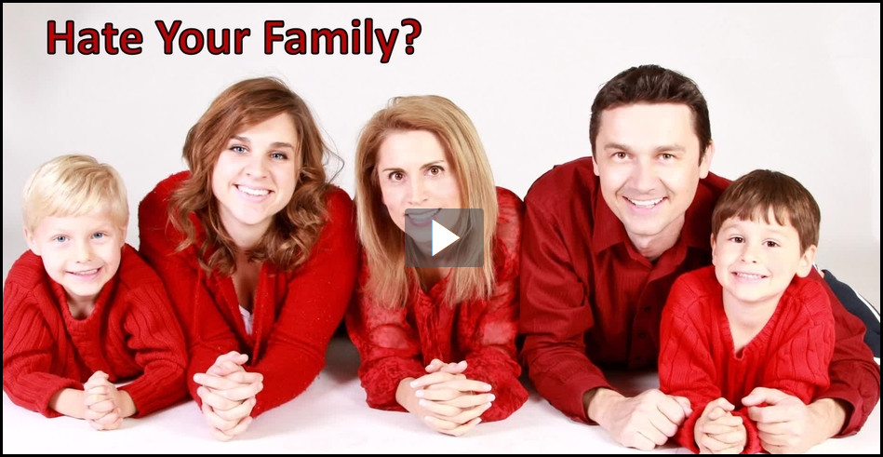
Total Devotion
View Video

Slide 8
Listen for the importance of counting the cost.
Luke 14:28-33 (NIV) "Suppose one of you wants to build a tower. Will he not first sit down and estimate the cost to see if he has enough money to complete it? 29 For if he lays the foundation and is not able to finish it, everyone who sees it will ridicule him, 30 saying, 'This fellow began to build and was not able to finish.' 31 "Or suppose a king is about to go to war against another king.

Slide 9
Listen for the importance of counting the cost.
Will he not first sit down and consider whether he is able with ten thousand men to oppose the one coming against him with twenty thousand? 32 If he is not able, he will send a delegation while the other is still a long way off and will ask for terms of peace. 33 In the same way, any of you who does not give up everything he has cannot be my disciple.

Slide 10
Count the Cost of Following Jesus
What should a person consider before starting a construction project or beginning a military campaign?
According to verse 33, what was Jesus’ point?
How do these two parables relate to true discipleship? If our salvation is free, why must we “count the cost?”

Slide 11
Count the Cost of Following Jesus
What costs do believers need to count in responding to Jesus? What are some of the costs of discipleship that Jesus states or implies?
What is the cost of discipleship in today’s world?
Why is it “worth the price” to follow Jesus … whether in a pagan culture or in our culture?

Slide 12
Listen for how we influence the world.
Matthew 5:13 (NIV) "You are the salt of the earth. But if the salt loses its saltiness, how can it be made salty again? It is no longer good for anything, except to be thrown out and trampled by men.

Slide 13
Make Others “Thirsty” for Jesus
Jesus speaks of believers being “salt of the earth”. What are the major uses of salt – especially in Jesus’ time on earth?
How are those qualities true about Jesus’ disciples?

Slide 14
Make Others “Thirsty” for Jesus
Jesus talks about salt losing its “saltiness”. The compound NaCl, sodium chloride, will always be “salty.” How might it lose its usefulness in real life?
What is a person like who has lost his or her "saltiness"?
So how can we keep and improve our “saltiness” for God?

Slide 15
Application
Evaluate yourself.
Do a self-evaluation. In what areas of your life is compromise evident?
If you determine you have not given everything to Christ, pray and make that commitment now.

Slide 16
Application
Influence others.
Determine to let your conversations this week reflect your relationship with Christ.
“Let your speech always be gracious, seasoned with salt, so that you may know how you should answer each person” (Col. 4:6).

Slide 17
Application
Count the cost.
Get involved in being salt in the community.
Invest your time and energy in helping others in your community see the love and grace of Christ in you.

Slide 18
Family Activities
We’re counting the cost. It’s worth a lot to spend time together as a family. Try the Family Activities at https://tinyurl.com/yxznje7x

Slide 19
Hate Your Family (?)
May 19

