Slide 1
Hannah:
Faith that Prays
June 16

Slide 2
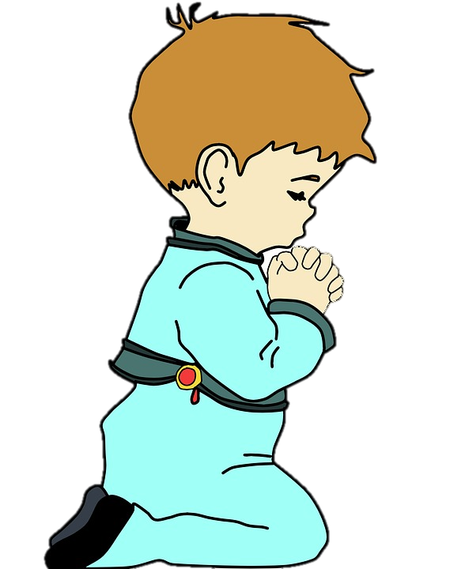
Prayers by children
Dear God, my Mom tells me that you have a reason for everything on Earth, I guess broccoli is one of your mysteries.
Please make my parents understand that if I don’t eat salad, I do better at school
Please forgive me for hiding my sister’s favorite doll…and please don’t tell her where it is.
Dear God, I need you to make my mom not allergic to cats. I really want a cat and I really don’t want to ask my mom to move out.

Slide 3
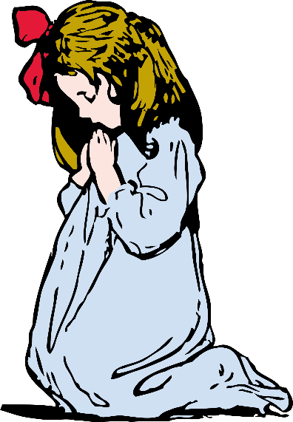
Prayers by children
Dear God…can you get me a Smartphone…Santa must have forgot.
Dear God, when will my sister stop being annoying, I’m down to my last patience.
Dear God, I promise to never say those words again, at least until my next shots.
Dear God, please don’t let it rain on Saturday, the first ball I hit will be for you.
Dear God, I hope my dog is with you in Heaven, please take care of him…sorry if he chews on your sandals

Slide 4
Hanna: Faith that Prays
We’re told that we need to have the faith of a little child
  And children can be quite literal in their requests.
  Today we consider that we can pray with confidence, God hears.

Slide 5
Listen for desperate prayer.
1 Samuel 1:1-2, 9 - 11 (NIV) There was a certain man from Ramathaim, a Zuphite from the hill country of Ephraim, whose name was Elkanah son of Jeroham, the son of Elihu, the son of Tohu, the son of Zuph, an Ephraimite. 2 He had two wives; one was called Hannah and the other Peninnah. Peninnah had children, but Hannah had none. … 9 Once when they had finished eating and drinking in Shiloh, Hannah stood up. Now Eli the priest was sitting on a chair by the

Slide 6

Listen for desperate prayer.
doorpost of the LORD's temple. 10 In bitterness of soul Hannah wept much and prayed to the LORD. 11 And she made a vow, saying, "O LORD Almighty, if you will only look upon your servant's misery and remember me, and not forget your servant but give her a son, then I will give him to the LORD for all the days of his life, and no razor will ever be used on his head."

Slide 7
Bring Your Needs to God
Why was Hannah so distressed?
What words and phrases describe her feelings?
How did she choose to handle her distress?
What are some reasons people might hesitate to bring their needs to the Lord?

Slide 8
Bring Your Needs to God
If Hannah lived today, what might she have done to help solve her particular problem?
Why is it more important to take our problems and requests to God?
What was the momentous promise she made to God?

Slide 9
Listen for how God answered prayer.
1 Samuel 1:17-18, 26 - 28 (NIV) Eli answered, "Go in peace, and may the God of Israel grant you what you have asked of him." 18 She said, "May your servant find favor in your eyes." Then she went her way and ate something, and her face was no longer downcast. … 26 and she said to him, "As surely as you live, my lord

Slide 10
Listen for how God answered prayer.
I am the woman who stood here beside you praying to the LORD. 27 I prayed for this child, and the LORD has granted me what I asked of him. 28 So now I give him to the LORD. For his whole life he will be given over to the LORD." And he worshiped the LORD there.

Slide 11
Trust God to Answer
Previous verses tell us that Eli at first thought she was drunk. Now, according to verse 17, what was Eli’s response to Hannah’s situation?
How did Hannah’s mood change after she had prayed? What did the presence of newfound peace allow her to do?
In a subsequent visit to Shiloh, what was Hannah’s testimony?

Slide 12

Trust God to Answer
What action did Hannah take that proved the sincerity of her vow to the Lord and her gratitude for His work in her life?
Agree or disagree?
It was a
good vow!
It was over the edge!
Yet God heard her vow and honored it
A Good Vow | Over the Edge

Slide 13
Trust God to Answer
Consider some promise you made to God at one time or another …
  To tithe or even give more than 10%
  To spend more time reading your bible and praying
  To volunteer for a church ministry (VBS, Bible Study groups, music ministry, visitation team, etc.)
⇨ Look for ways in which you can actually carry out on that promise this week.

Slide 14
Listen for how Hannah praises God.
1 Samuel 2:1-3 (NIV) Then Hannah prayed and said: "My heart rejoices in the LORD; in the LORD my horn is lifted high. My mouth boasts over my enemies, for I delight in your deliverance. 2 "There is no one holy like the LORD; there is no one besides you; there is no Rock like our God. 3 "Do not keep talking so proudly or let your mouth speak such arrogance, for the LORD is a God who knows, and by him deeds are weighed.

Slide 15
Thank God for His Answer
What are the main points of her prayer?
What are the prevailing emotions of Hannah’s prayer?
What traits of the Lord are highlighted in these verses? Why can He be trusted?

Slide 16
Thank God for His Answer
Why can God be trusted?
What are some practical ways to cultivate a lifestyle of gratitude?
Download and print 101 Reasons to Praise God
http://average-heros.tripod.com/id17.html to use in your personal time of prayer and praise.

Slide 17
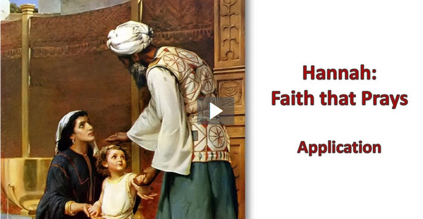
Applications
View Video

Slide 18
Applications
Pray.
  If you’re not in the habit of praying, begin.
  Do more than just offer quick, casual prayers;
  Set aside time each day for an uninterrupted conversation with God with no distractions.

Slide 19
Applications
Pray with others.
  Share your needs with others and pray together.
  Claim Jesus’ promise, “Again, truly I tell you that if two of you on earth agree about anything they ask for, it will be done for them by my Father in heaven. For where two or three gather in my name, there am I with them” (Matt. 18:19-20)

Slide 20
Applications
Pray with a journal.
  Begin a prayer journal or write down your prayer requests.
  Record Scriptures that speak of God’s character and His plans for your life.
  Journal about the ways you see God working in the midst of your need.

Slide 21

Family Activities
I’m just “hanging around” to try to do the Word Search. Humph! Some of the words are upside down. Yes, you got your precious Crossword Puzzle, but there’s words to be found at https://tinyurl.com/y3jb5yx2 ... Other fun and games there too. Humph! You’d be wise to get over there and GET TO WORK!

Slide 22
Hannah:
Faith that Prays
June 16

