Slide 1
Haman
August 18

Slide 2
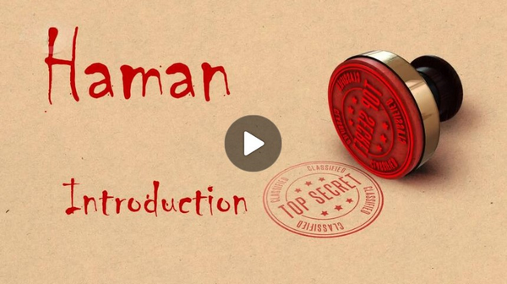
Video Introduction
View Video

Slide 3
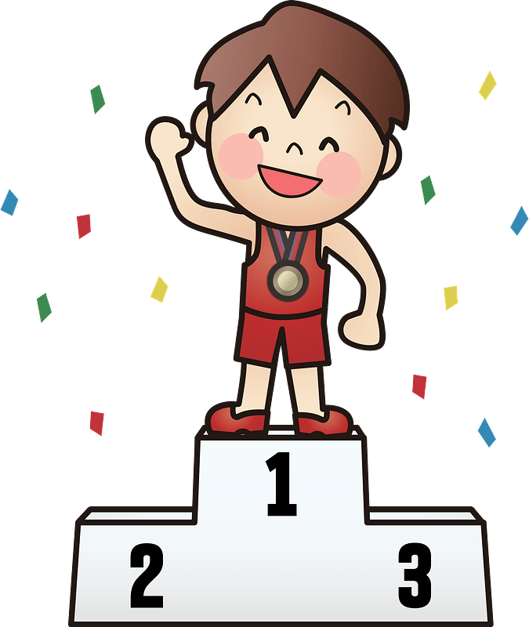
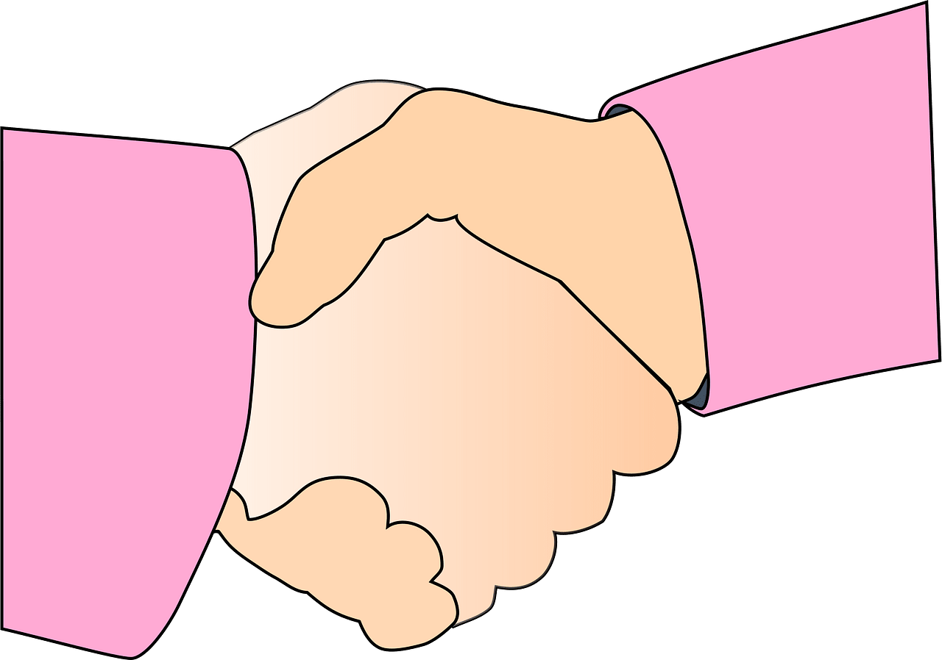
What do you think ?
In your opinion, what are some good ways to earn the respect of others?
Today we study a counter example of these practices.
Whatever you do, do it with humility

Slide 4
Listen for civil disobedience.
Esther 3:1-5 (NIV) After these events, King Xerxes honored Haman son of Hammedatha, the Agagite, elevating him and giving him a seat of honor higher than that of all the other nobles. 2 All the royal officials at the king's gate knelt down and paid

Slide 5
Listen for civil disobedience.
paid honor to Haman, for the king had commanded this concerning him. But Mordecai would not kneel down or pay him honor. 3 Then the royal officials at the king's gate asked Mordecai, "Why do you disobey the king's command?" 4 Day after day they spoke to him but

Slide 6
Listen for civil disobedience.
he refused to comply. Therefore they told Haman about it to see whether Mordecai's behavior would be tolerated, for he had told them he was a Jew. 5 When Haman saw that Mordecai would not kneel down or pay him honor, he was enraged.

Slide 7
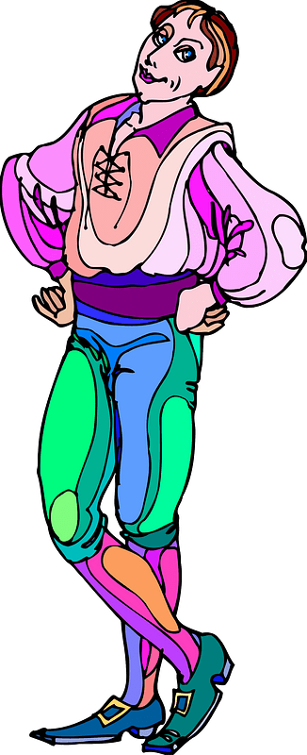
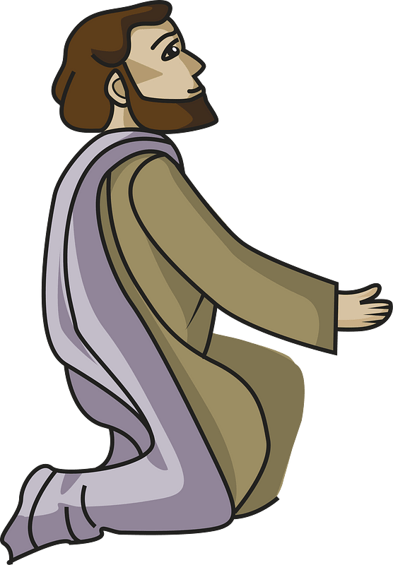
Accept Honors with Humility
How was Haman honored by the king?

Slide 8
Accept Honors with Humility
Note the description of Haman’s lineage
Descendant from the Amalekite King Agag.
When God commanded Saul to destroy the Amalekites, King Agag was on the throne.
The strife between Israel and the Amalekites started much earlier when they battled after the exodus.
Long enmity between Israelites and Amalekites.

Slide 9
Accept Honors with Humility
So, why do you think Mordecai refused to bow down to Haman?
How would you feel in Haman’s place?
Verse 5 says Haman was “enraged.” Do you think he was right or wrong to be mad? Why?
Correct to Be Upset | No Reason to Be Mad

Slide 10
Accept Honors with Humility
How would you describe humility? What are some synonyms?
How can believers guard against the temptations of pride and greed?

Slide 11
Listen for a deadly scheme.
Esther 3:6-9 (NIV) Yet having learned who Mordecai's people were, he scorned the idea of killing only Mordecai. Instead Haman looked for a way to destroy all Mordecai's people, the Jews, throughout the whole kingdom of Xerxes. 7 In the twelfth year of King Xerxes, in the first

Slide 12
Listen for a deadly scheme.
month, the month of Nisan, they cast the pur (that is, the lot) in the presence of Haman to select a day and month. And the lot fell on the twelfth month, the month of Adar. 8 Then Haman said to King Xerxes, "There is a certain people dispersed and scattered among the peoples in all the provinces of your kingdom whose customs

Slide 13
Listen for a deadly scheme.
are different from those of all other people and who do not obey the king's laws; it is not in the king's best interest to tolerate them. 9 If it pleases the king, let a decree be issued to destroy them, and I will put ten thousand talents of silver into the royal treasury for the men who carry out this business."

Slide 14
Pursuing Personal Gain
When Haman saw firsthand that Mordecai refused to show him honor and learned Mordecai’s ethnicity, what did he determine to do?
How did Haman take advantage of his position, his relationship to the king, and the king’s ego, to gain royal approval to exterminate the Jews?

Slide 15
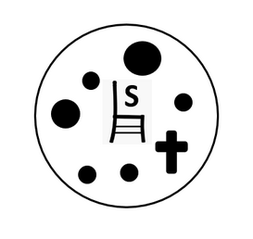
Pursuing Personal Gain
How can we identify when we’re drifting toward pettiness and revenge?
What can happen when someone's personal agenda attempts to override God's will?

Slide 16
Listen for how the tables were turned.
Esther 6:10-14 (NIV) "Go at once," the king commanded Haman. "Get the robe and the horse and do just as you have suggested for Mordecai the Jew, who sits at the king's gate. Do not neglect anything you have recommended." 11 So Haman got the robe and the horse. He robed Mordecai,

Slide 17
Listen for how the tables were turned.
and led him on horseback through the city streets, proclaiming before him, "This is what is done for the man the king delights to honor!" 12 Afterward Mordecai returned to the king's gate. But Haman rushed home, with his head covered in grief, 13 and told Zeresh his wife and all his friends everything that

Slide 18
Listen for how the tables were turned.
had happened to him. His advisers and his wife Zeresh said to him, "Since Mordecai, before whom your downfall has started, is of Jewish origin, you cannot stand against him--you will surely come to ruin!" 14 While they were still talking with him, the king's eunuchs arrived and hurried Haman away to the banquet Esther had prepared.

Slide 19
Destructiveness of Pride
The back story …
The king wanted to honor someone who had acted in his (the King’s) behalf
Haman didn’t realize it at first, but it was Mordecai
Some months/years previously, Mordecai had uncovered a plot against the king
Esther had relayed the warning, and the plot was foiled

Slide 20
Destructiveness of Pride
So, what ways did Haman suggest to show honor to someone (himself, he assumed)?
How is Haman an example of the destructiveness of pride and ego?

Slide 21
Destructiveness of Pride
In what ways can pride affect your relationship with God and others? Why do you think pride is so displeasing to God?
How can we protect ourselves against the temptation to be proud or arrogant?

Slide 22
Application
Consider.
Have you received special recognition lately … a raise or a promotion?
Did you receive it with humility?
Thank God for His favor and blessing and commit to accepting every recognition with humility.
Consider a way you can use your blessing to bless others.

Slide 23
Application
Confess.
Can you recognize the subtle pride within you?
Do you know when you’re starting down that slippery slope that leads to destruction?
Ask for forgiveness from others for any act of pride you have displayed.

Slide 24
Application
Be Accountable.
Do you have an accountability partner?
Have you given your family and friends the freedom to be open and honest with you?
Prayerfully choose someone who can ask you the tough questions.
Regularly meet and humbly submit to one another

Slide 25
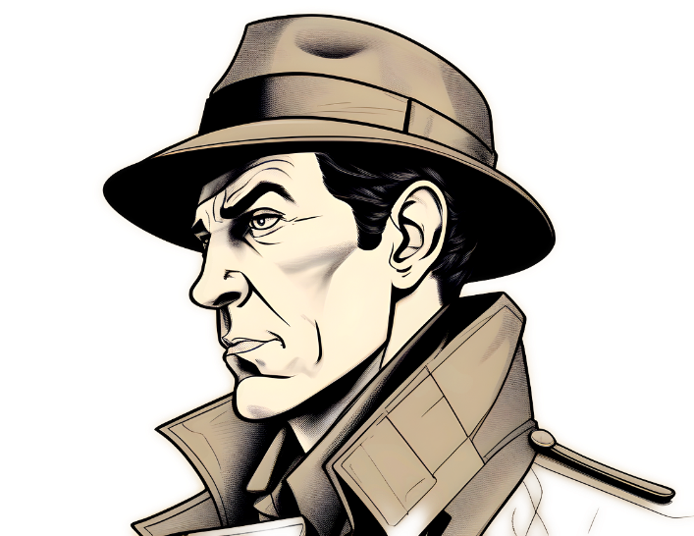
Family Activities
This is the key to the message you have been given. You must figure out some of the missing numbers as you decode the messge. The underground church in Hrainsau Blicgin gave the two parts of the message to operatives from our consulate. Share the decoded message with other Bible Study leaders. Help and other Family Activities are found at https://tinyurl.com/ytbcd3pn

Slide 26
Haman
August 18

