Slide 1

True Glory
October 11
True Glory

Slide 2

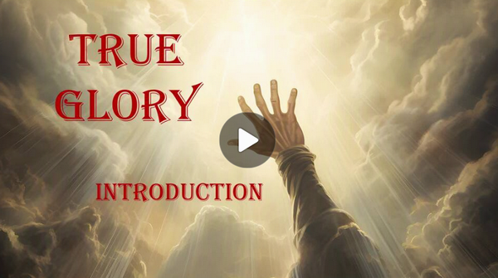
Video Introduction
View Video

Slide 3

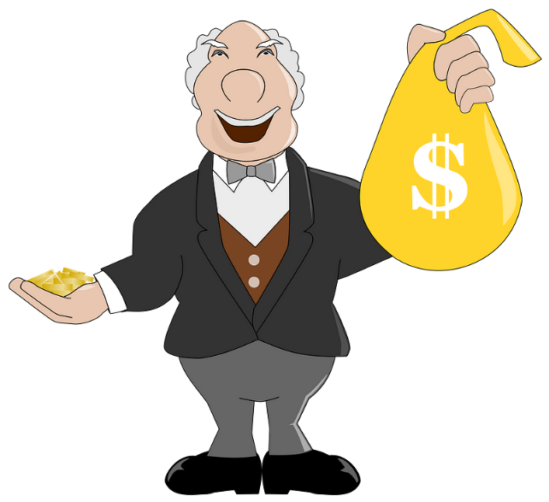

So they remember me …
What are some ways our culture tries to preserve legacy?
Today we note Jesus did not preserve His legacy through monuments or endowments.
  Jesus left a legacy of sacrifice.
  Jesus taught that true life comes through surrender.

Slide 4
1. True Glory Is
Found in Surrender, Not
Self-preservation.

Slide 5
Listen for how we follow Jesus.
John 12:23-26 (NIV) Jesus replied, "The hour has come for the Son of Man to be glorified. 24 I tell you the truth, unless a kernel of wheat falls to the ground and dies, it remains only a single seed. But if it dies, it produces many seeds. 25 The man

Slide 6
Listen for how we follow Jesus.
who loves his life will lose it, while the man who hates his life in this world will keep it for eternal life. 26 Whoever serves me must follow me; and where I am, my servant also will be. My Father will honor the one who serves me.

Slide 7
Surrender, Not Self-Preservation
How was Jesus’ path to glory contrary to what most Jews usually thought?
The reality was that Jesus came as a suffering servant (Isaiah 53) who would end up dying – and rising again from death.
According to Jesus, what attitude and actions constitute true discipleship?

Slide 8
Surrender, Not Self-Preservation
How do we too often “love” our own lives?
How does Jesus want us to hate our lives?
What would you tell someone about the challenges and benefits of following Christ?
Challenges | Benefits

Slide 9
2. The Pursuit of Human Glory Leads to Spiritual Blindness.

Slide 10
Listen for spiritual blindness.
John 12:37-42 (NIV) Even after Jesus had done all these miraculous signs in their presence, they still would not believe in him. 38 This was to fulfill the word of Isaiah the prophet: "Lord, who has believed our message and to whom has the arm of the Lord been

Slide 11
Listen for spiritual blindness.
revealed?" 39 For this reason they could not believe, because, as Isaiah says elsewhere: 40 "He has blinded their eyes and deadened their hearts, so they can neither see with their eyes, nor understand with their hearts, nor turn--and I would heal them." 41 Isaiah said

Slide 12
Listen for spiritual blindness.
this because he saw Jesus' glory and spoke about him. 42 Yet at the same time many even among the leaders believed in him. But because of the Pharisees they would not confess their faith for fear they would be put out of the synagogue;

Slide 13
Human Glory, Spiritual Blindness
According to this passage, why did some people refuse to believe in Jesus?
For this reason they could not believe, because, as Isaiah says elsewhere: "He has blinded their eyes and deadened their hearts, so they can neither see with their eyes, nor understand with their hearts, nor turn--and I would heal them."

Slide 14
Human Glory, Spiritual Blindness
It sounds like they were destined or forced not to believe. But …
  Parallel passage in Matt. 13:15 “For this people’s heart has become calloused... They have closed their own eyes."
  God's blinding is a judicial response to their persistent refusal to believe
  If you continuously reject the light of truth, your spiritual capacity to see that truth is destroyed.
  God "blinds" them by letting them have exactly what they wanted—a reality without His truth.

Slide 15
Human Glory, Spiritual Blindness
Actually, verse 42 shows that they did have a choice. Why didn’t the leaders who did believe in Jesus admit their faith?
How can people see the work of Jesus in others’ lives and still not believe in Him?

Slide 16
Human Glory, Spiritual Blindness
Where do you experience the tension between pleasing people and honoring God?
What consequences might a Christian face for publicly admitting faith in Jesus?

Slide 17
3. True Life Comes through
Believing And Obeying Jesus.

Slide 18
Listen for comments on belief.
John 12:44-50 (NIV) Then Jesus cried out, "When a man believes in me, he does not believe in me only, but in the one who sent me. 45 When he looks at me, he sees the one who sent me. 46 I have come into the world as a light, so that no one who believes in me should

Slide 19
Listen for comments on belief.
stay in darkness. 47 "As for the person who hears my words but does not keep them, I do not judge him. For I did not come to judge the world, but to save it. 48 There is a judge for the one who rejects me and does not accept my words; that very word which I spoke will

Slide 20
Listen for comments on belief.
condemn him at the last day. 49 For I did not speak of my own accord, but the Father who sent me commanded me what to say and how to say it. 50 I know that his command leads to eternal life. So whatever I say is just what the Father has told me to say."

Slide 21
Believing and Obeying Jesus
What does Jesus say about Himself in verse 44? What does believing in Jesus also mean?
Why do you think Jesus describes Himself as the “light” in verse 46? What does light do for us?

Slide 22
Believing and Obeying Jesus
When Jesus says, “He that believeth on me,” what does genuine belief in Jesus involve besides simply knowing that He exists?
Why does genuine belief in Jesus naturally affect the way a person lives?

Slide 23
Application
Think about it …
  Jesus said a grain of wheat must fall to the ground and die to produce much fruit.
  Other than your salvation, how have you seen this truth in your own life?

Slide 24
Application
Who do you glorify?
  Jesus didn’t seek His own glory; but the Father’s.
  What should the relationship between the Father, Son, and Spirit teach us about glorifying God versus self-glorification?

Slide 25
Application
This week …
  What would it look like to live this week for God’s glory over your own?
  How can you glorify God in the daily routine of your life?

Slide 26
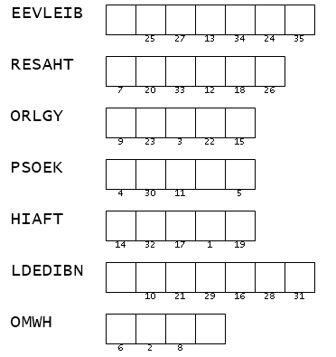

Family Activities
Mes amis, I have received, through our most discreet contacts in the Far East, a most intriguing communication. Employ your powers of deduction and unscramble certain key words. Use the accompanying numbers to determine which letters belong in the squares of the hidden message. Help can be found (with the Crossword) at https://tinyurl.com/mv6cw3ah

Slide 27
True Glory
October 11
True Glory

