Slide 1

The Wedding at Cana

Slide 2

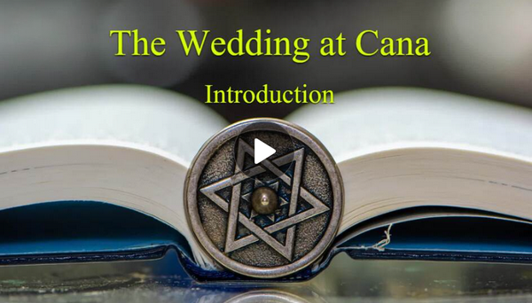
Introduction Video
View Video

Slide 3


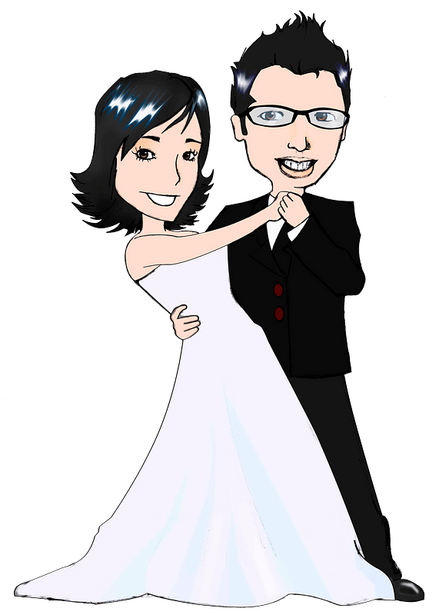

It was epic …
Have you ever experienced something going wrong at a wedding? What happened?

Slide 4
The Wedding at Cana
This lesson looks at something that went wrong in a wedding Jesus attended.
  Jesus steps in to solve the problem with a miracle.
  It happened unnoticed by many, but it was a demonstration of Jesus working in people’s lives ultimately for His glory.

Slide 5
1. Followers of Jesus Submit to His Authority.

Slide 6
Listen for who points out the problem.
John 2:1-5 (NIV) On the third day a wedding took place at Cana in Galilee. Jesus' mother was there, 2 and Jesus and his disciples had also been invited to the wedding. 3 When the wine was

Slide 7

Listen for who points out the problem.
gone, Jesus' mother said to him, "They have no more wine." 4 "Dear woman, why do you involve me?" Jesus replied. "My time has not yet come." 5 His mother said to the servants, "Do whatever he tells you."

Slide 8
Submit to His Authority
At the wedding celebration, it was Jesus’ mother Mary who told him the host had run out of wine. What did Jesus remind Mary when he replied?
"Dear woman, why do you involve me?" Jesus replied. "My time has not yet come." His mother said to the servants, "Do whatever he tells you."

Slide 9
Submit to His Authority
Why do you think she got Jesus involved?
Why do you think Jesus seemed to hesitate to help?
What did she do to demonstrate trust and understanding that He was more than merely the Son she had raised?

Slide 10
Submit to His Authority
Why do we find it difficult to sometimes place our needs in Jesus’ hands and trust Him to do what is best?
How does understanding Jesus’ mission help you see Him as more than a miracle worker or emergency responder?
What difference should this make in your prayers, attitudes and actions?

Slide 11
2. Followers of Jesus
Experience His Power.

Slide 12
Listen for a quality miracle.
John 2:6-10 (NIV) Nearby stood six stone water jars, the kind used by the Jews for ceremonial washing, each holding from twenty to thirty gallons. 7 Jesus said to the servants, "Fill the jars with water"; so they filled them to the brim. 8 Then he

Slide 13
Listen for a quality miracle.
told them, "Now draw some out and take it to the master of the banquet." They did so, 9 and the master of the banquet tasted the water that had been turned into wine. He did not realize where it had come from, though the servants

Slide 14
Listen for a quality miracle.
who had drawn the water knew. Then he called the bridegroom aside 10 and said, "Everyone brings out the choice wine first and then the cheaper wine after the guests have had too much to drink; but you have saved the best till now."

Slide 15
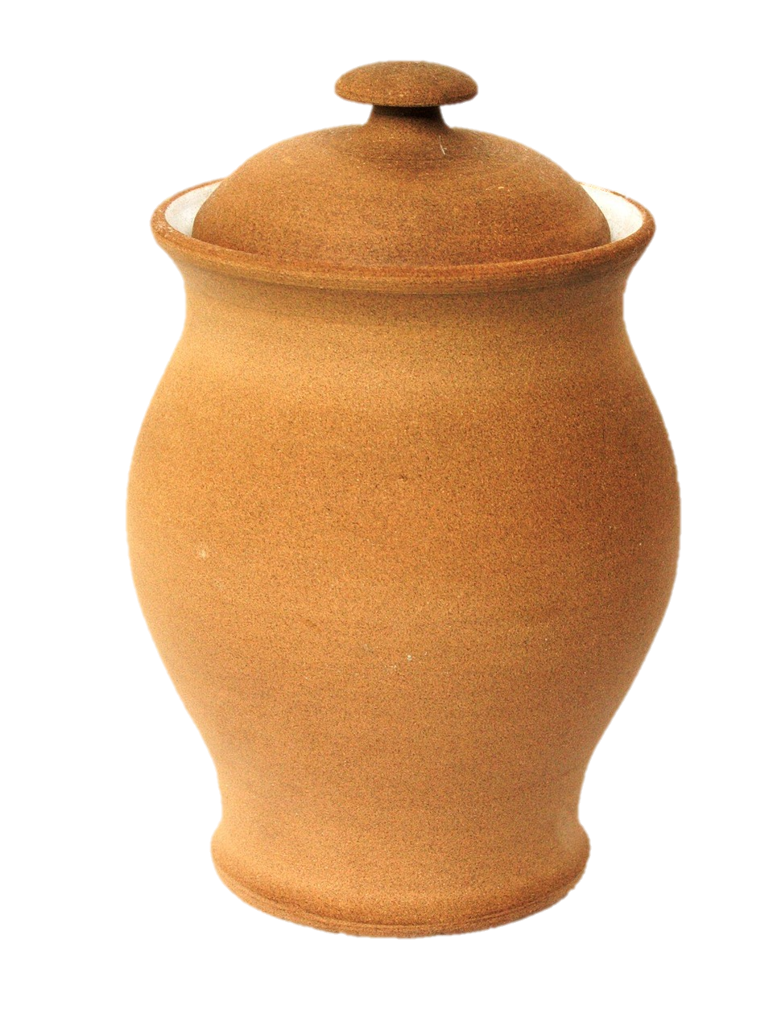
Experience His Power.
Note the physical difficulty about obeying Jesus’ commands.
  Six jugs, 20 – 30 gallons each
  Would be from 120 – 180 gallons
  of water
  This is a total weight of 1000 – 1500
  pounds to be carried or drawn up
  from a well

Slide 16
Experience His Power.
After all the difficulty of filling the water jugs, why might the servants be hesitant to take a sample of the contents to the master of ceremonies.
What benefits did the servants receive from following Jesus’ command?

Slide 17
Experience His Power.
Some of the commands Jesus gives us are difficult. What are the benefits to us or others?
Difficult Commands | Benefits of Obedience
Witness to people Take the Gospel worldwide Give tithes, offerings Love neighbor as self Raise children to honor God

Slide 18
Experience His Power.
How did Jesus’s miracle impact more than just the servants and the master of ceremonies?
How might Jesus do a miracle in someone else’s life and indirectly benefit you?

Slide 19
3. Followers of Jesus behold His glory.

Slide 20
Listen for the disciples’ response.
John 2:11-12 (NIV) This, the first of his miraculous signs, Jesus performed at Cana in Galilee. He thus revealed his glory, and his disciples put their faith in him. 12 After this he went down to Capernaum with his mother and brothers and his disciples. There they stayed for a few days.

Slide 21
Behold His Glory
According to the passage, what were the results of this miracle?
This, the first of his miraculous signs, Jesus performed at Cana in Galilee. He thus revealed his glory, and his disciples put their faith in him.

Slide 22
Behold His Glory
What qualities of God do you think weighed heavily and shone brightly to the disciples as they observed Jesus?
The disciples believed. What things has Jesus accomplished in your life that have increased your faith in Him?

Slide 23
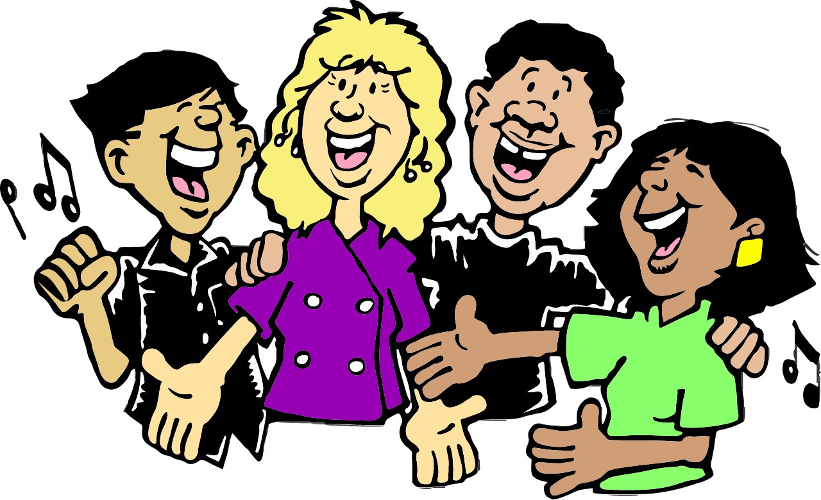
Behold His Glory
How does Jesus reveal His glory to us today?
How should we respond to these revelations of God’s glory?

Slide 24
Application
Family events such as weddings are personal and social celebrations, but they also should be sacred occasions
  When Jesus becomes involved in our life events, something special and unexpected can happen
  Invite Jesus’ special presence and power to your events this week

Slide 25
Application
It is easy to be unaware of the miracles that go on about us.
  Following Jesus opens up our lives to special and exciting blessings
  Look for God at work in your daily life – He’s there!

Slide 26
Application
God revealed His glory in the person of Jesus, His one and only Son
  The disciples faith had an initial start, but it grew as they saw Jesus’ ongoing ministry
  Allow God to dynamically grow your faith each day

Slide 27
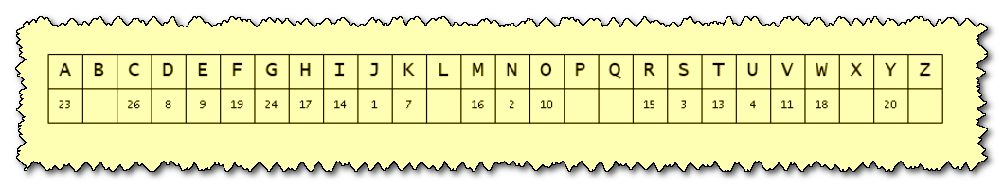
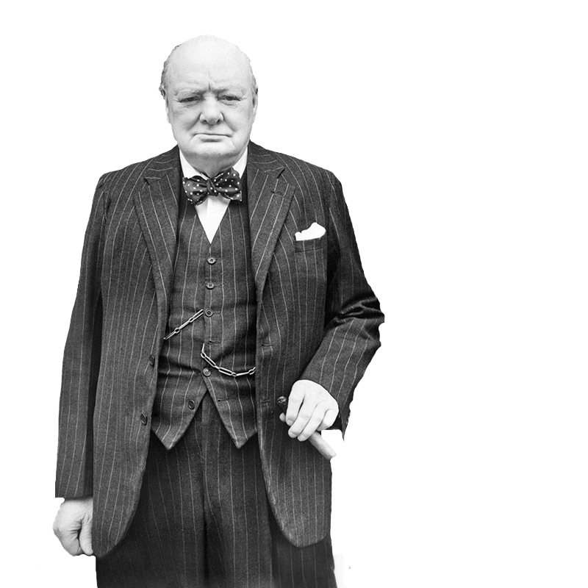
Family Activities
Our agents of MI6 have received a coded message from our valiant operatives in Cairnu Vangabia—borne from the underground church that gathers in secrecy and steadfast courage. Use the key from our secret files, match numbers to letters. Reliable sources indicate help and further fun
Family Activities can be found at https://tinyurl.com/6x2eu56h

Slide 28
The Wedding at Cana

