Slide 1

Testimony of the Samaritan Woman at the Well

Slide 2

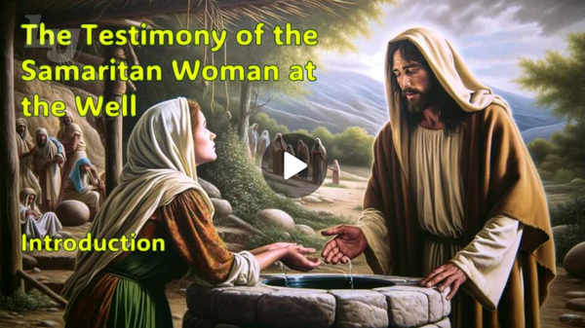
Video Introduction
View Video

Slide 3



Who can you trust?
What actions by another let you know you can trust them?
Today we study how Jesus built up trust with someone by the way He acted.
⇨We learn how to build up trust with people to
whom we can share the gospel

Slide 4
1. Jesus Invites Us to
Living Water.

Slide 5
Listen for a surprise.
John 4:7-14 (NIV) When a Samaritan woman came to draw water, Jesus said to her, "Will you give me a drink?" 8 (His disciples had gone into the town to buy food.) 9 The Samaritan woman said to him, "You are a Jew and I am a Samaritan woman. How can you ask me for a drink?" (For Jews do not associate with Samaritans.) 10 Jesus

Slide 6
Listen for a surprise.
answered her, "If you knew the gift of God and who it is that asks you for a drink, you would have asked him and he would have given you living water." 11 "Sir," the woman said, "you have nothing to draw with and the well is deep. Where can you get this living water? 12 Are you greater than our father Jacob, who gave

Slide 7
Listen for a surprise.
us the well and drank from it himself, as did also his sons and his flocks and herds?" 13 Jesus answered, "Everyone who drinks this water will be thirsty again, 14 but whoever drinks the water I give him will never thirst. Indeed, the water I give him will become in him a spring of water welling up to eternal life."

Slide 8
Jesus Invites Us to Living Water.
Note the Samaritan woman’s surprise:
  Jesus was a Jew
  She was Samaritan, she was a woman
  Jews didn’t associate with Samaritans
  Relative to a Jewish rabbi, a Samaritan woman was at the bottom of the social ladder

Slide 9
Jesus Invites Us to Living Water.
Jesus answered …
"If you knew the gift of God and who it is that asks you for a drink, [then] you would have asked him, and he would have given you living water."

Slide 10
Jesus Invites Us to Living Water.
What did the Samaritan woman think Jesus was talking about?
Sir," the woman said, "you have nothing to draw with and the well is deep. Where can you get this living water? Are you greater than our father Jacob, who gave us the well and drank from it himself, as did also his sons and his flocks and herds?"

Slide 11
Jesus Invites Us to Living Water.
Jesus answered, "Everyone who drinks this water will be thirsty again, but whoever drinks the water I give him will never thirst. Indeed, the water I give him will become in him a spring of water welling up to eternal life."
How do you know that the woman misunderstood what Jesus was saying? She may have even been sarcastic in her response.
List what Jesus said would be the result of drinking the “water” He offered?
How can confusion about spiritual things open the door for more discussion?

Slide 12



Jesus Invites Us to Living Water.
Note Jesus’ use of water as a metaphor to teach about salvation.
He also used
  Bread
  Light
  Breath
Jesus provides all that is needed to sustain spiritual life.

Slide 13
Jesus Invites Us to Living Water.
Think about some everyday objects – how might we use these to communicate a truth or confront people with a need in their lives?
  A car
  Your garden
  A road detour
  Your fishing rod
  Food

Slide 14
2. Jesus Invites Us to Living Relationships.

Slide 15
Listen for a sad confession by the woman.
John 4:15-18 (NIV) The woman said to him, "Sir, give me this water so that I won't get thirsty and have to keep coming here to draw water." 16 He told her, "Go, call your husband and come back."

Slide 16
Listen for a sad confession by the woman.
"I have no husband," she replied. Jesus said to her, "You are right when you say you have no husband. 18 The fact is, you have had five husbands, and the man you now have is not your husband. What you have just said is quite true."

Slide 17

Jesus Invites Us to Living Relationships
Note the facts we learn about the woman in this passage.
  No husband
  Five failed marriages
  Current live-in boyfriend

Slide 18
Jesus Invites Us to Living Relationships
Why do you think Jesus asked her to call her husband?
Certainly Jesus has the right to go directly to our sore spots, but how are we to follow His example when we witness or counsel?
What are some “wells” that people “drink” from in efforts to satisfy their “thirst”?

Slide 19
Jesus Invites Us to Living Relationships
This may be one of the hardest parts of witnessing … the Holy Spirit must do the convincing.
Why do these efforts fail?
Why is it essential that this woman, and any of us, be confronted with the sin in our lives?

Slide 20
3. Jesus Invites Us into
Living Mission.

Slide 21
Listen for a sudden realization.
John 4:28-30 (NIV) Then, leaving her water jar, the woman went back to the town and said to the people, 29 "Come, see a man who told me everything I ever did. Could this be the Christ?" 30 They came out of the town and made their way toward him.

Slide 22
Jesus Invites Us into Living Mission.
What conclusion did the woman apparently come to because of her conversation with Jesus?
Then, leaving her water jar, the woman went back to the town and said to the people, "Come, see a man who told me everything I ever did. Could this be the Christ?" They came out of the town and made their way toward him.

Slide 23
Jesus Invites Us into Living Mission.
Note her response
  Tell others
  Go out of her way to communicate her experience
  “You need to see Him”
  “I think He could be the Messiah”
  “He knows stuff!”
  “We need to hear what He has to say”

Slide 24
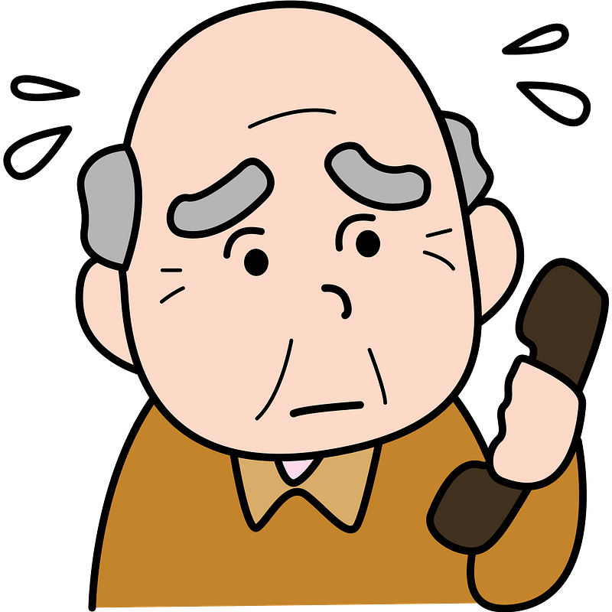
Jesus Invites Us into Living Mission.
What barriers keep us from talking to other people about Christ?

Slide 25
Top Ten Pointers from Jesus’ Encounter
10. Go where lost people are.
9. Create interest by what you are saying.
8. Meet lost people at their immediate point of need.
7. Ignore barriers to talking with them.
6. Use a different approach if the first one doesn’t work well.

Slide 26
Top Ten Pointers from Jesus’ Encounter
5. Refuse to be side-tracked in religious arguments.
4. Keep your focus on who Jesus is and what He has done.
3. Encourage new believers to share their faith with others.
2. Disciple new believers by spending time with them.
1. Look for more lost people.

Slide 27
Application
Jesus is still offering the living water of eternal life today
  The Samaritan woman’s response was one of acceptance not rejection
  People today are thirsting for the Living Water
  We should take initiative to offer them eternal life

Slide 28
Application
When you talk to people, listen to what they have to say
  Answer their questions
  Deal briefly with their excuses
  Return their focus to Jesus … who He is, what He has done for them

Slide 29
Application
Pray for specific people in your circle of acquaintances who are not believers
  Pray for opportunities to share with them
  Pray that you will be aware “divine appointments” which God provides to share with others
  Pray for god’s wisdom in using Jesus’ model for sharing the gospel

Slide 30
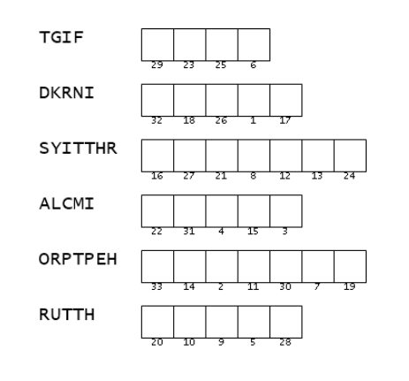

Family Activities
Friends, two small scraps of paper found their way into the Baptist consulate in Wilie Sierusal. They came from a persecuted church, reminding us—quietly but powerfully—that God is still changing lives, even in the hardest places. Take a moment with it. Let their courage warm your heart. It’s a simple reminder, but one filled with hope.

Slide 31
Testimony of the Samaritan Woman at the Well

