Slide 1

The Testimony of John the Baptist

Slide 2
The Testimony of John the Baptist
March 1

Slide 3
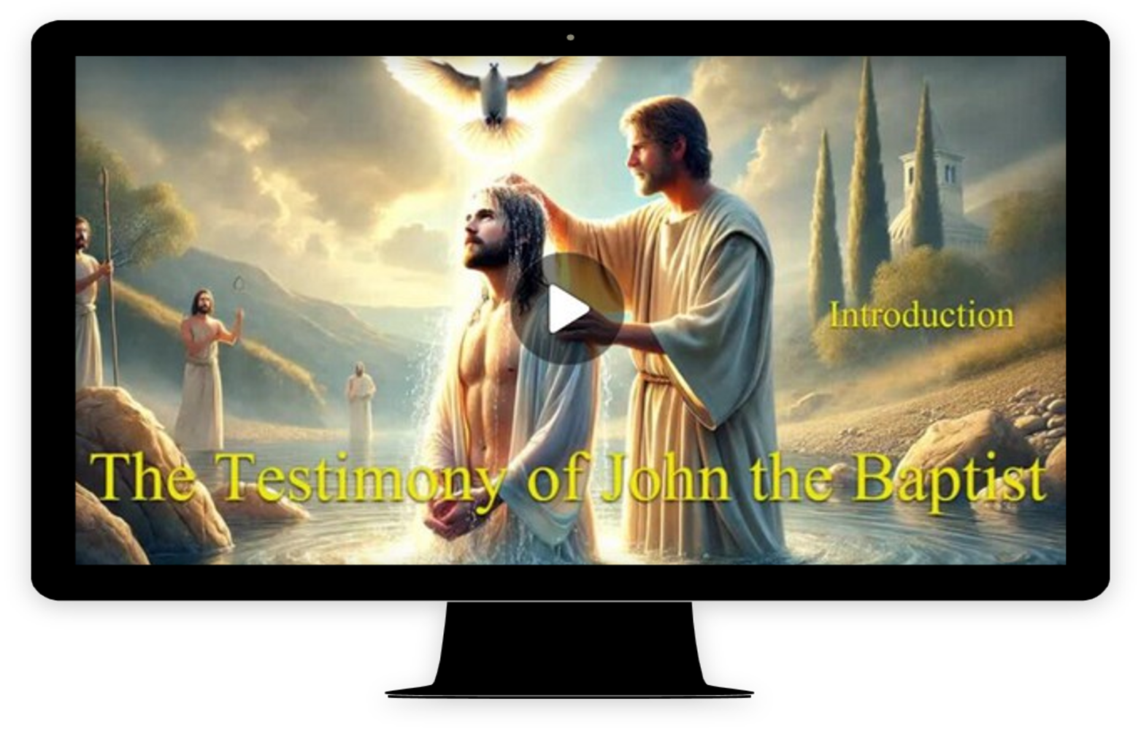
Video Introduction
View Video

Slide 4



Admit it, now …
What are some ways we display what we like the most?
Most of us naturally like to impress others with how important we are
We like to exalt ourselves … but …
As stated by John the Baptist, Christ-centered living chooses to exalt Christ, not self.

Slide 5
1. John the Baptist’s Identity Pointed Toward Jesus.

Slide 6
Listen for Q and A.
John 1:19-23 (NIV) Now this was John's testimony when the Jews of Jerusalem sent priests and Levites to ask him who he was. 20 He did not fail to confess, but confessed freely, "I am not the Christ." 21 They asked him, "Then who are you? Are you Elijah?" He said, "I am not." "Are

Slide 7
Listen for Q and A.
you the Prophet?" He answered, "No." 22 Finally they said, "Who are you? Give us an answer to take back to those who sent us. What do you say about yourself?" 23 John replied in the words of Isaiah the prophet, "I am the voice of one calling in the desert, 'Make straight the way for the Lord.'"

Slide 8
Identity Pointed Toward Jesus
Why was John the Baptist an unexpected messenger?
What are some unexpected ways God might speak to us today?

Slide 9
Identity Pointed Toward Jesus
What did John get asked? How did he answer?
Questions | Answers
sent priests and Levites to ask him who he was. … confessed freely, "I am not the Christ." They asked him, "Then who are you? Are you Elijah?" He said, "I am not." "Are you the Prophet?" He answered, "No." Finally they said, "Who are you? Give us an answer… John replied in the words of Isaiah the prophet, "I am the voice of one calling in the desert, 'Make straight the way for the Lord.'"

Slide 10

Identity Pointed Toward Jesus
Why do you think John the Baptist used the idea of being “the voice” to describe his role?
What does it mean to seek your identity in Christ?
What difference does seeking your identity in Christ make in everyday life?

Slide 11
2. John the Baptist’s Ministry Pointed Toward Jesus.

Slide 12
Listen for a contrast.
John 1:24-28 (NIV) Now some Pharisees who had been sent 25 questioned him, "Why then do you baptize if you are not the Christ, nor Elijah, nor the Prophet?" 26 "I baptize with water," John replied, "but among you

Slide 13
Listen for a contrast.
stands one you do not know. 27 He is the one who comes after me, the thongs of whose sandals I am not worthy to untie." 28 This all happened at Bethany on the other side of the Jordan, where John was baptizing.

Slide 14
Ministry Pointed Toward Jesus
How did John the Baptist’s baptism point toward Jesus?
What do you think is the significance of the phrase “whose sandal strap I’m not worthy to untie”?
Identify the ways John lifted up the Christ and at the same time highlighted his own unworthiness.

Slide 15
Testimony Pointed Toward Jesus
Are there ways to serve God vocationally even if you are not in full-time ministry? How can we be the “warm up act” for people learning about the Good News of salvation?
How could you surrender your vocational service, inside or outside of the home, as a place for Christ to rule and reign?

Slide 16

Ministry Pointed Toward Jesus
How do we confess/communicate/declare Christ’s superiority over us today?

Slide 17
3. John the Baptist’s Testimony Pointed Toward Jesus.

Slide 18
Listen for an introduction.
John 1:29-34 (NIV) The next day John saw Jesus coming toward him and said, "Look, the Lamb of God, who takes away the sin of the world! 30 This is the one I meant when I said, 'A man who comes after me has surpassed me because he was before me.'

Slide 19
Listen for an introduction.
31 I myself did not know him, but the reason I came baptizing with water was that he might be revealed to Israel." 32 Then John gave this testimony: "I saw the Spirit come down from heaven as a dove and remain on him. 33 I would not

Slide 20
Listen for an introduction.
have known him, except that the one who sent me to baptize with water told me, 'The man on whom you see the Spirit come down and remain is he who will baptize with the Holy Spirit.' 34 I have seen and I testify that this is the Son of God."

Slide 21
Testimony Pointed Toward Jesus
What two titles did John the Baptist ascribe to Jesus?
John saw Jesus coming toward him and said, "Look, the Lamb of God, who takes away the sin of the world! … I have seen and I testify that this is the Son of God."

Slide 22
Testimony Pointed Toward Jesus
How are they both important to understand Him rightly?
Lamb of God | Son of God

Slide 23
Testimony Pointed Toward Jesus
What are the “sins of the world”? What does Jesus do with the sins of the world?
"Look, the Lamb of God, who takes away the sin of the world!

Slide 24
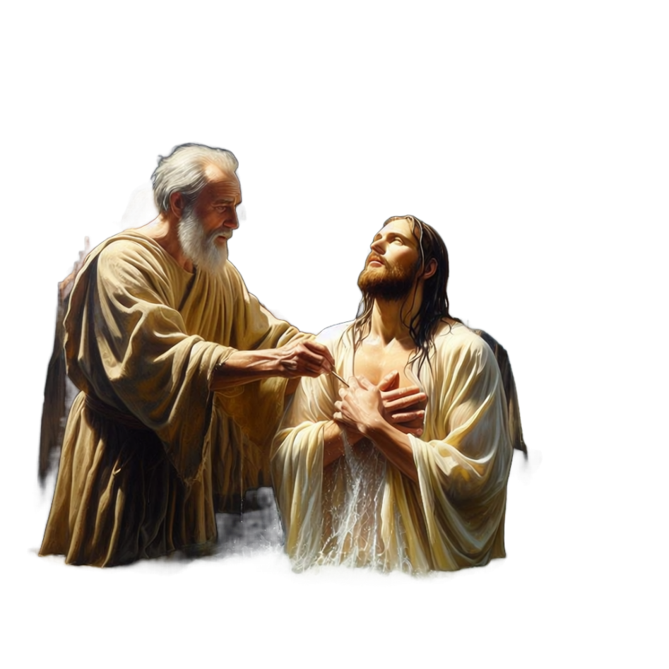
Testimony Pointed Toward Jesus
John had a personal experience with Jesus and that was important. Why is a personal testimony so powerful?

Slide 25
Application
Where do you need to apply John’s words, “He must become greater, I must become less”?
In your finances
In your family
With your co-workers

Slide 26
Application
Take a personal inventory of yourself.
Determine who or what your life points to.
Consider the steps you need to take to place the focus of your life rightfully on Jesus.

Slide 27
Application
Write out your testimony.
Express it in a way that keeps all the focus on Jesus.
Pray for an opportunity to share your testimony.

Slide 28

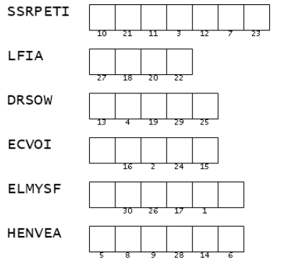

Family Activities
Pay close attention to the taped message. It will tell you how to decrypt the important message from the underground church in Jithecoast. Technical help and more Family activities are found at https://tinyurl.com/2m6ne4n9

Slide 29
The Testimony of John the Baptist

