Slide 1

Nicodemus and the New Birth

Slide 2

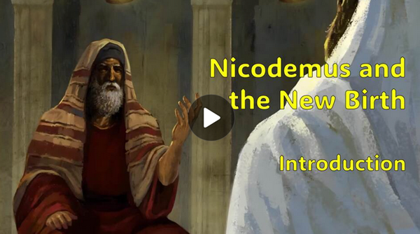
Video Introduction
View Video

Slide 3


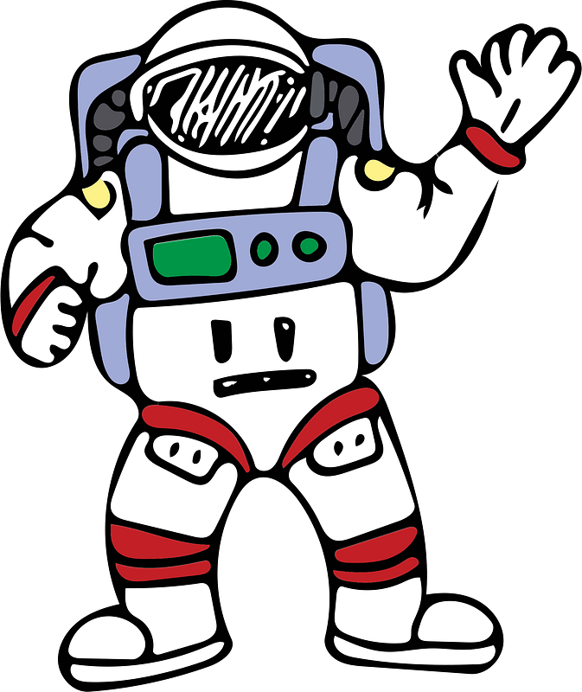
Surprising facts … really TRUE!
Tuesday, 5:23 am
Snakes can predict earthquakes.
Lego mini figures have the largest population on earth (more than China).
Astronauts grow taller in space.

Slide 4




Surprising facts … really TRUE!
There’s a 50% chance that two people will share a birthday in a group of 23 people.
Sea lions are the only animals that can clap to a beat.
Glass balls bounce higher than rubber balls.
It snows metal on Venus.

Slide 5
Really True
These are interesting, but somewhat inconsequential to our daily lives.
Truths about God are much more important.
Today we look at Nicodemus’ search for and revelation to Truth.

Slide 6
1. New Birth Is Required.

Slide 7
Listen for confusion.
John 3:1-9 (NIV) Now there was a man of the Pharisees named Nicodemus, a member of the Jewish ruling council. 2 He came to Jesus at night and said, "Rabbi, we know you are a teacher who has come from God. For no one could perform the miraculous signs you are doing if God were not with him." 3 In reply Jesus declared, "I tell

Slide 8
Listen for confusion.
you the truth, no one can see the kingdom of God unless he is born again." 4 "How can a man be born when he is old?" Nicodemus asked. "Surely he cannot enter a second time into his mother's womb to be born!" 5 Jesus answered, "I tell you the truth, no one can enter the kingdom of God unless he is born of water and the Spirit. 6 Flesh gives

Slide 9
Listen for confusion.
birth to flesh, but the Spirit gives birth to spirit. 7 You should not be surprised at my saying, 'You must be born again.' 8 The wind blows wherever it pleases. You hear its sound, but you cannot tell where it comes from or where it is going. So it is with everyone born of the Spirit." 9 "How can this be?" Nicodemus asked.

Slide 10
New Birth is Required
Note facts about Nicodemus in verse 1.
He is a Pharisee
Member of the Jewish ruling council
Came to Jesus at night

Slide 11
New Birth is Required
What might be some reasons that he came to Jesus at night?
At least on surface level, whom did he acknowledge Jesus to be? List the attributes he stated about Jesus.
"Rabbi, we know you are a teacher who has come from God. For no one could perform the miraculous signs you are doing if God were not with him.”

Slide 12
New Birth is Required
Rather than respond to Nicodemus’s compliments, note the assertions Jesus made.
No one can see the kingdom of God unless he is born again … no one can enter the kingdom of God unless he is born of water and the Spirit … 'You must be born again

Slide 13
New Birth is Required
Why would such a statement be a challenge to Nicodemus’ thinking, and indeed, all Pharisees?
What are options for understanding that a man be “born of water and of the Spirit”? What did Jesus mean?

Slide 14

New Birth is Required
Note the illustration from nature used to convey a spiritual truth … He compares the concept of God’s Spirit to the wind.

Slide 15
New Birth is Required
What are some characteristics of wind listed by the passage?
How do these characteristics of wind describe the work of the Holy Spirit?
The wind blows wherever it pleases. You hear its sound, but you cannot tell where it comes from or where it is going. So it is with everyone born of the Spirit.

Slide 16
2. New Birth Is Received by Faith.

Slide 17
Listen for a reprimand.
John 3:10-15 (NIV) "You are Israel's teacher," said Jesus, "and do you not understand these things? 11 I tell you the truth, we speak of what we know, and we testify to what we have seen, but still you people do not accept our testimony. 12 I have spoken to you of earthly things and you do not believe; how

Slide 18
Listen for a reprimand.
then will you believe if I speak of heavenly things? 13 No one has ever gone into heaven except the one who came from heaven--the Son of Man. 14 Just as Moses lifted up the snake in the desert, so the Son of Man must be lifted up, 15 that everyone who believes in him may have eternal life.

Slide 19
New Birth Is Received by Faith
Recall the “snake event” in Numbers 21:4 – 9.
The people suffering from snake bites had merely to look at the snake image on the pole
Jesus here is saying that this was a symbolic event that looked forward to Jesus being “lifted up” on a cross
A sinner suffering from sin’s penalty and power looks to Jesus for spiritual life
Note that in both situations, it was God’s purpose to save … not to condemn

Slide 20
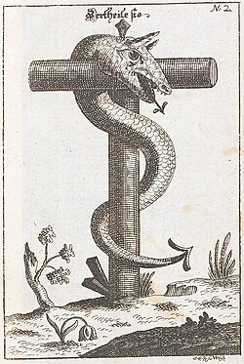
New Birth Is Received by Faith
How does the historical illustration support Jesus’s message to Nicodemus? Why is the symbol of the bronze serpent a fitting connection to Jesus on the cross?

Slide 21
New Birth Is Received by Faith
How did both of these methods of salvation point to the concept of faith?
Beyond the moment of salvation, we are to fix our eyes on Christ every day. What does it mean for you to “look to Jesus” in your daily life?

Slide 22
3. New Birth Brings Us Into The Light.

Slide 23
Listen for facts about Light
John 3:19-21 (NIV) This is the verdict: Light has come into the world, but men loved darkness instead of light because their deeds were evil. 20 Everyone who does evil hates the light, and

Slide 24
Listen for facts about Light
will not come into the light for fear that his deeds will be exposed. 21 But whoever lives by the truth comes into the light, so that it may be seen plainly that what he has done has been done through God."

Slide 25
New Birth Brings Us into the Light
How are darkness and light contrasted in this passage?
Darkness | Light
Light has come into the world, but men loved darkness instead of light because their deeds were evil. Everyone who does evil hates the light, and will not come into the light for fear that his deeds will be exposed. But whoever lives by the truth comes into the light, so that it may be seen plainly that what he has done has been done through God

Slide 26
New Birth Brings Us into the Light
What do we mean when we use the word “darkness” in this way? Just what is “darkness”?
So, what then is the contrasting meaning of “light”?
Why do some people love darkness rather than light?
What is the attitude of those who love and live the Truth and the light manifested in Christ?

Slide 27
Application
Meditate
The world God loves includes you.
What does it mean to think that God loves you enough to send Jesus?

Slide 28
Application
Experience God’s Love
Let the knowledge of God’s love impact the way you lead your family.
Show God’s love in your workplace.
Allow it to impact your interactions with others.

Slide 29
Application
Live in God’s Light
Reflect on when the Light of Jesus first shone into your life.
Allow God’s Light to shine into all areas of your life.
Think about how it can bring confession, repentance, and renewal.

Slide 30


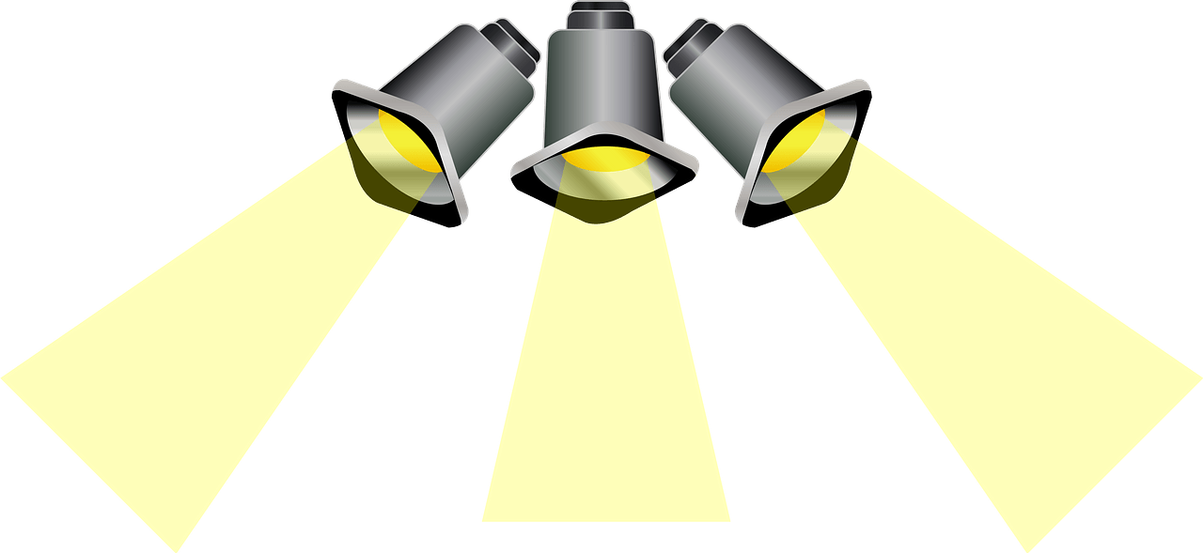
Family Activities
Let me shine some more light on this challenge. You need to look for clues in John 3:19 – 21; 8:31 – 36 (NIV). Check the link on your handout for even more fun Family Activites!

Slide 31
Nicodemus and the New Birth

