Slide 1

The Last Supper – Farewell Discourse

Slide 2

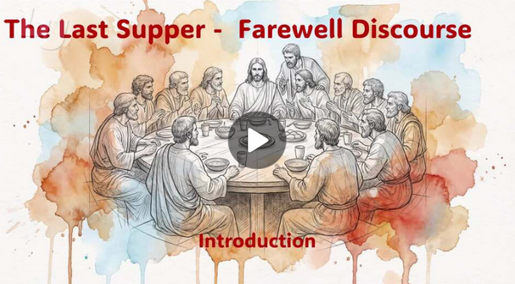
Video Introduction
View Video

Slide 3
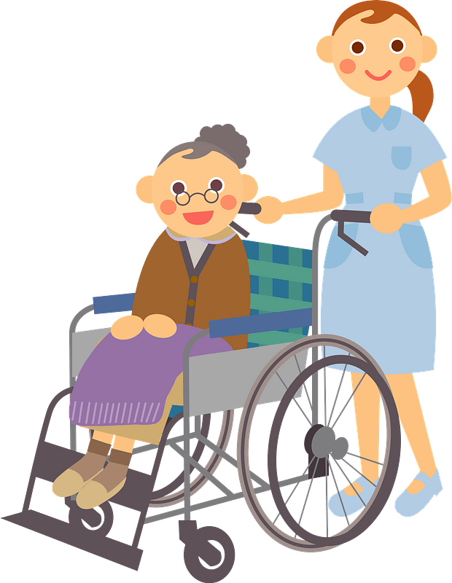

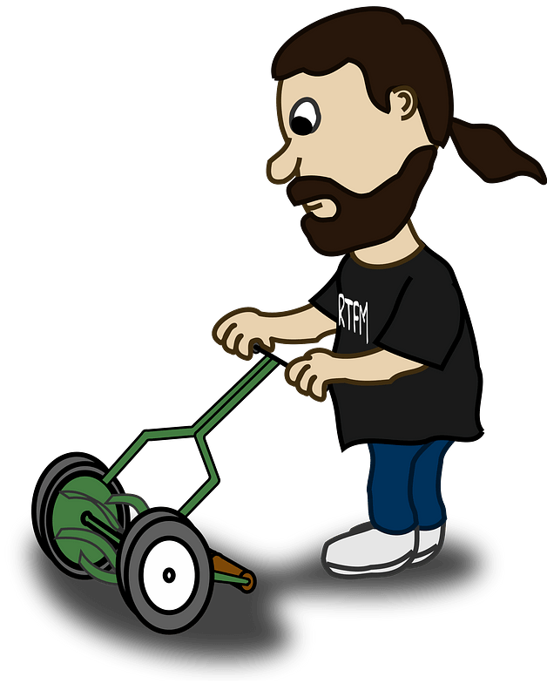
Remember that time?
When have you seen someone go out of their way to serve others?

Slide 4
Remember that time?
When have you seen someone go out of their way to serve others?
Today we study the example of Jesus who served others.
  He washed the dirty, stinky feet of the disciples.
  Including Judas, whom He knew was about to betray Him.

Slide 5
1. Because Jesus Loves Me,
I Can Serve Others, Even Those Who Hurt Me.

Slide 6
Listen for what Jesus did that was unusual.
John 13:1, 3-8 (NIV) It was just before the Passover Feast. Jesus knew that the time had come for him to leave this world and go to the Father. Having loved his own who were in the world, he now showed them the full extent of his love. … [3] Jesus knew that the Father had put

Slide 7
Listen for what Jesus did that was unusual.
all things under his power, and that he had come from God and was returning to God; [4] so he got up from the meal, took off his outer clothing, and wrapped a towel around his waist. [5] After that, he poured water into a basin and began to wash his disciples' feet, drying them with the towel that was

Slide 8

Listen for what Jesus did that was unusual.
wrapped around him. 6 He came to Simon Peter, who said to him, "Lord, are you going to wash my feet?" 7 Jesus replied, "You do not realize now what I am doing, but later you will understand." 8 "No," said Peter, "you shall never wash my feet." Jesus answered, "Unless I wash you, you have no part with me."

Slide 9
Serving Others.
Consider the significance of those statements in understanding who Jesus is.
  God the Son had a specific role in the creation
  He was/is fully God and fully human, He entered into time and physical space as a human
  He would leave as a physical human and return in spirit form with Divine characteristics … omnipresence, omnipotence, omniscience

Slide 10
Serving Others.
Despite His position as God of the Universe, Jesus loved these men He had mentored. How did Jesus show his disciples the full extent of his love?

Slide 11
Serving Others.
Recall some of the conversations the disciples had recently had in Jesus presence …
  Wanted to have positions immediately beside Jesus’ throne when He began to reign
  Argued about who was really the greatest disciple
  In the midst of His teaching about the coming death and resurrection, they are quibbling about who is more important
Humility is demonstrated through service but begins with attitude

Slide 12
Serving Others.
What is the relevance of the three things Jesus knew about Himself, in the context of what He did?
Jesus knew that the Father had put all things under his power, and that he had come from God and was returning to God; so he got up from the meal, took off his outer clothing, and wrapped a towel around his waist. After that, he poured water into a basin and began to wash his disciples' feet, drying them with the towel that was wrapped around him.

Slide 13
Serving Others.
Note how Peter was struggling, uncomfortable with the lesson. Jesus was trying to teach all the disciples through this sequence of events …
  The previous “who’s the greatest?” Conversations
  Revelations of the coming crucifixion and resurrection
  The humble, servant task of foot washing
How do we express our willingness to submit to God’s workings in our lives?

Slide 14
2. Because Jesus Set
An Example of Service, I Can Serve Others as An Extension of His Love.

Slide 15
Listen for Jesus explanation of the lesson He was teaching the disciples.
John 13:12-17 (NIV) When he had finished washing their feet, he put on his clothes and returned to his place. "Do you understand what I have done for you?" he asked them. [13] "You call me 'Teacher' and 'Lord,' and rightly so, for that is what I am. [14] Now that I, your Lord and Teacher, have

Slide 16
Listen for Jesus explanation of the lesson He was teaching the disciples.
washed your feet, you also should wash one another's feet. [15] I have set you an example that you should do as I have done for you. [16] I tell you the truth, no servant is greater than his master, nor is a messenger greater than the one who sent him. [17] Now that you know these things, you will be blessed if you do them.

Slide 17
Extend God’s Love
Note the two titles Jesus affirmed … Lord and Teacher. What is the significance of each?
Lord | Teacher

Slide 18
Extend God’s Love
So, what is Jesus’ point after claiming these positions of authority?
What would be equivalent to washing other people’s feet for a Christ-follower today?
In what kinds of service can we be involved in our circle of acquaintances?

Slide 19
3. Because of Jesus’
Faithfulness, I Can Remain Faithful to Love and Obey.

Slide 20
Listen for Jesus’ clue.
John 13:21-27 (NIV) After he had said this, Jesus was troubled in spirit and testified, "I tell you the truth, one of you is going to betray me." 22 His disciples stared at one another, at a loss to know which of them he meant. 23 One of them, the disciple whom Jesus loved,

Slide 21
Listen for Jesus’ clue.
was reclining next to him. 24 Simon Peter motioned to this disciple and said, "Ask him which one he means." 25 Leaning back against Jesus, he asked him, "Lord, who is it?" 26 Jesus answered, "It is the one to whom I will give this piece of

Slide 22
Listen for Jesus’ clue.
bread when I have dipped it in the dish." Then, dipping the piece of bread, he gave it to Judas Iscariot, son of Simon. 27 As soon as Judas took the bread, Satan entered into him. "What you are about to do, do quickly," Jesus told him.

Slide 23
Faithful Love and Obedience
The passage says that Jesus was “troubled in spirit.” What kinds of emotions do you think this phrase was describing? How have you felt when betrayed by a friend?

Slide 24
Faithful Love and Obedience
How did the disciples react to Jesus’ saying a betrayer was in their midst?
"I tell you the truth, one of you is going to betray me."
His disciples stared at one another, at a loss to know which of them he meant. One of them, the disciple whom Jesus loved, was reclining next to him. Simon Peter motioned to this disciple and said, "Ask him which one he means." Leaning back against Jesus, he asked him, "Lord, who is it?"

Slide 25
Faithful Love and Obedience
Judas had been with Jesus three years, following Him, watching the miracles, listening to the teachings. How do you think He was able to turn and betray Jesus?
What specific things can we do to avoid falling into Satan’s trap of temptation to betray Jesus?

Slide 26
Application
Observe.
  Pay attention to those who have the responsibility of serving you.
  Create a list of the ways Jesus has sent others to serve you and thank Him for those people and ways.
  Take the initiative to express your gratitude to those who serve you.

Slide 27

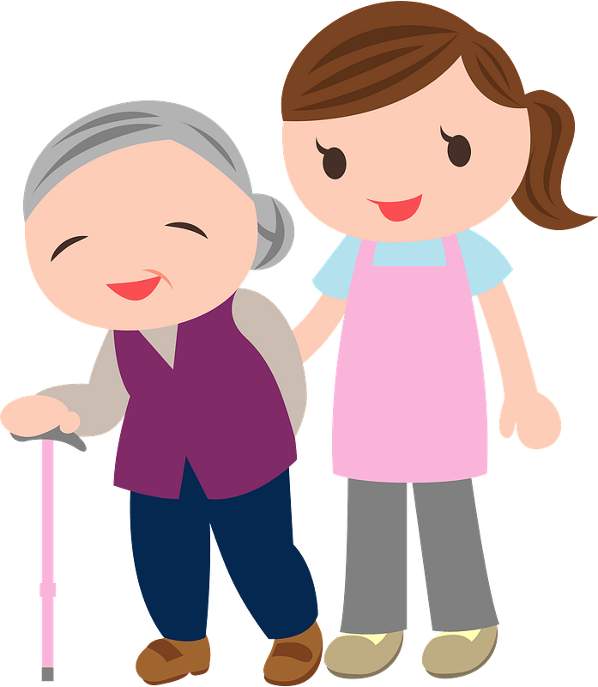
Application
Serve.
  Ask God to put one person on your heart whom you can serve this week.

Slide 28
Application
Share.
  Ask God to put one person on your heart who has not experienced the cleansing of Jesus.
  Share with that person how Jesus has forgiven you.

Slide 29
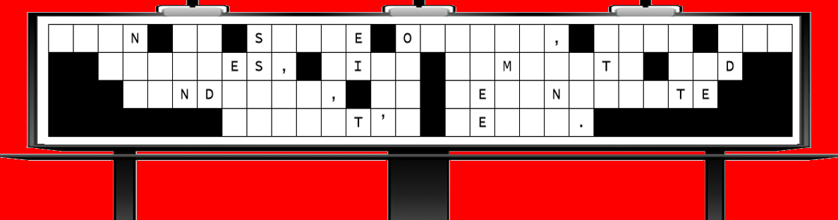
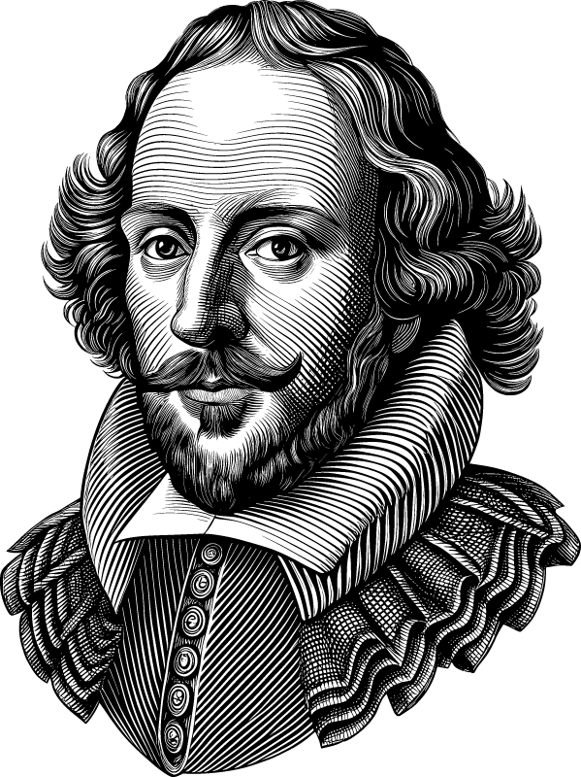
Family Activities
Alas! What grievous mischief hath befallen thy churchly sign! Some vile and knavish rogue hath set upon it. We beseech thee, good friends, lend us thy aid! Take heart. behold, thou canst find help (and sundry other edifying exercises) at https://tinyurl.com/3nrvmdhw

Slide 30
The Last Supper – Farewell Discourse

