Slide 1

John the Baptist’s Final Testimony

Slide 2

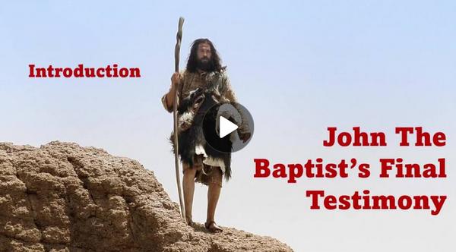
Video Introduction
View Video

Slide 3
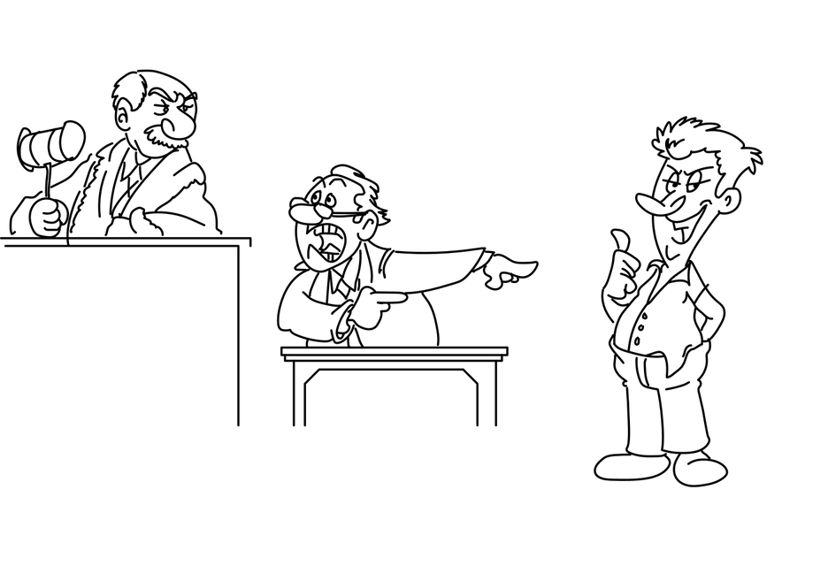
How can you tell?
What makes someone’s testimony about an event seem either credible or incredible?

Slide 4
Credible?
Today we consider the last testimony of John the Baptist concerning Jesus.
John was related to Jesus
He had personal interaction with Jesus
He was Jesus’ forerunner – we might say the “warmup act”
His testimony was entirely credible

Slide 5
1. Ministry in Transition—From Forerunner to Witness.

Slide 6
Listen for parallel ministries.
John 3:22-26 (NIV) After this, Jesus and his disciples went out into the Judean countryside, where he spent some time with them, and baptized. 23 Now John also was baptizing at Aenon near Salim, because there was plenty of water, and people were constantly coming to be baptized. 24 (This was before John

Slide 7
Listen for parallel ministries.
was put in prison.) 25 An argument developed between some of John's disciples and a certain Jew over the matter of ceremonial washing. 26 They came to John and said to him, "Rabbi, that man who was with you on the other side of the Jordan--the one you testified about--well, he is baptizing, and everyone is going to him."

Slide 8
From Forerunner to Witness
Why might it have been difficult for John’s followers to see Jesus becoming more prominent than their own teacher?
What might they have expected John to do about Jesus’ growing influence?
How does this situation test whether John and his disciples truly understood his role as the forerunner?

Slide 9
From Forerunner to Witness
John’s task was to prepare the way. What is the difference between preparing the way for someone and competing with them?
Preparing the Way | Competing

Slide 10
From Forerunner to Witness
What attitudes help a person rejoice when someone else succeeds or becomes more prominent?
In what ways can Christians today act like John—faithfully pointing others to Jesus even when we receive less recognition?

Slide 11
2. Ministry in Submission— Jesus is Supreme.

Slide 12
Listen for John’s response to his disciples.
John 3:27-30 (NIV) To this John replied, "A man can receive only what is given him from heaven. 28 You yourselves can testify that I said, 'I am not the Christ but am sent ahead of him.' 29 The bride belongs to the

Slide 13
Listen for John’s response to his disciples.
bridegroom. The friend who attends the bridegroom waits and listens for him, and is full of joy when he hears the bridegroom's voice. That joy is mine, and it is now complete. 30 He must become greater; I must become less.

Slide 14
Jesus is Supreme
John’s disciples have voiced their concern about what they saw as competition. What do you think John meant when he said, “A man can receive only what is given him from heaven.”?
What did John say about his future status?

Slide 15

Jesus is Supreme
What do you think John means in the contrast of the bridegroom and the friend at the wedding? Who is who in this sentence?

Slide 16
3. Ministry in Witness—Eternal Life in the Son.

Slide 17
Listen for requirements for salvation.
John 3:31-36 (NIV) "The one who comes from above is above all; the one who is from the earth belongs to the earth, and speaks as one from the earth. The one who comes from heaven is above all. 32 He testifies to what he has seen and heard, but no one accepts his testimony. 33 The man who has accepted it

Slide 18
Listen for requirements for salvation.
has certified that God is truthful. 34 For the one whom God has sent speaks the words of God, for God gives the Spirit without limit. 35 The Father loves the Son and has placed everything in his hands. 36 Whoever believes in the Son has eternal life, but whoever rejects the Son will not see life, for God's wrath remains on him."

Slide 19
Eternal Life in the Son
Note where Jesus says He has come from, and how that makes Him different from earthly teachers.
Comes from above all, from heaven
Contrast to one from the earth,
Belongs to the earth, speaks as one from the earth

Slide 20
Eternal Life in the Son
Observe what John says Jesus is testifying about.
Testifies about what He has seen and heard
But no one accepts His testimony

Slide 21
Eternal Life in the Son
What does it mean in these verses to accept or receive His testimony?
He testifies to what he has seen and heard, but no one accepts his testimony. The man who has accepted it has certified that God is truthful.

Slide 22
Eternal Life in the Son
Why do you think believing in the Son is emphasized rather than simply believing in God in general?
From John’s final testimony in these verses, what are the eternal stakes for how people respond to Jesus today?

Slide 23
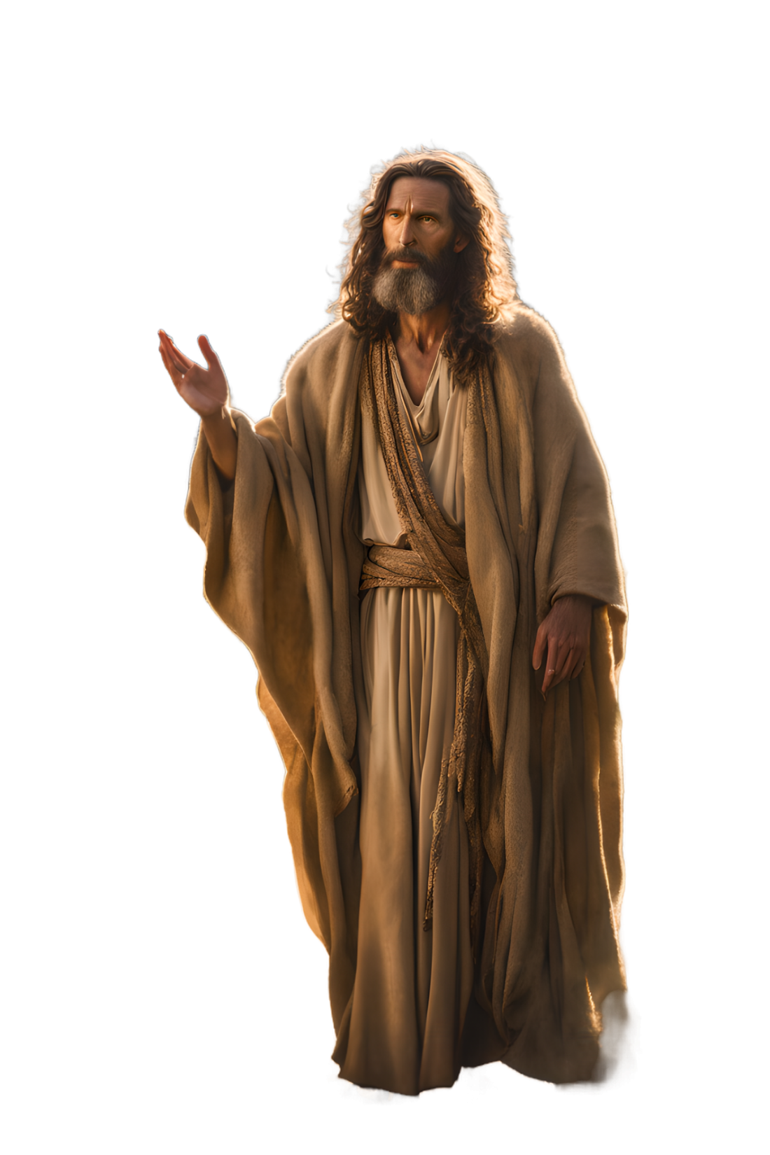
Eternal Life in the Son
How might John’s testimony challenge people who admire Jesus as a teacher but do not believe in Him as the Son of God?

Slide 24
Application
A devotional exercise
Write a statement describing what your like was like (or would have been like) without Christ
Write what you realized that Christ accomplished in your life when He died on the cross.
Tell about what is different about your life, now that you know Jesus is your savior.

Slide 25

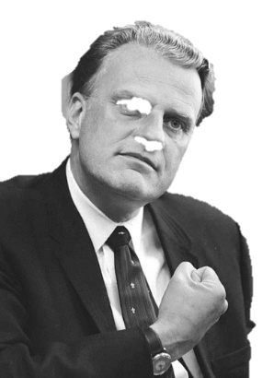
Cryptogram Puzzle
My friends, word has reached us—quietly, courageously—from a little house church in the province of Jidaditapit. They smuggled a two‑part message all the way to our Baptist consulate in Mumbai. And they send it with one great desire: that we remember the final, burning testimony of the John the Baptizer we studied today. Use this key to find the letters hidden in the number coded message. We have prepared help and additional Family Activities for you to study at home. Counselors are standing by at https://tinyurl.com/5djynu24

Slide 26
John the Baptist’s Final Testimony

